Slide 1
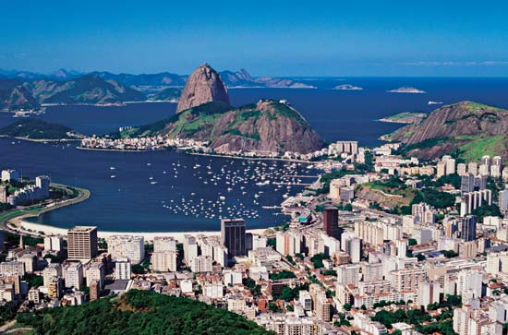
Rio de Janeiro Favelas Case Study

Slide 2
`
Task instruction:
Look at these images and build an idea of where Brazil is located geographically, politically and culturally.
This will set context for what we are about to learn.
Introducing Brazil
Video
Textbook
Review HW
Introducing Brazil

Slide 3
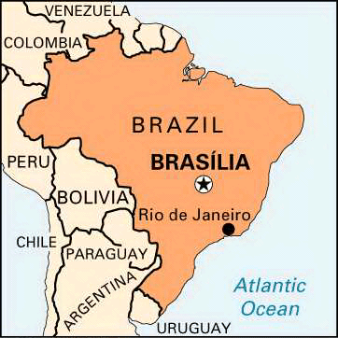
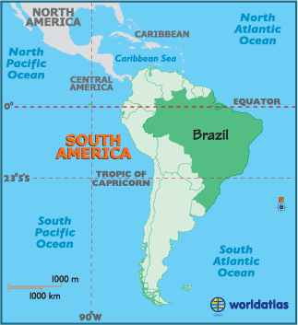
As of 1960, the capital of Brazil was Brasilia, previously it was Rio. Rio is located in the continent of South America, South East Brazil, on the coast, the ocean is the Atlantic Ocean. The Tropic of Capricorn passes close to Rio, this is a line of latitude. Rio lies at 22° South (latitude) and 43° West (longitude).

Slide 4
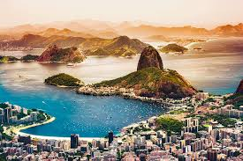
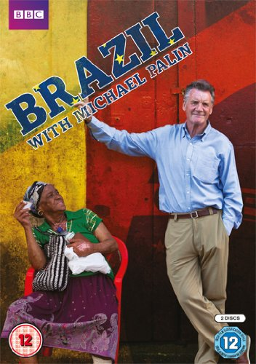
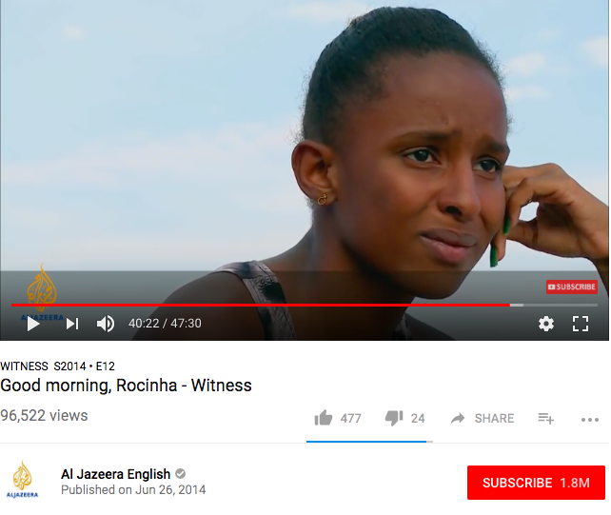
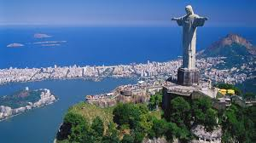
Documentaries which could help you build the idea of what it is like in Rio are Michael Palin’s BBC series Brazil available on YouTube and this Aljazeera documentary I sent on firefly.
Famous sugar loaf mountain and Christ statue

Slide 5
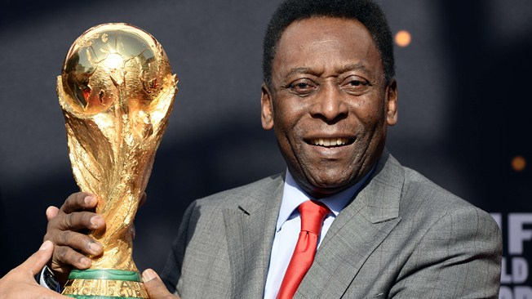
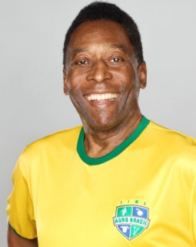
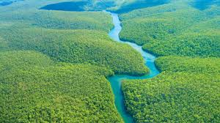
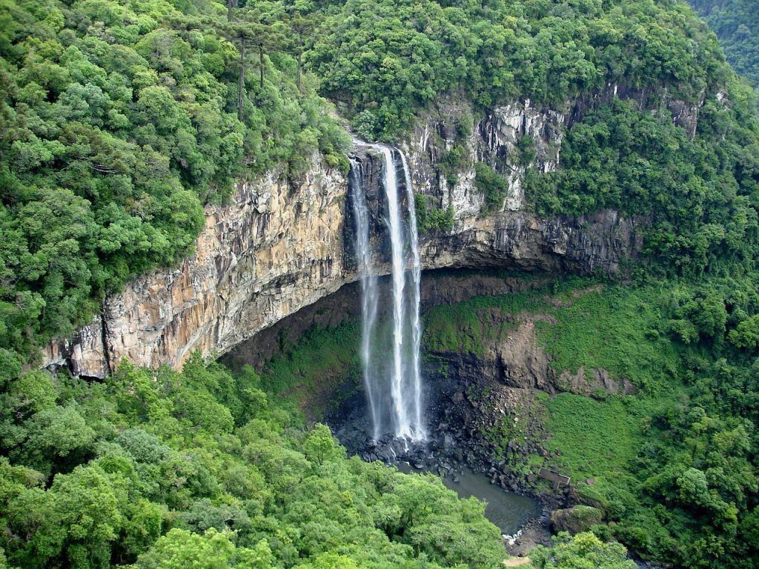


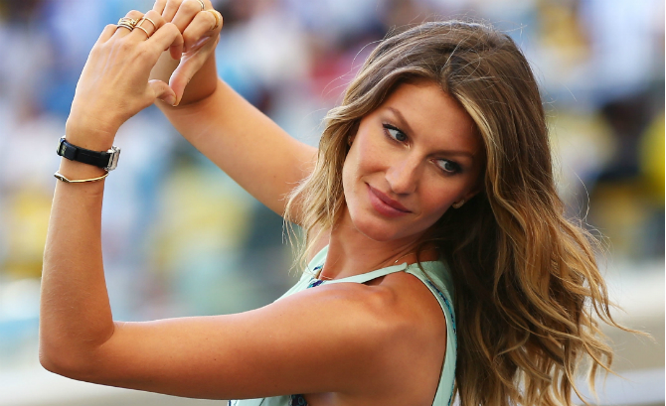
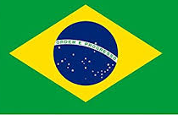
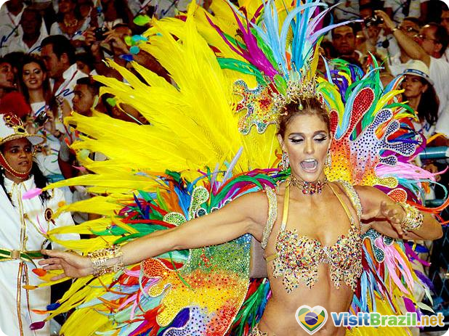
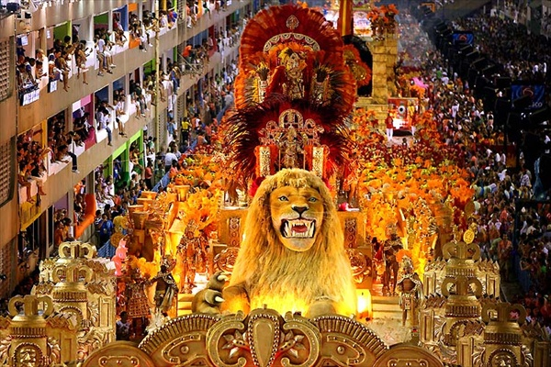
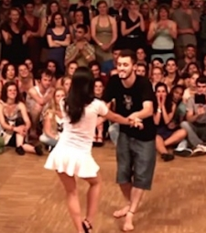
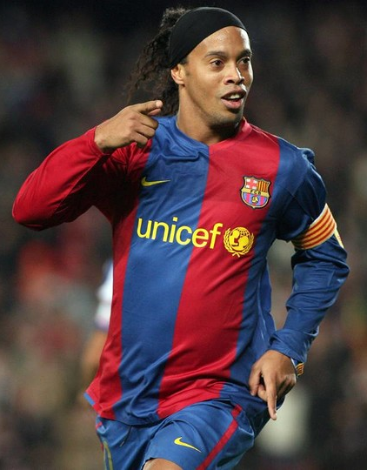
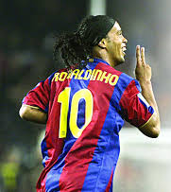
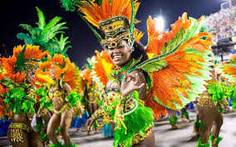
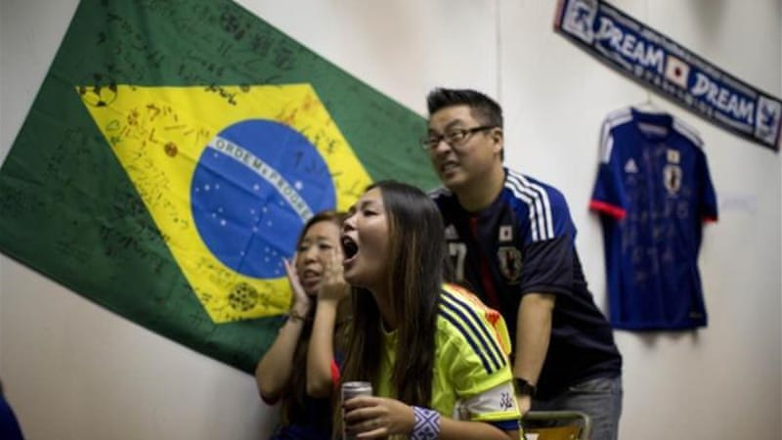
Some of the world’s best football players are Brazilian: Pelé above and Ronaldinho below. Rio is famous for Carnival. Dances include Forro and Samba. There is a big Japanese immigrant population. The Brazilian flag says Order and Progress. Famous literature includes Paulo Coelho The Alchemist. Gisele Bundchen is a famous model. Brigarieros are famous Brazilian chocolate truffles. They speak Portuguese!

Slide 6
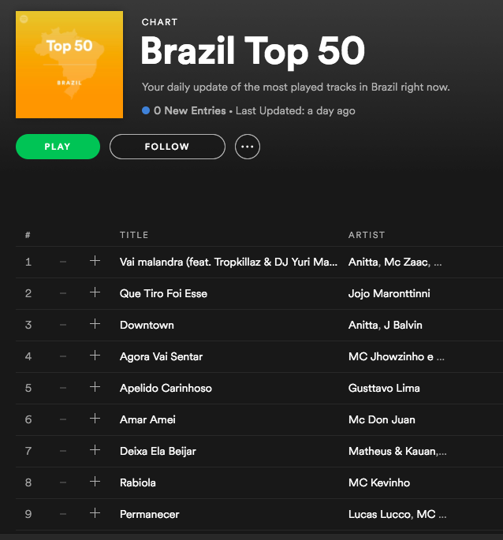
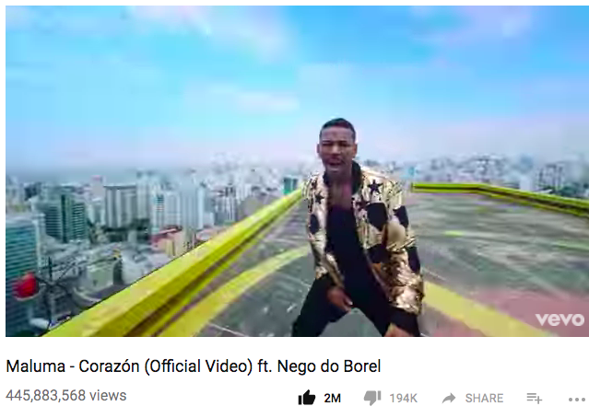
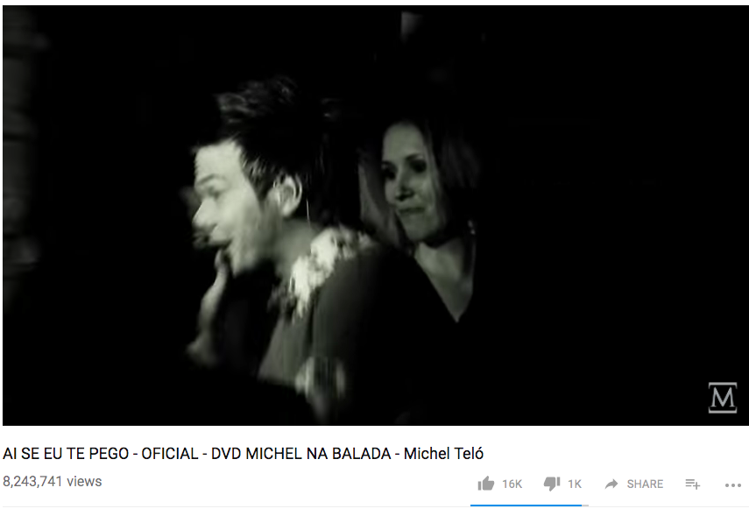
You can extend your understanding of Brazil culturally by looking at their music. Two famous songs you might have heard of are ‘Corazon’ ft. Nego do Borel, the music video is filmed in Brazil’s favelas with Ronaldinho in it, it is the 4th most viewed video on YouTube so what does this tell us about the Spanish and Portuguese speaking population of the world? Also ‘Ai Se Eu Te Pego’ by Michel Telo.
N.B. you don’t need to know these cultural things for your exam, it is extra to help you build your geographical imagination to picture the places we are talking about.

Slide 7
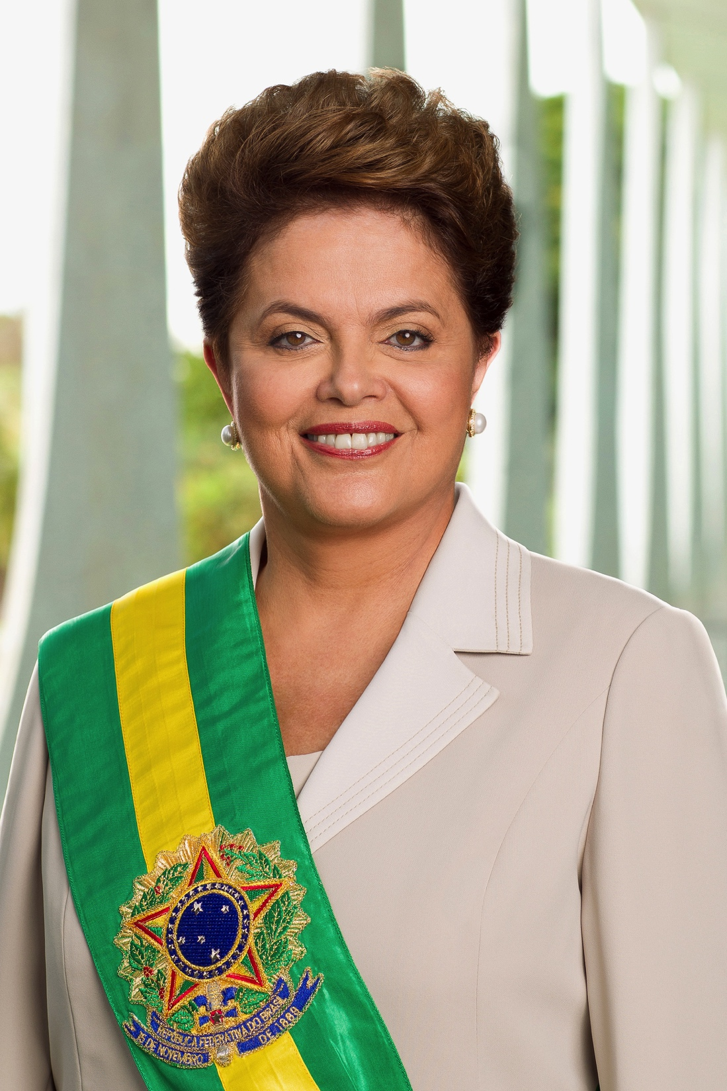
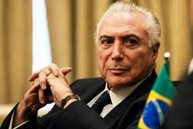
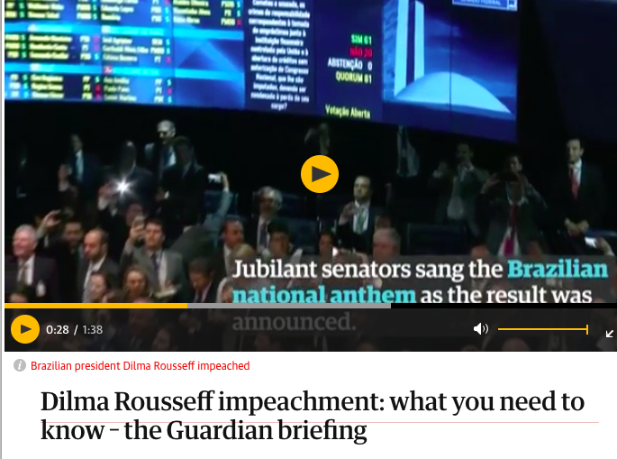
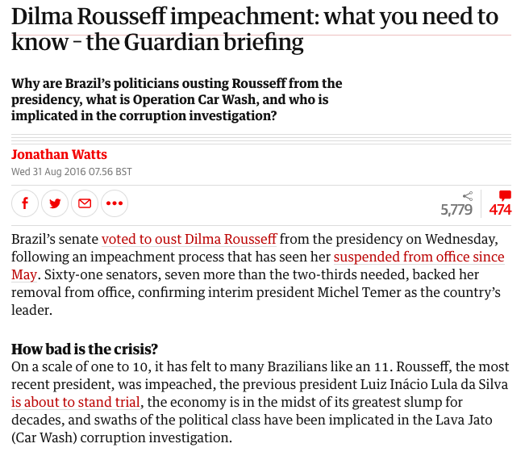
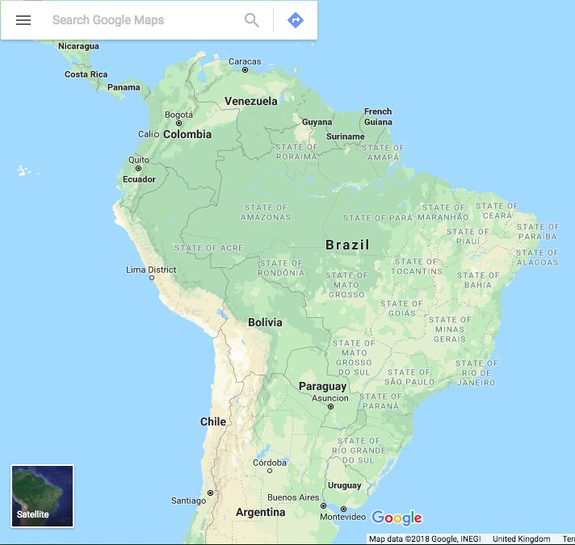
This is useful to know about because we can think about how well the government are are looking after and prioritising people in squatter settlements whilst this major scandal is happening.
The President of Brazil was Dilma Rousseff from 2011 until 2016 when she was impeached (voted out by the senate) for being an incapable leader, knowing about a major corruption scandal and not saying anything, and for cooking the books on government accounts. Now it is Michel Temer an equally hated man whose speech at the Olympics was cut to 10 second and was drowned out by booing. You can read more by clicking on the article or video link above on the ppt on firefly. https://www.theguardian.com/news/2016/aug/31/dilma-rousseff-impeachment-brazil-what-you-need-to-know
Notes:
https://www.theguardian.com/news/2016/aug/31/dilma-rousseff-impeachment-brazil-what-you-need-to-know

Slide 8
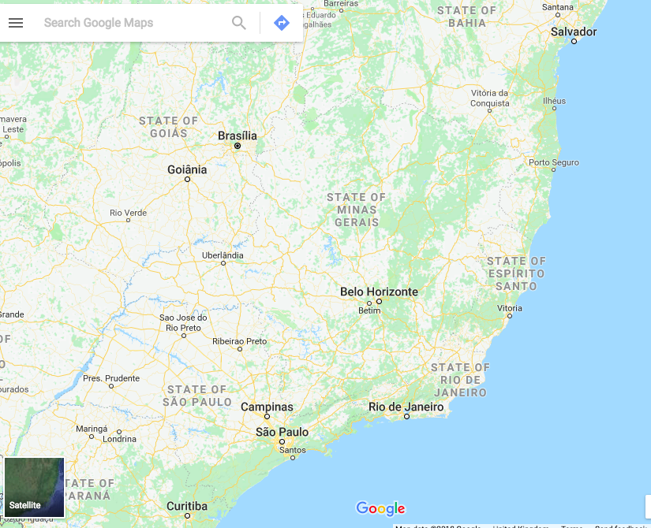
The capital of Brazil is Brasilia as of 1960. Other big cities include: Sao Paulo, Belo Horizonte and Rio.

Slide 9
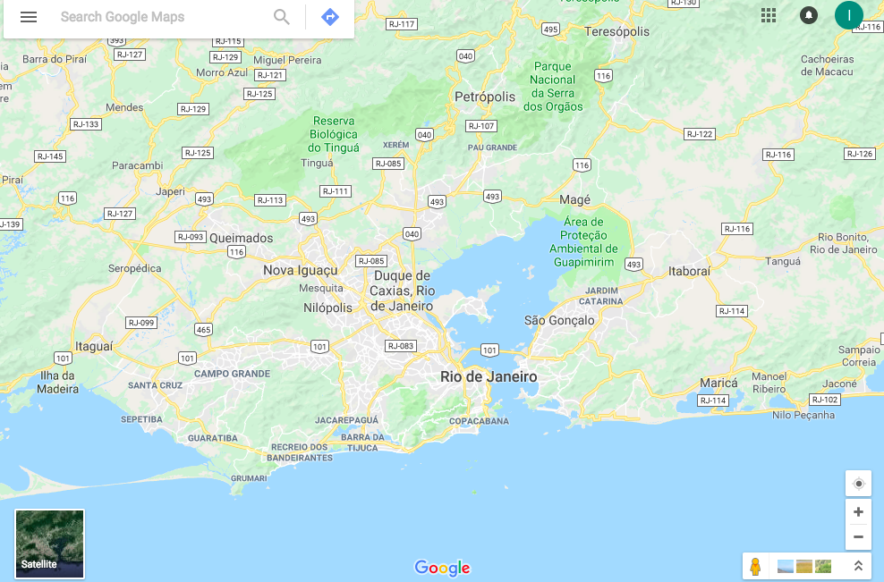

Slide 10
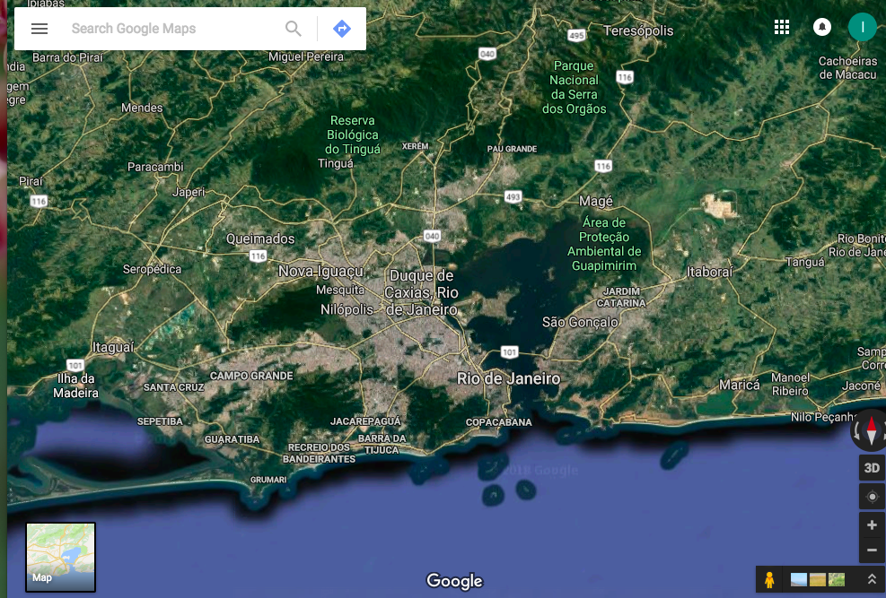

Slide 11
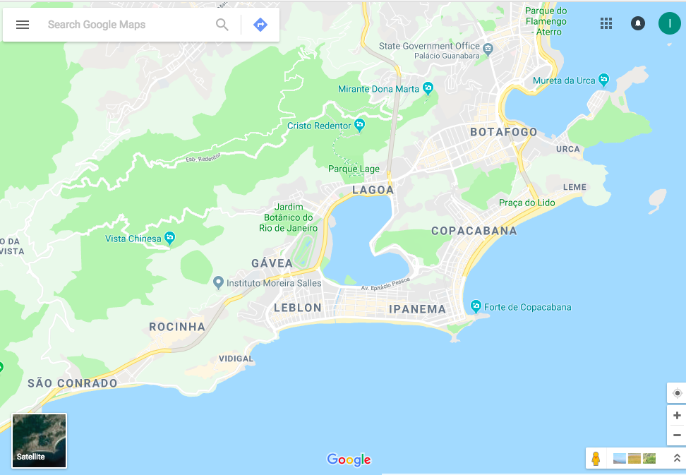
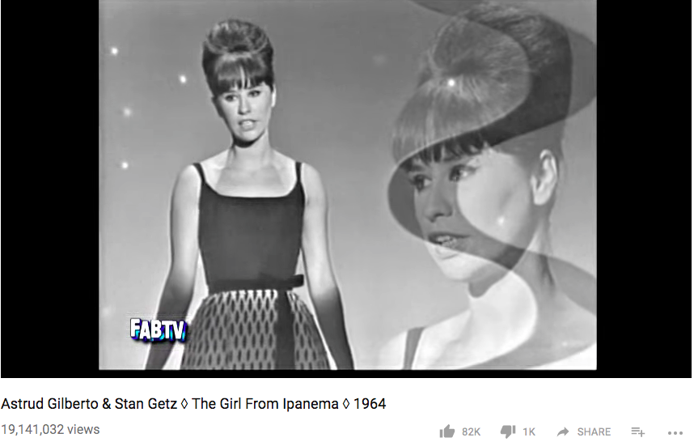
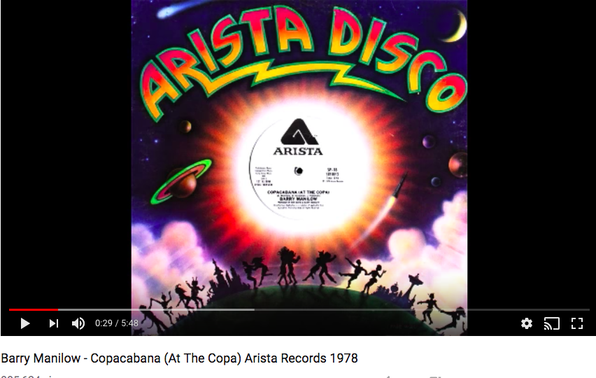
Rocinha is the favela / squatter settlement we will focus on in Rio. You may have heard of beaches Copacabana and Ipanema mostly due to the songs made about them. ”The Girl from Ipanema” “Copacabana” by Barry Manilow. Hyperlinks below available from ppt.
Notes:
https://www.youtube.com/watch?v=Pth79-bpgGs
https://www.youtube.com/watch?v=UJkxFhFRFDA

Slide 12
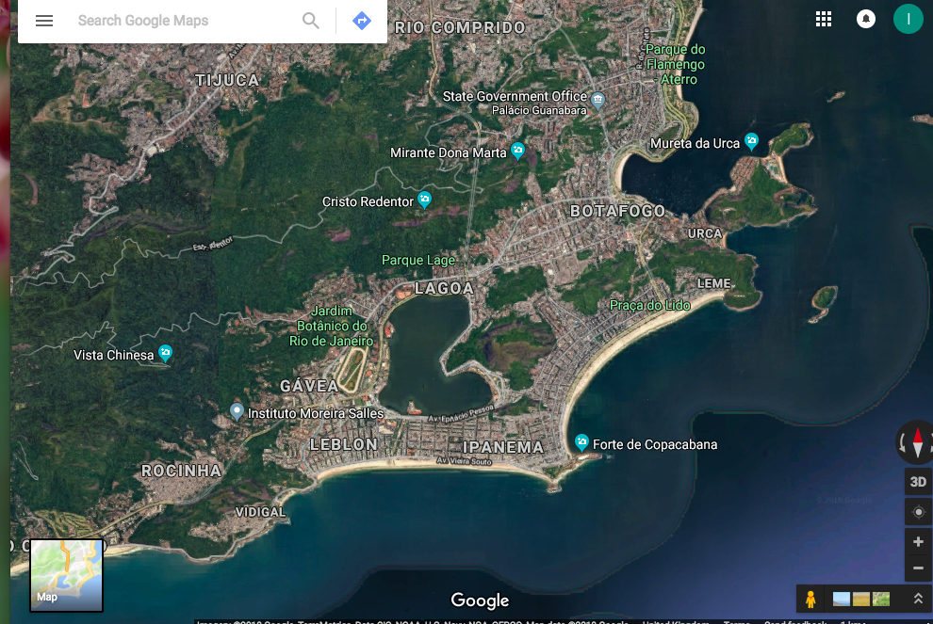
Rocinha the squatter settlement is developing outside of the main city centre area and up the mountain, like Ciudad Bolivar was in Bogota it is illegal housing which is built from make shift items but also can be very colourful.

Slide 13
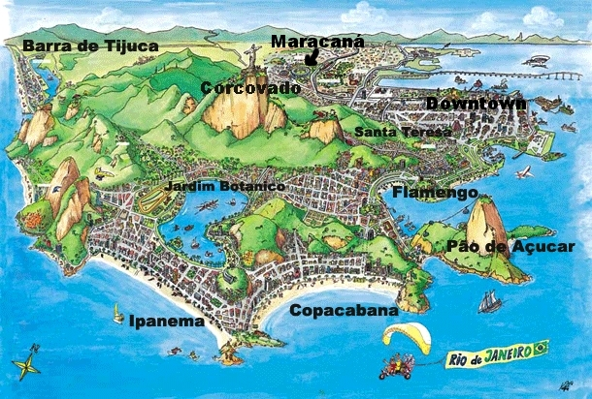

Slide 14

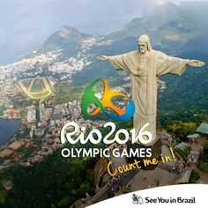

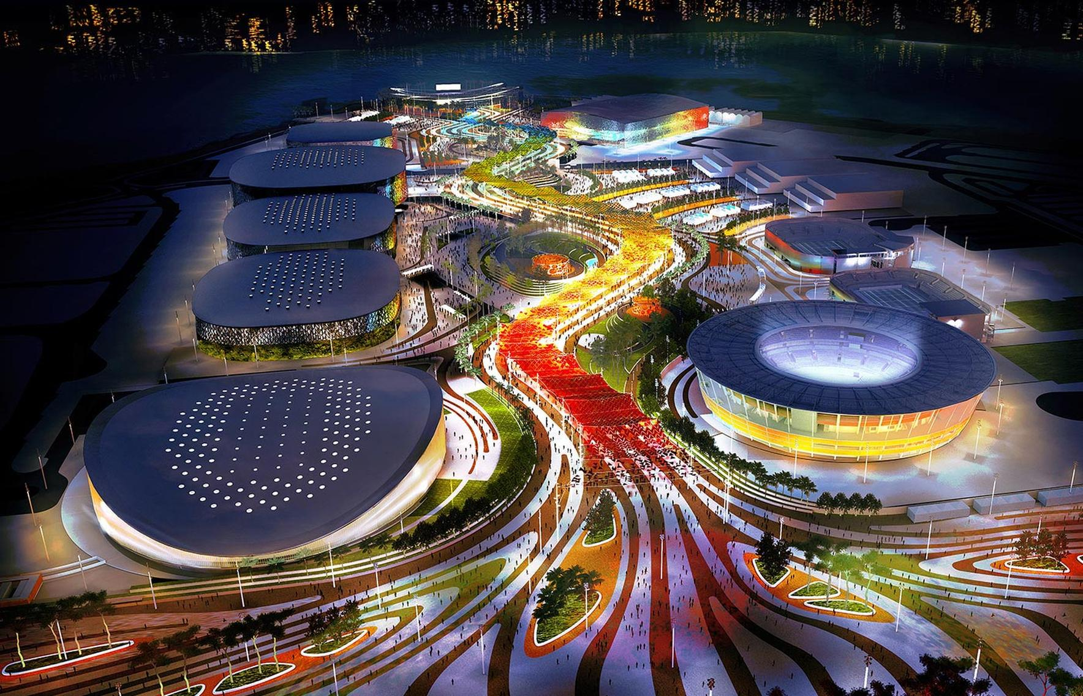

Slide 15
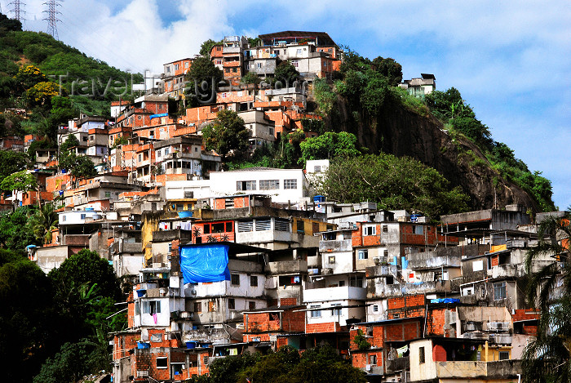

Slide 16
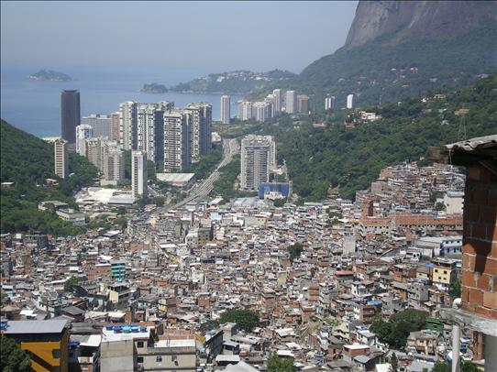

Slide 17
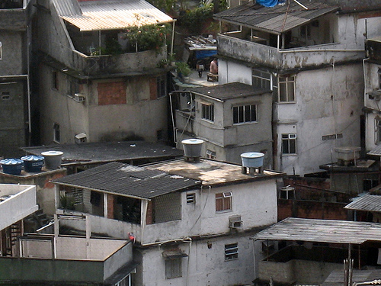

Slide 18
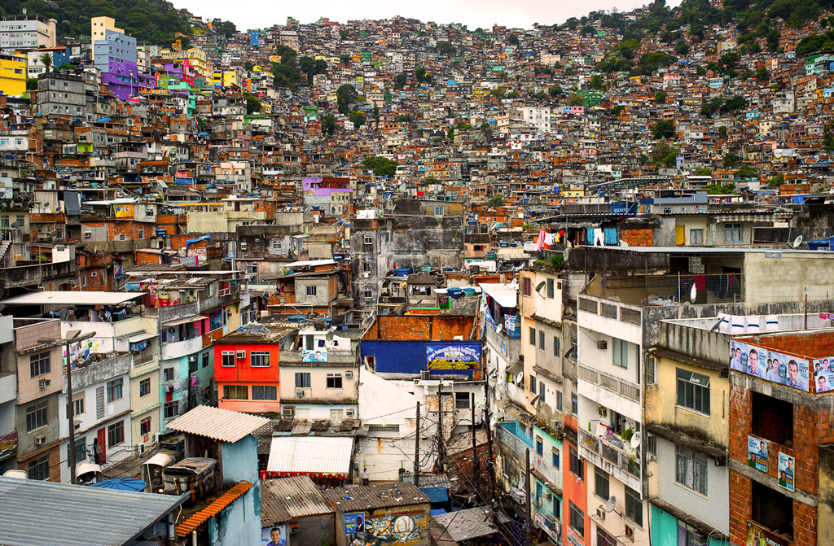
How would you describe the population density in this part of Rio?
Do you think the houses are built well?
What might some of the issues be with this many houses crammed on to the side of a mountain?

Slide 19
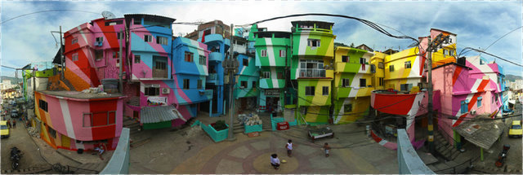

Slide 20
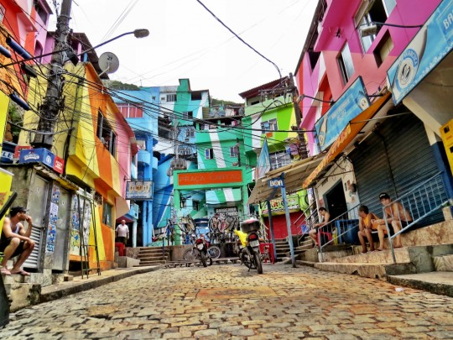

Slide 21
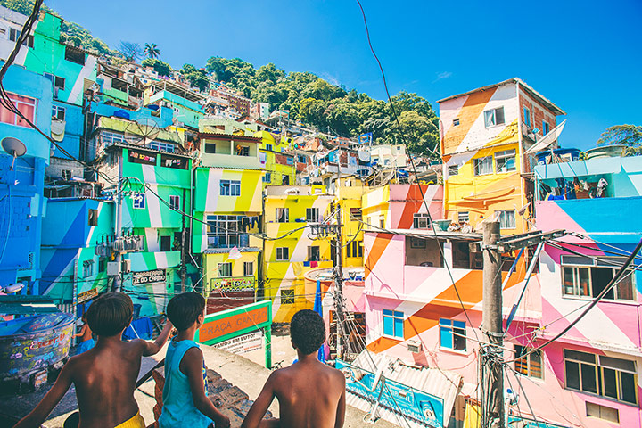
Would you want to live here?
Would you feel safe and free from disease if you did?
Why/Why not?

Slide 22
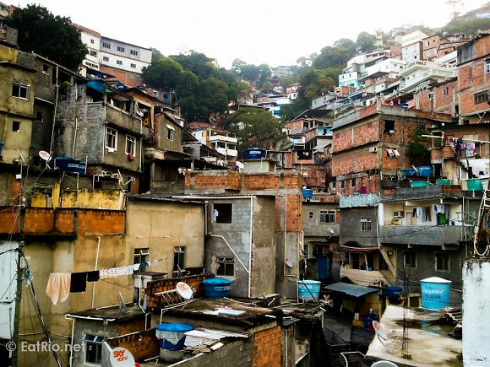
Would you want to live here?
Would you feel safe and free from disease if you did?
Why/Why not?

Slide 23
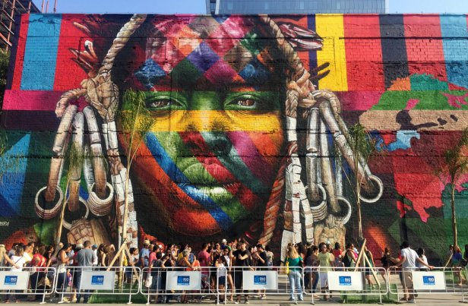

Slide 24
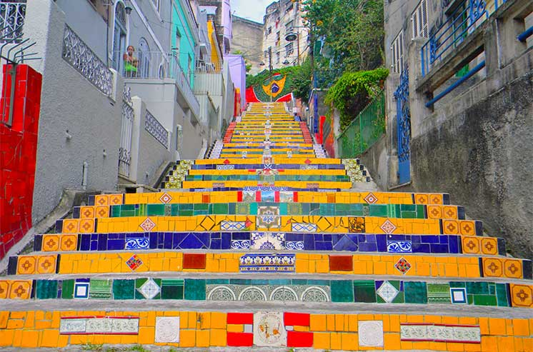

Slide 25
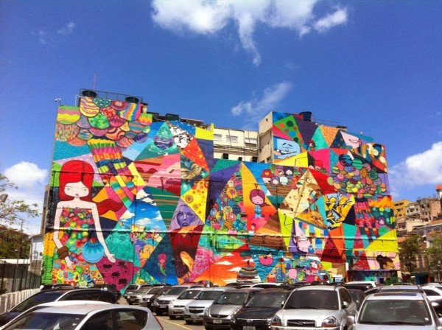

Slide 26
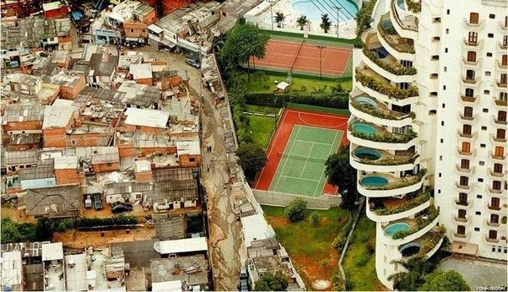
What do you think the rest of this picture will look like?
This is a typical image to show the inequalities that exist so close in South American Countries.

Slide 27


Slide 28


Slide 29

`
Task Instructions:
Watch this video and write down any problems and solutions about Rio’s favelas.
Vox: Rios’s favelas
https://www.youtube.com/watch?v=c3BRTlHFpBU
Problems | Solutions
Introducing Brazil
Video
Textbook
Review HW
Video

Slide 30



BBC David Shukman http://www.bbc.co.uk/news/science-environment-18552512
Class clips Rio http://www.bbc.co.uk/education/clips/zgp4d2p
Aljezera: Good morning Rocinha Witness Ep12 2014
https://www.youtube.com/watch?v=AjkzPyKaTZs
………………………………………………………….
Slumming it: Kevin McCloud 48 minuteshttp://www.youtube.com/watch_popup?v=Im0tHRs9Bng

Slide 31
Video notes (and other added details):
People of the asphalt = rich area planned by city planners
People of the hill = poorer area not planned illegal housing
Favelas = informal housing home to drug gangs, creative & resourceful people. Built without public authority and without public services and infrastructure like plumping, safe electricity and rubbish collection
Rio had many slaves, slavery ended in 1888 and they built their own informal communities. The favelas they made have increased in size due to migration of rural Brazilians looking for work.
25% of Rio lives in a favela. There are more than 1000 favelas in Rio (1600 in São Paulo another major city in Brazil), the biggest two are: Rocinha and Morro de Alemão each with populations over 100,000 people. Others include: Vidigal, Maré, Providencia,, Santa Marta.
Individuals taking ownership of land, cleaning up trash and growing fruit and veg gardens, reusing trash for other purposes like landscaping
Lots of creativity
Rocinha is a fully functioning city within a city

Slide 32
Video notes continued…
Art centres for young people
Photography of life in the favela used as a weapon against the foul play of police and drug cartels
People feel like they have been forgotten about by the government and authorities, so they have survived in their own way, many Non Governmental Organisations (NGOs) go to help in different ways in favelas.
Gangs including the red command (Comando Vermelho in Portuguese) formed in 1969 started as a left wing political rebellion but now engaged mostly in arms (weapons) and drug trafficking.
Favelas can be dysfunctional due to lack of regulation
Pacification, police trying to get rid of gangs, but causes 1 death in every 23 arrests, worked in some but not all favelas. Police Pacification Units started in 2008 (Unidade de Polícia Pacificadora = UPPs)
6% of Brazilians live in a favela (2010 data) life expectancy is 48 years in a favela but 68 in the rest of Brazil.

Slide 33
Migration to Rio
Industries moved to suburbs and workers commuted from the core to the periphery
1920s - industrialisation attracted new migrant populations. - jobs
1940 -1960 saw growth rate of 3% due to immigration and high fertility rates
1950s suburbs so crowded - only areas left were swamps, steep hills, mangroves and river banks → favelas (shanty towns)
Pop increased to 6.32m in 2010 with pop density of 1485 per km2
Since 1990, decrease in BR and DR so decreasing growth, and increasing number of elderly
1960s – growth of 30% due to rural – urban migration

Slide 34
Problems:
Housing: half a million homeless, 1 million in favelas, 1 million in poor quality housing local authority housing (periferia). Officially a favela is: a residential area of 60 or more families living in accommodation that lacks basic services (no running water, sewerage or electricity) and have no legal right to the land on which they live’. Houses are made from anything available like wood, corrugated iron, broken bricks and tiles. Built on hillsides considered too steep for normal houses. Best houses at the bottom, but sewage runs down past them in open drains. People who live up hill have to carry everything they need including water. When it rains flash floods can carry away the flimsy houses. Storms in 1988 caused over 200 deaths. They tried to get rid of favelas before the Pope visited but then the people returned as they had no where to go.
Crime: drug trafficking and weapons trafficking, some say crime has decreased and community spirit has increased.
Traffic: Lots of congestion, pollution and noise even through the night.
Pollution: An industrial haze has been intensified by the traffic fumes and hangs over Guanabara Bay. The ocean is also polluted as are the beaches. Rubbish is not collected in favelas and the sewers are open which causes big health hazards e.g. an outbreak in cholera in 1992.

Slide 35
Solutions:
Self help schemes: Most of the original temporary wooden structures have been upgraded to brick and tile and some have been extended. Many informal sector industries have been set up. The authorities now work with the local residents associations. They have added electricity, paved and lit some steep streets and added water pipes. Improvements are very restricted due to the high population density and steepness of the hills.
Favela Barrio Project: 1990 the cities authorities set aside £200 million to improve the living conditions in 60 of the 600 favelas. They chose to help smaller favelas because it was perceived to be easier and cheaper, they had fewer drug, crime and unemployment issues, they were closer to rich areas and tourist spaces. Planned to integrate them with the city culturally and socially, replacing buildings that were either made of wood or built on dangerous slopes with brick-built housing. Widen streets, so emergency services and waste collection can gain access. Laying pavements and concrete paths, water pipes, electricity cables, improving sanitation, adding health facilities and providing sports areas, using labour from the favela so residents can develop new skills but in return residents have to pay taxes to the authorities.
New Towns: Barra da Tijuca: Due to the crime and over population many of Rio’s richer residents have moved out of the city leading to population decrease in central Rio, which is rare and normally only associated with MEDC’s. Because of the mountains the south of Rio areas were blocked off until the 1980’s when a 4 lane motorway was built through tunnels. In 2000 Barra da Tijuca had a population of almost 140,000. This place sounds like it is for just rich people with lots of nice services and luxuries. Barra now is starting to have its own favelas for low paid housekeepers, cooks and cleaners, gardeners etc. are employed by the wealthy residents.

Slide 36
Environment: relating to the place we live, inside and outside spaces as well as the natural world, physical geography, trees, oceans.
Social: relating to culture, traditions, lifestyle, people, family, relationships, communities.
Economic: relating to money, income, jobs, industry, business, tax.

Slide 37
Past Questions:
Explain why many people in cities in LEDCs live in slums.
……………………………………………………………………………………………………………………………………………………………………………………………………………………………………………………………………………………………………………………………………………………………………………………………………………………………………………………………...[5]
Name a city and describe what has been done to improve living conditions in the slums.
………………………………………………………………………………………………………………………………………………………………………………………………………………………………………………………………………………………………………………………………………………………………………………………………………………………………………………………………………………………………………………………………………………….......................................................……..[7]

