Slide 1
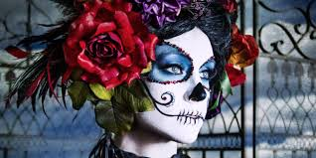
Dia de los muertos
LO: What is “day of the dead”?
Why? It is not just Mexican Halloween!

Slide 2
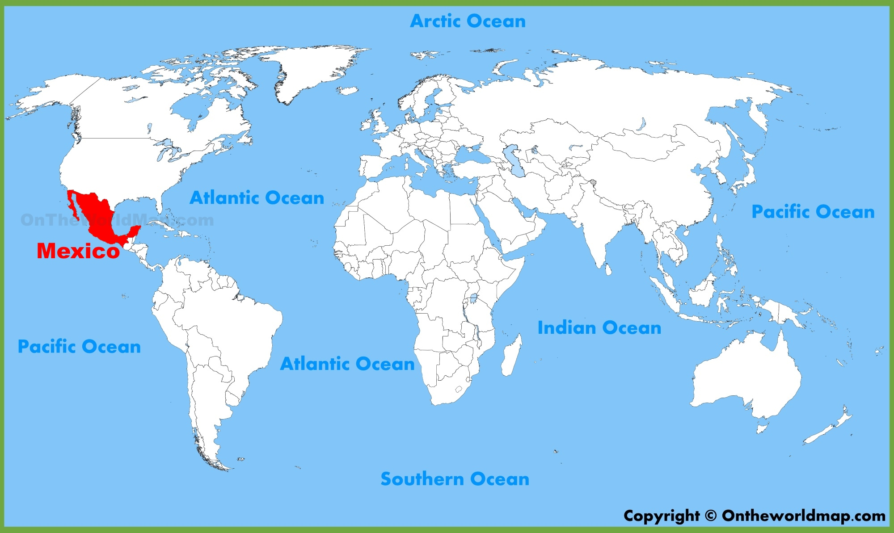
Dia de los Muertos is celebrated in Mexico…can you find it on a map?

Slide 3
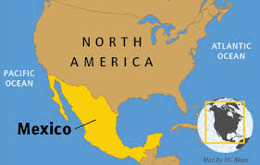
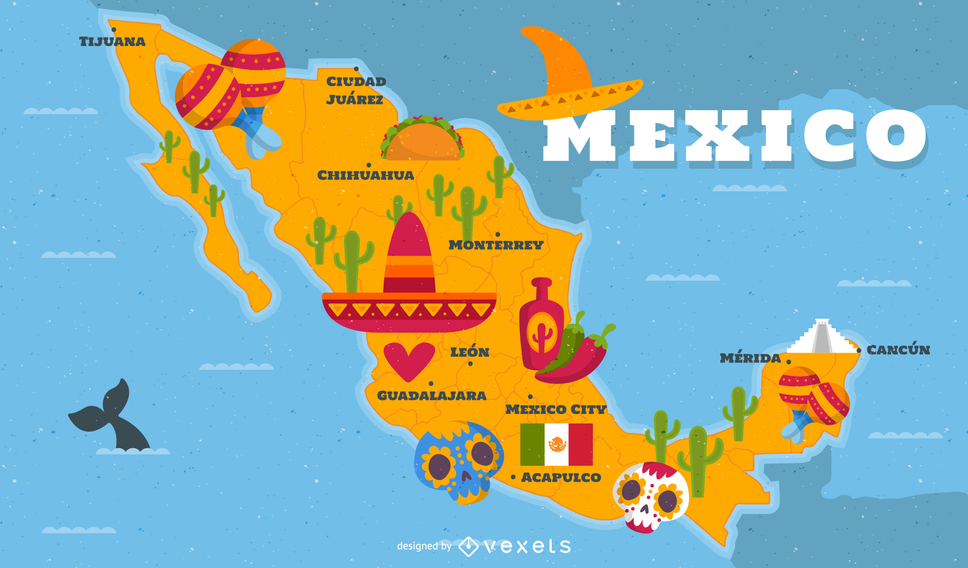
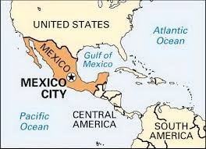
Mexico is a Spanish speaking country located in the continent of North America, it borders the United States of America to the north and Guatemala and Belize to the south. The capital city is called: Mexico City.

Slide 4
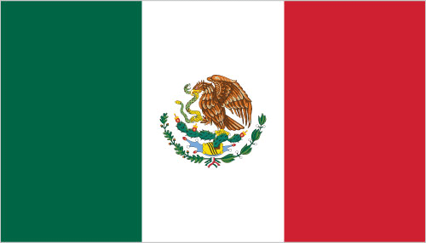
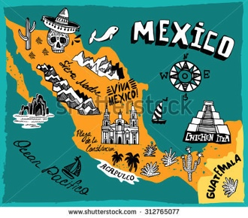
This is the Mexican flag: green is for hope, white is for unity and red is the blood of the heroes, the coat of arms is an eagle eating a rattle snake sat on a cactus. The map shows some famous landmarks in Mexico like the pyramids and Sierra Madre Mountain range.

Slide 5
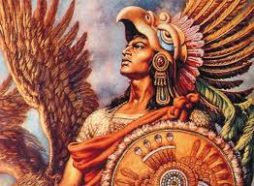
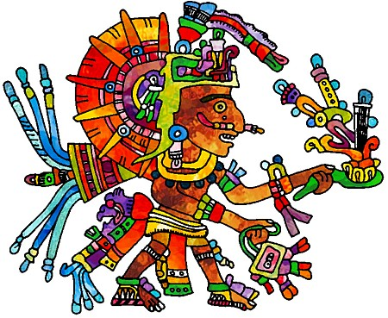
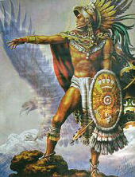
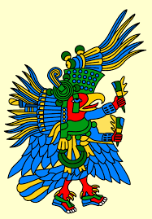
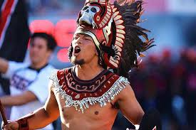
Mexico is known for its ancient civilisation: The Aztecs.

Slide 6
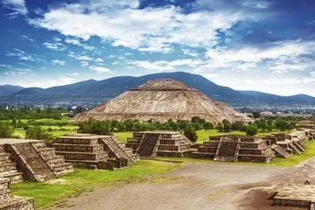
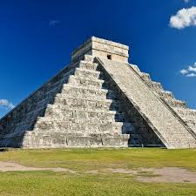
The Aztecs (and other ancient civilisations including the Mayan’s) built the pyramids as a place to be closer to the gods, sacrifice and religious ceremony.

Slide 7
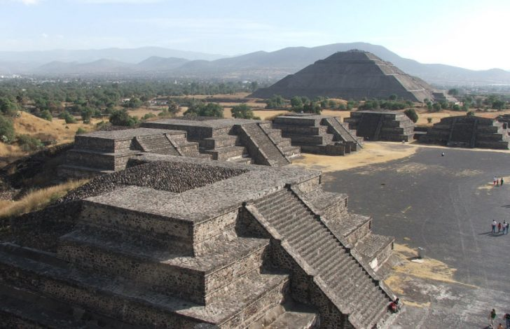
These pyramids are known as the sun and the moon.

Slide 8
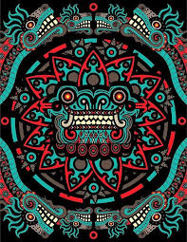
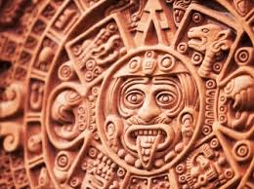
This is some Aztec artwork.

Slide 9
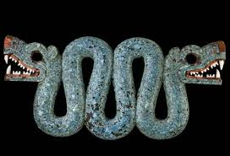
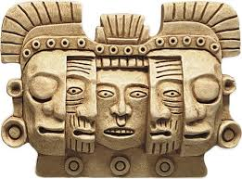
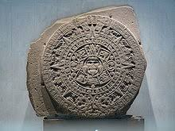
This is some Aztec artwork.

Slide 10
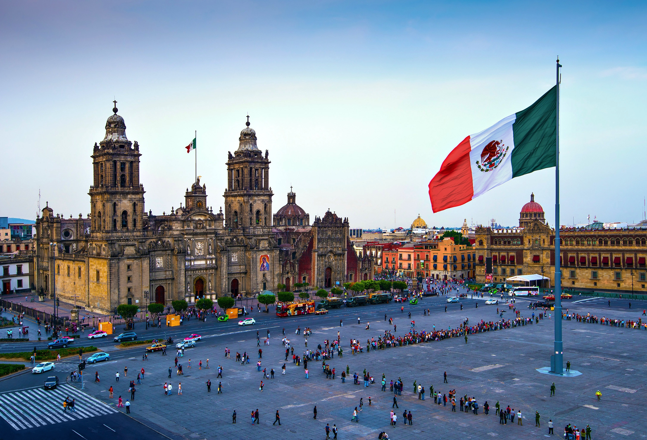
This is the Cathedral in the main square in the middle of Mexico city.

Slide 11
Day of the dead:
Dia de los muertos is a Mexican Festival that comes from the Aztec tradition over 3000 years ago.
The Aztecs would honour the goddess of the underworld “Michecacihuati” for 1 month.
There is a lot of art involved in this festival.
They believe that as long as they are remembered they are not dead, they live on in our minds and in our souls.
Now people remember their loved ones: “the departed” by having an altar and putting food they like on it and giving offerings and celebrate their life.

Slide 12
Day of the dead:
1st November ‘Dia de los Angelitos’ Day of the angels, innocents souls of children are remembered
2nd November ‘Dia de los Difuntos’ Day of the dead (adults)
The official celebration day is the 2nd November but celebrations can start on the 31st October so it lasts 3 days in total.
The festival is to remember your loved ones which have passed away, be happy, joyful and laugh.
Aztecs believed that in this life we are only dreaming and that when we die we are going on to live another life.
Dia de los muertos is not related to Halloween, it is an older Aztec celebration.
The difference with Halloween is that day of the dead is a happy event and Halloween instils fear in people about death and the dead which does not preserve their spirit or memory respectfully or peacefully. Discuss.
Notes:
Discuss the last point with students, is society too distanced from death. How do they feel about death or if they saw a dead person. If you had to face or have faced death in your family, would you be afraid to see them, or calm because you know every day of the dead you will put their photo on the altar like the rest of your family and remember them with happy memories. How do they feel about celebrating Halloween, how does it make them feel about the underworld. What impact could this have later on when dealing with death?

Slide 13
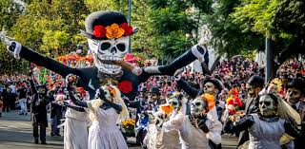
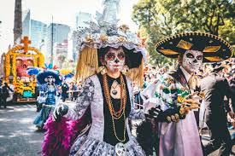
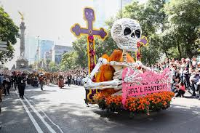
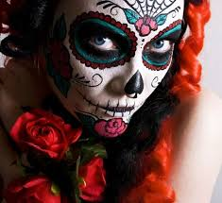
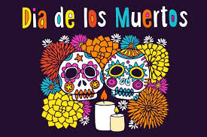
Celebrations

Slide 14
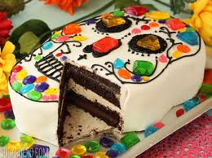
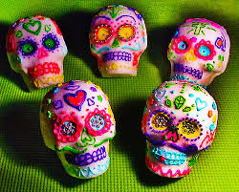
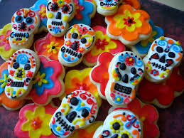
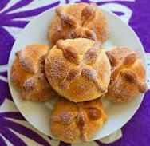
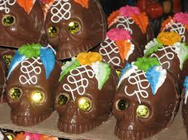
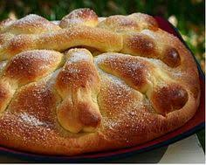
Sugar sculls
Food
Pan de muerto/death bread: has bone shapes on the top, it is a sweet orange sugary bread – try making it, it is delicious!

Slide 15
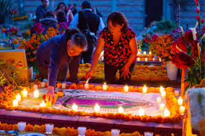
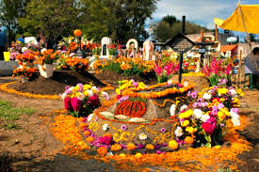
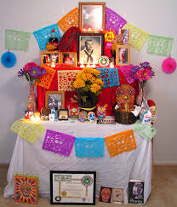
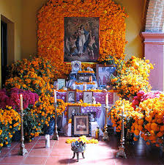
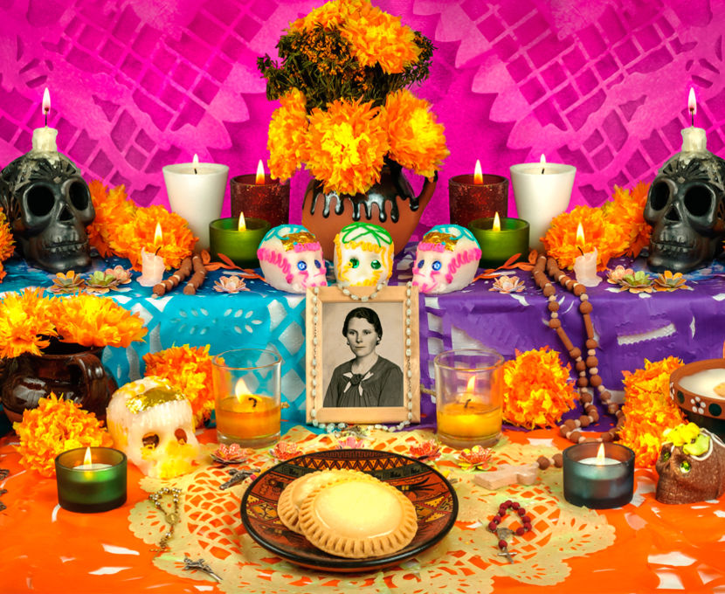
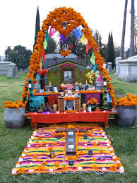
Altars

Slide 16
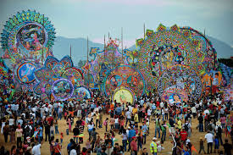
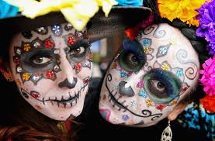
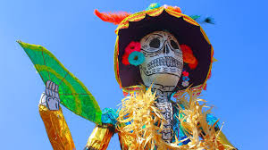
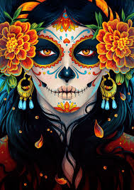
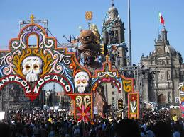
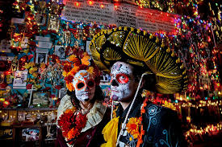
Celebrations

Slide 17
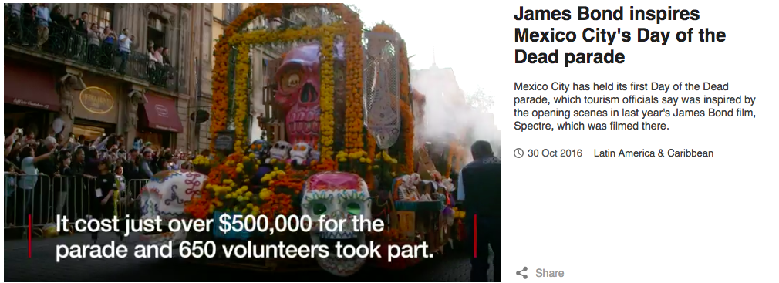
https://www.tripsavvy.com/day-of-the-dead-vocabulary-1588706

Slide 18
