Slide 1
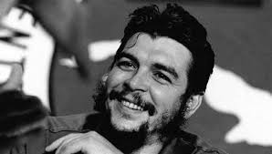
‘Che’ Guevara
LO: Who was Che?
Why? You probably know his face from T-Shirts.

Slide 2
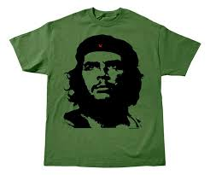
Ernesto ‘Che’ Guevara de la Serna y Llynch
Born June 14th 1928
Executed by shooting 9th October 1967
Born in Argentina
Marxist revolutionary
Asthmatic (crippling in those days)
Doctor
Guerrilla leader
Diplomat
Major figure in Cuban Revolution
His image has become associated with countercultural symbol or rebellion in popular culture

Slide 3
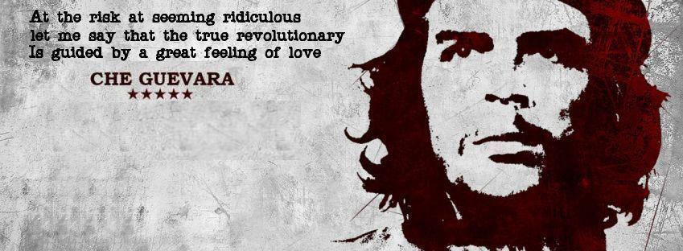

Slide 4
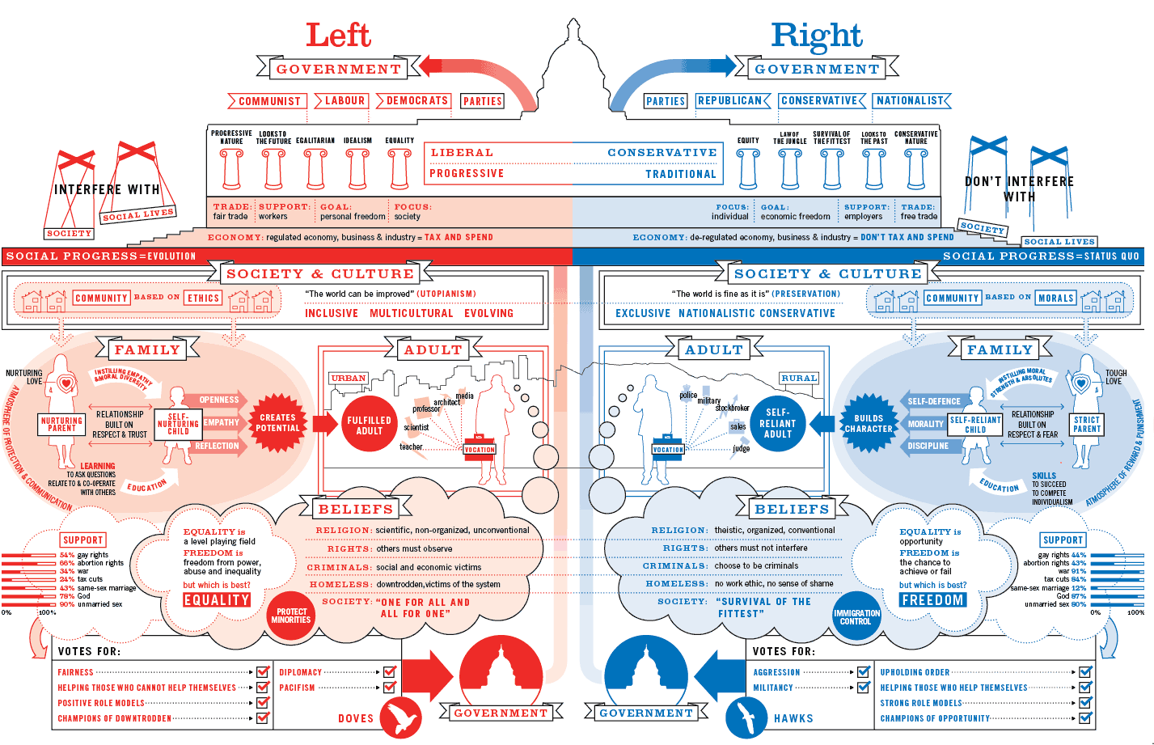

Slide 5
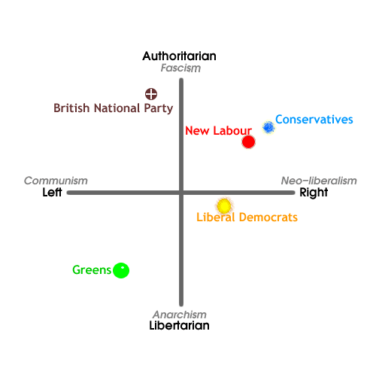
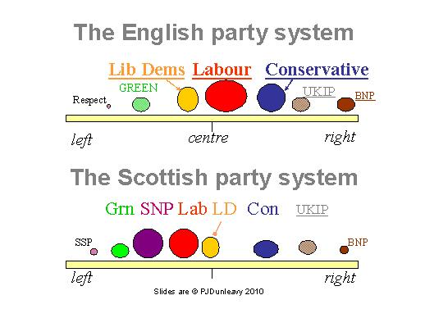

Slide 6
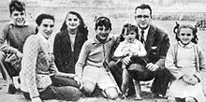
Approximately 1944

Slide 7
Early life
Parents: Ernesto Guevara Lynch and Celia de la Serna y Llosa
They referred to Ernesto as Ernestito (little Ernesto) as his dad shared the name
Born in Rosario, Argentina
Eldest of 5 children in a middle-class Argentine family
His parents were of Spanish decent, Basque and Cantabrian as well as Irish
His dad said he had the Irish rebel blood flowing through his veins
His family were leftists and he had an affinity for the poor from a young age.
His dad was a supporter of the Republicans in the Spanish Civil War and often hosted many veterans from the conflict in their home.
He was very sporty despite his chronic asthma and played Rugby Union at the University of Buenos Aires and was called ‘Fuser’ a combination of the word El Furibundo (raging) and his mums surname de la Serna for his aggressive style.

Slide 8
Interests
He played chess which he learned from his father. He even competed in local chess tournaments
He was passionate about poetry especially from Pablo Neruda, John Keats, Federico Garcia Lorca and others.
He could recite the poem: If- by Rudyard Kipling and Martin Fierro by Jose Hernandez
His parents home had over 3000 books which allowed him to be a big reader
The CIA later released a report which stated that he was: ‘quite well read’ and crudely said: “Che is fairly intellectual for a Latino” a derogatory statement which would not be tolerated in todays society

Slide 9
If-
Rudyard Kipling
If you can keep your head when all about you
Are losing theirs and blaming it on you,
If you can trust yourself when all men doubt you,
But make allowance for their doubting too;
If you can wait and not be tired by waiting,
Or being lied about, don’t deal in lies,
Or being hated, don’t give way to hating,
And yet don’t look too good, nor talk too wise:
If you can dream—and not make dreams your master;
If you can think—and not make thoughts your aim;
If you can meet with Triumph and Disaster
And treat those two impostors just the same;
If you can bear to hear the truth you’ve spoken
Twisted by knaves to make a trap for fools,
Or watch the things you gave your life to, broken,
And stoop and build ’em up with worn-out tools:
If you can make one heap of all your winnings
And risk it on one turn of pitch-and-toss,
And lose, and start again at your beginnings
And never breathe a word about your loss;
If you can force your heart and nerve and sinew
To serve your turn long after they are gone,
And so hold on when there is nothing in you
Except the Will which says to them: ‘Hold on!’
If you can talk with crowds and keep your virtue,
Or walk with Kings—nor lose the common touch,
If neither foes nor loving friends can hurt you,
If all men count with you, but none too much;
If you can fill the unforgiving minute
With sixty seconds’ worth of distance run,
Yours is the Earth and everything that’s in it,
And—which is more—you’ll be a Man, my son!

Slide 10
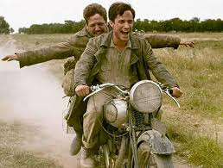
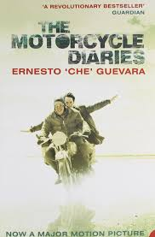
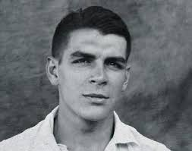
Motorcycle Diaries
As a young medical student Guevara travelled throughout the continent of South America.
The poverty, hunger, disease, suffering and inequality he saw changed him forever.
“The Motorcycle Diaries” is a film you can watch about this trip.

Slide 11
Motorcycle Diaries
In 1948 Che went to University to study medicine
In 1950 he took a 4500km solo trip around rural northern Argentina on a bicycle to which he added a small motor
In 1951 he took a 9 month 8000km continental motorcycle trek through much of South America with his friend Alberto Granado. He took a year out of University to do this.
The end goal was to volunteer at the San Pablo leper colony in Peru on the banks of the Amazon River
His trips changed the way he saw himself and the modern economic issues in Latin America
In Chile he found working conditions of miners angered him. He was moved by the night he spent in the Atacama Desert and met a couple who were persecuted for being communist’s and described them as: “the shivering flesh and blood victims of capitalist exploitation”
It was particularly the rural poor which struck him as concerning.
Guevara was so moved by his experiences in his trip through Latin America that even though he returned to complete his medical studies and became a doctor, he changed to a life in politics and armed struggle in order to make more of an impact on the lives of these people.

Slide 12
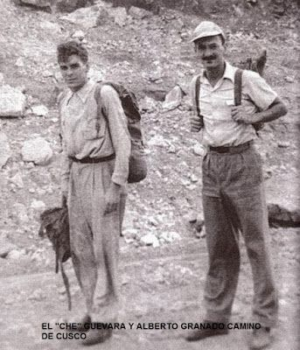
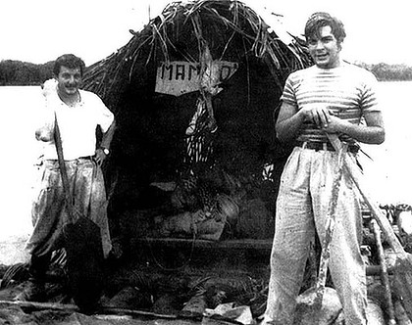

Slide 13
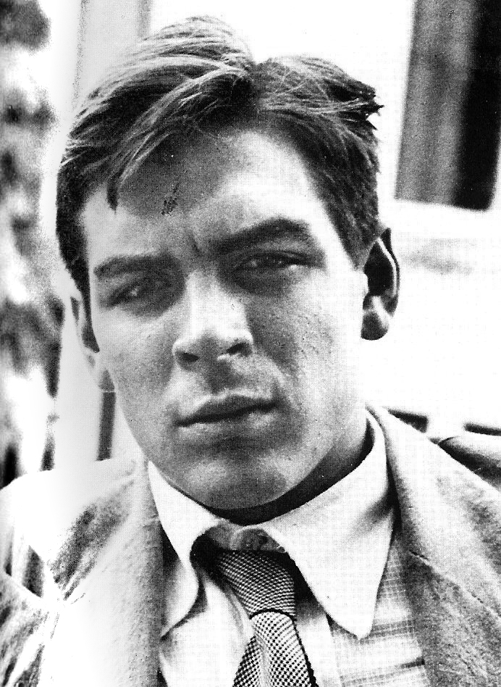
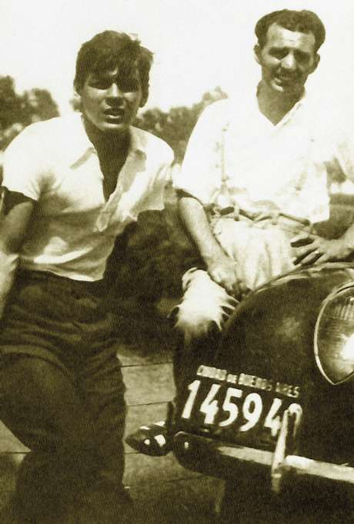
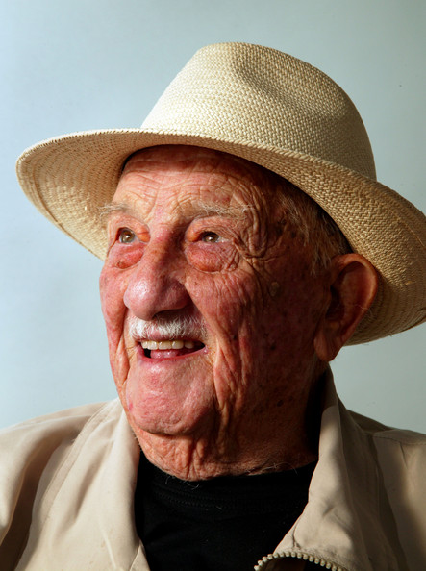

Slide 14
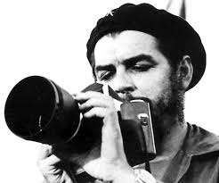
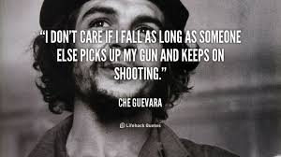
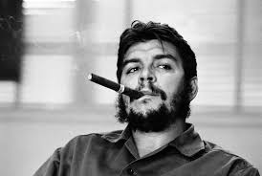

Slide 15
Family Life
He had 2 wives.
Hilda Gadea (1955 - 1959)
Aledia March (1959-1967 when he died)
He had 4 children
  Aledia born: 1960
  Camilo born: 1962
  Celia born: 1963
  Ernesto born: 1965

Slide 16
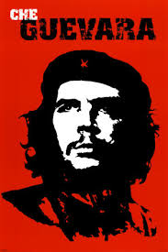
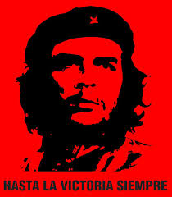
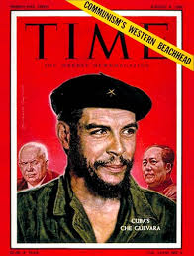
Why are these images all red?
What does this colour represent?

Slide 17
Towards the Cuban Revolution
Ernesto took time in Guatemala to perfect himself and train to become a revolutionary
In Guatemala, Ernesto was introduced to a group of Cuban exiles linked to Fidel Castro.
This is when he became known as ‘Che’ because it is a frequent word used by Argentine Spanish, like ‘eh’ in Canadian
In 1954 Guevara moved from Guatemala to Mexico and worked in an allergy section of the general hospital, he also gave lectures on medicine.
His first wife Hilda commented in her memoir that even though he considered going to work as a doctor in Africa, he was continually troubled by the poverty around him
In 1955 Che was introduced to Raul Castro who later introduced him to his brother Fidel who at that time was plotting to overthrow the dictatorship from Batista
Despite their contrasting personalities from the first night they met, Che and Fidel began to create a “revolutionary friendship that would change the world” as a result coinciding their commitment to anti-imperialism.
Che signed up as a member of the July 26 movement as it felt like the cause that he was searching for
Che signed up to be the combat medic, but was considered the best guerrilla of them all.

Slide 18
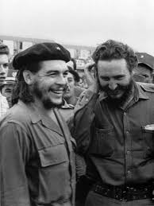
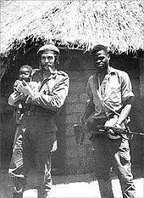

Slide 19
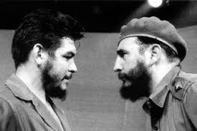
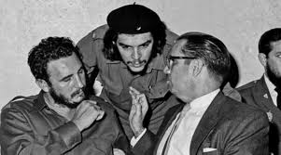

Slide 20
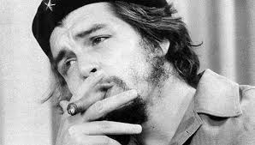
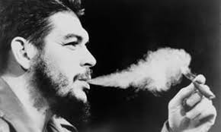

Slide 21
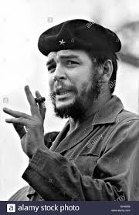
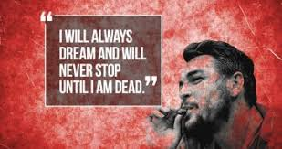

Slide 22
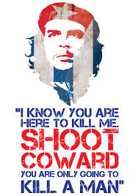
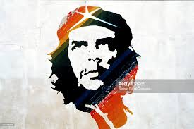
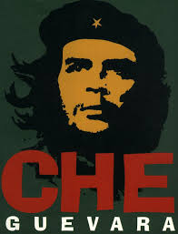

Slide 23
Cuban Revolution
The group of 82 men trained in guerrilla warfare and left for Cuba from Mexico on November 25th 1956
They were attacked by Batista’s military leaving only 22 men who found each other afterwards, some were killed some were captured and executed
At this point Che laid down his medical supplies and picked up a box of ammunition dropped by a fleeing comrade – which proves a symbolic moment in his life.

