Slide 1
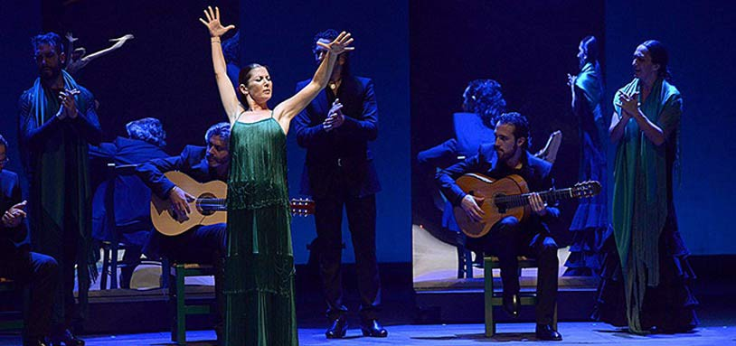
Flamenco
LO: What is Flamenco?
Why? It is more than just a dance!
Notes:
Camarón, José Mercé or Lola Flores
Heroin in the 1980s wiped out a lot of gypsies

Slide 2
Flamenco: (Etymology; theories where the word comes from)
Spanish word: “flama” meaning “flame”, which could describe the fiery behaviour of the gypsy players and performers.
From the Hispano-Arabic term “Fellahmengu” meaning “expelled peasant” referring here to the Andalusian’s of the Islamic or Jewish faith who were persecuted in Spain and joined alliance with the Gypsy outsiders (disproven but popular theory).
The word means Flemish in Spanish, which was the origin of many Gypsies.
In 1842 the word “flamenco” was synonymous with “Gypsy”

Slide 3
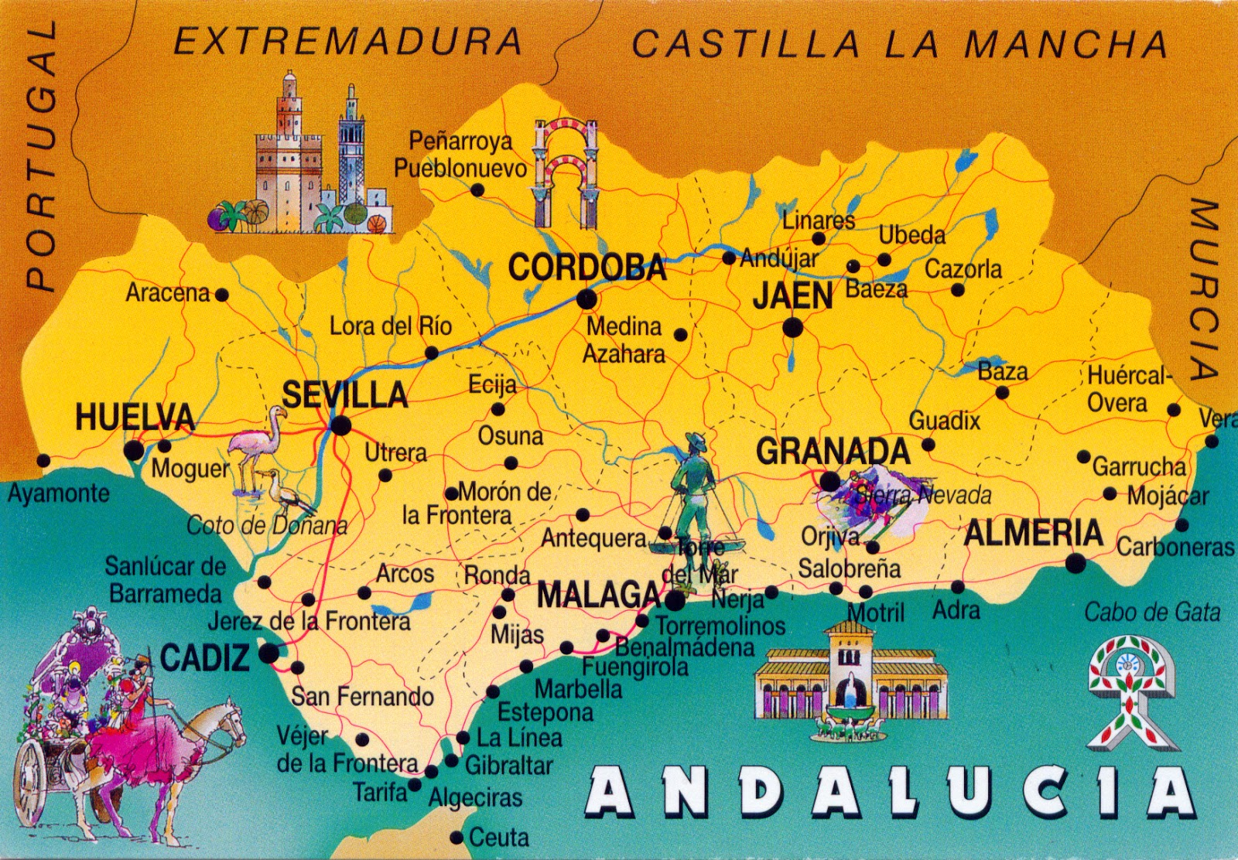
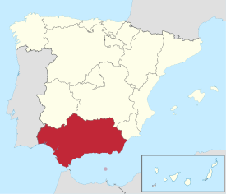
Areas important to the birth of flamenco were around the South of Spain Andalucia. Sevilla is the capital of Andalucia.

Slide 4
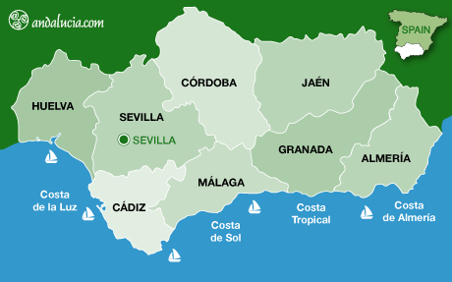

Slide 5
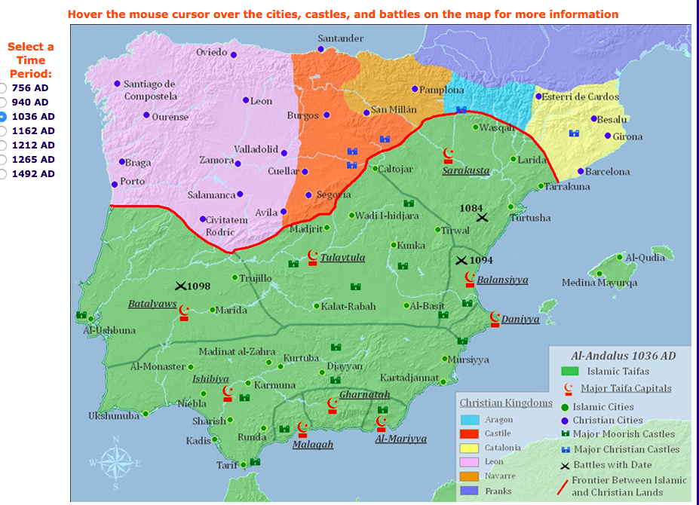
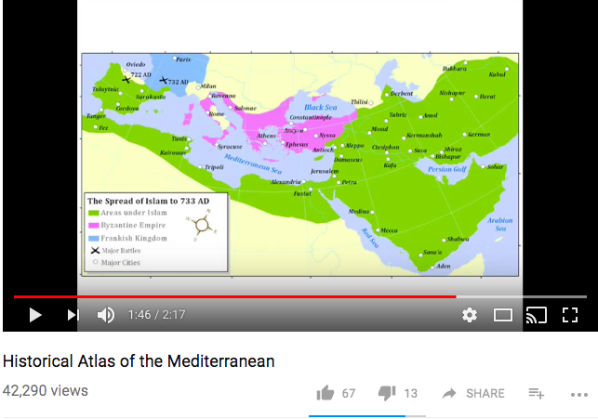
Changing Boarders
Click here to see how the Islam took over most of Spain, then how the Spanish fought back.
This is important in understanding how and why flamenco developed.

Slide 6
Flamenco: History
The gypsies arrived in Andalusia in the 15th Century during the Christian re-conquest of Spain.
Anyone who was not a Christian i.e. Jews, Muslims, African Slaves and Gypsies, who were all considered outsiders were persecuted (mistreated).
Strict laws meant they could not speak their language, meet up in groups or wear their traditional dress. This is called oppression.
Many gypsies survived working as blacksmiths (makes horse shoes and sharpened weapons) in a forge (the workshop, a special fireplace you heat and hammer metal into shape), it is in these forge’s where flamenco began.
Notes:
The gypsies arrived in Andalusia in the 15th Century during the Christian re-conquest of Spain.
The 15th Century was the time of Ferdiand and Isabel – who persecuted anyone who was a Muslim of Jew, because they were bringing in their religion. Gypsies were caught up in the persecution.
There were very strict rules like that Gypsies couldn’t speak in their own language which was different from Spanish, they couldn’t wear their dress or to meet up, the Spanish at the time didn’t treat gypsies well.
Gypsies were outsiders in Christian Spain along with other minority cultures including muslims, jews and african slaves. And flamenco is the coming together of these things in Sevilla, Cadiz, they had many influences from all these places.
1922 – the Alhambra in Granada held a flamenco competition/concourso. Before this time flamenco was not popular, it was only seen to be a thing for Gypsies and poor people. After this event it opened it up in to the mainstream starting the changing face of flamenco in Spain
Most gypsies were blacksmiths – the songs first came from these places – the forge where they worked. They made shoes for horses and nails.
In 1850 there was a lot of work for blacksmiths, but not enough of them so a lot of gypsies became blacksmiths
Martinete is a song which is very fuerte – its tragic and full of pain and sorrow and suffering, the martinete is a rhythem which only has that of the hammer and this word means hammer
https://www.youtube.com/watch?v=1FXmbqxT0IA&t=815s BBC Documentary – 16minutes through singing in blacksmiths with translation

Slide 7
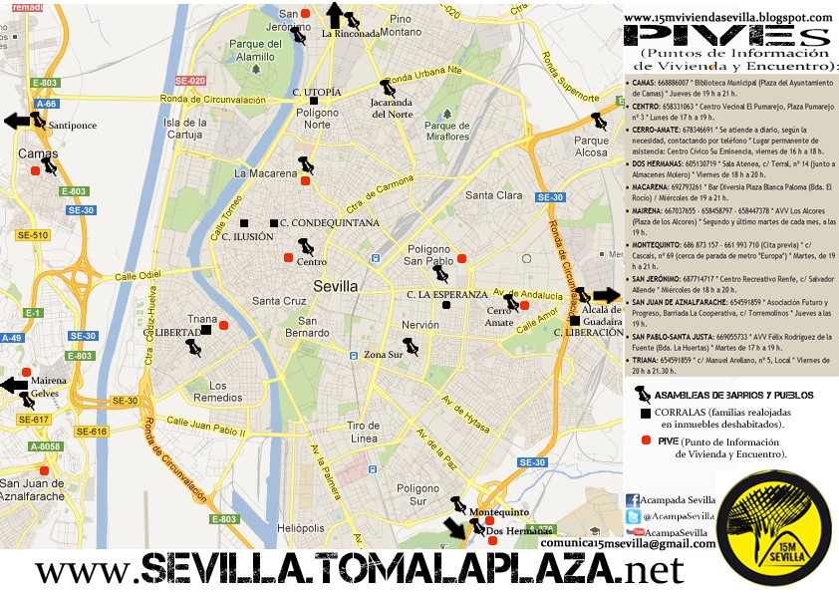
Triana
Poligono Sur
The gypsy community was marginalised and pushed south to Poligono Sur whilst Triana was developed in the 1950’s by Franco. Triana was the birth place of flamenco but Poligono Sur is the reality today. Triana is now a rich posh place to live for the upper class.

Slide 8
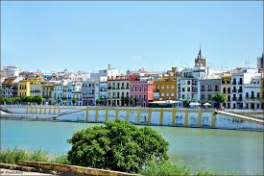
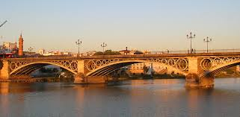
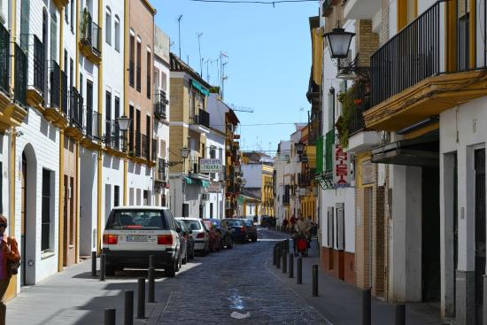
Triana

Slide 9
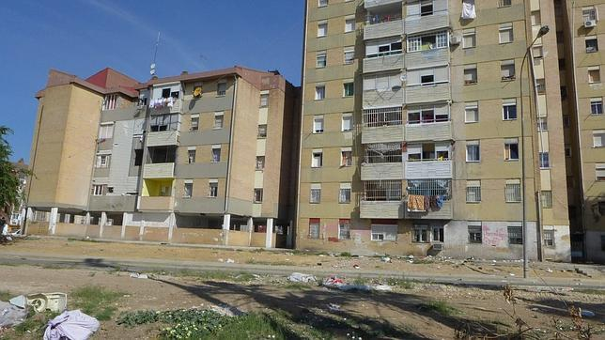
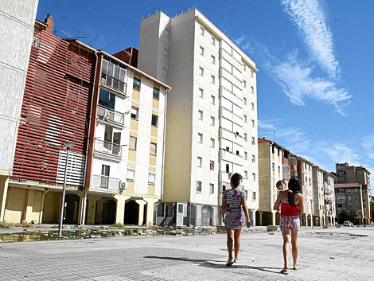
Poligono Sur

Slide 10
Flamenco: History
Before the theatre performances we now know as flamenco (introduced in the 19th century), flamenco was a way of life.
It is a Spanish art form passed down orally from one generation to the next within families.
Often gypsies were poor families who could not read or write would pass stories and information by singing.
Some gypsies lived in caves in Granada.
In 1922 the Alhambra in Granada hosted a flamenco competition, before this event flamenco was considered only for poor people and Gypsies, after the event many more people started accepting flamenco.
Notes:
The gypsies arrived in Andalusia in the 15th Century during the Christian re-conquest of Spain.
The 15th Century was the time of Ferdiand and Isabel – who persecuted anyone who was a Muslim of Jew, because they were bringing in their religion. Gypsies were caught up in the persecution.
There were very strict rules like that Gypsies couldn’t speak in their own language which was different from Spanish, they couldn’t wear their dress or to meet up, the Spanish at the time didn’t treat gypsies well.
Gypsies were outsiders in Christian Spain along with other minority cultures including muslims, jews and african slaves. And flamenco is the coming together of these things in Sevilla, Cadiz, they had many influences from all these places.
1922 – the Alhambra in Granada held a flamenco competition/concourso. Before this time flamenco was not popular, it was only seen to be a thing for Gypsies and poor people. After this event it opened it up in to the mainstream starting the changing face of flamenco in Spain
Most gypsies were blacksmiths – the songs first came from these places – the forge where they worked. They made shoes for horses and nails.

Slide 11
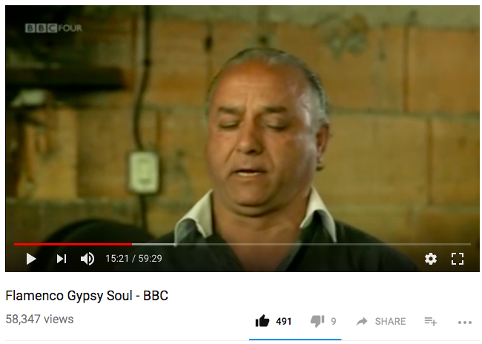
Flamenco: History
Flamenco song’s represent the history they tell, so they are often sorrowful, tragic, full of pain and suffering, and you can hear this in the way they sing it.
In the life of a gypsy flamenco is a state of the soul.
Flamenco guitar changed the sound of flamenco forever and is how we recognise it today, however it is not the main thing, the singing leads, the guitar follows
Notes:
16 minutes through
The Compass = the guitar
20 mins through the guitar
27:30 goat man sings
Manolo Sanlucar - guitarists
Paco de Lucia – guitarists
Triana = flamenco centre and gypsie centre
The gypsies were involved in crime, so it was worrying for the government so in 1749 they arrested lots of gypsies just for being gypsies. Massive persecution of being gypsy more recently as well as during Isabel and Ferdinand.
Now Triana is a classy upper class place, they build the flats in the 1950s in order to expel the gypsies to the periphery – this happens in many areas geographically.
The truth is Triana is flamencos past but today flamenco is in Poligono Sur. The Poligono Sur is an area in South Seville which Franco created by Franco for Sevilles marginal and poor. It is like housing estates. When they moved there, there was nowhere to do flamenco so they did it on the streets.
You cannot understand flamenco if you don’t understand blacksmithing. Now the children are born in to flamenco and it is imprinted into thier senses.
The people who live in Poligono Sur don’t have money for food but they are happy and happy to sing in the street for money
Carboneria = coal
Real singers sing from a place of pain and feel it.
If you motivate yourself to sing flamenco by drinking, you are afraid of your emotions. If you feel it you have to sing it, if you are silent about your suffering, you will die.
Diego De Gastor – god of slow flamenco – he barely recorded because he thought it was a private song for gypsies
Slow flamenco is harder to listen to
Some are just born in to it – they don’t choose it or do it for art, it is what it is.
Flamenco is different from other singing types because they transmit the sadness on to you to feel it.
In the smaller towns gypsies worked on the land and had a hard time always outside.
Frederico Garcia Lorca said that Jerez was the Gypsy city – because gypsies integrated well in the city
Duende = a spirit in the woods, or
In Jerez, people are not divided as Gypsy and non gypsy they are all together
In the past people did not live in flats, they lived in small houses next to each other
Before flamenco was on every street corner every day, but now it is only in shows and festivals
Gypsies always liked to have a king or a god – this artist Cameron was accepted in that way.
Cameron – and paco de lucia together 9 albums
People wrote songs based on Lorca’s poems
Cameron changed flamenco – it became rock infused and LSD fueled and he broke the rules of flamenco which previously constrained the subculture
Cameron put flamenco on the map for the world but in 1992 he died
He had the biggest funeral it was full of all the gypsies in spain. He brought gypsies to life with this song – not one gypsy didn’t have his album at home

Slide 12
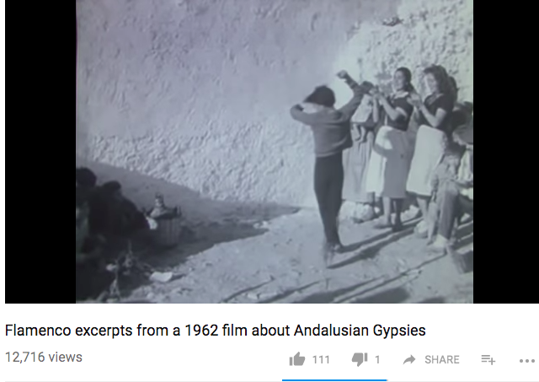
1962 Film about Andalusian Gypsies
The 12 year old boy dances Flamenco bare foot and then in his full Flamenco attire.

Slide 13
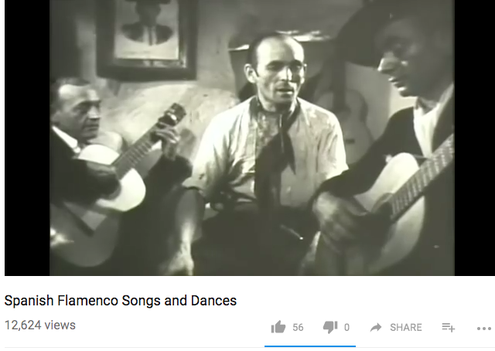
1948 Spanish Gypsies Family Festival
In a Granada grotto.
A group of artists perform dances and songs.

Slide 14
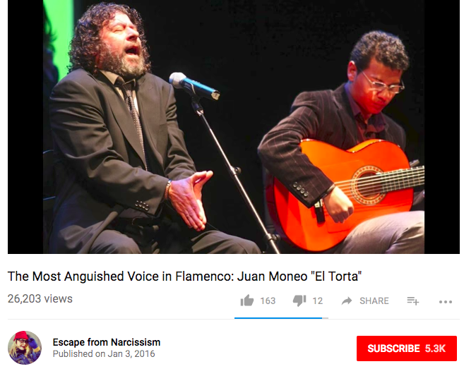
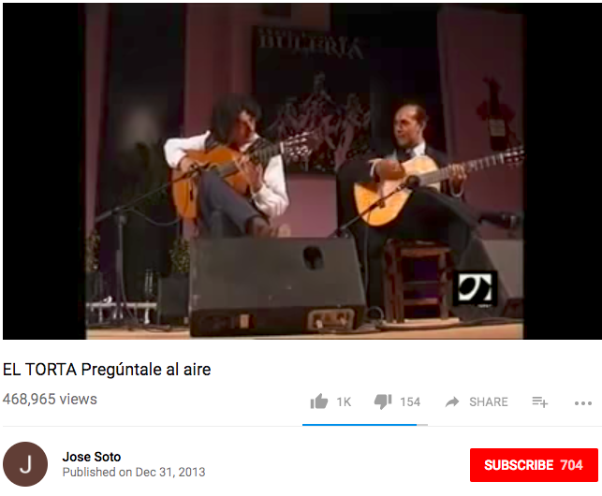
El Torta: Juan Moneo
Tells the story of suffering in the 1980s when many gypsies and poor people were wiped out by heroin addiction.
The singing is a kind of wailing song that expresses true and raw suffering and heart ache.
The Arabic influence is historic in the South of Spain as it was historically a Moorish area.

Slide 15
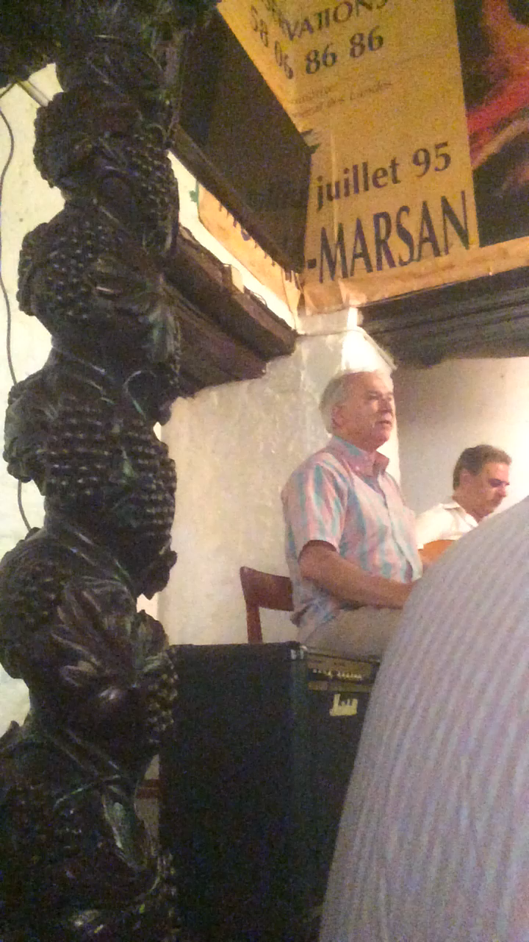
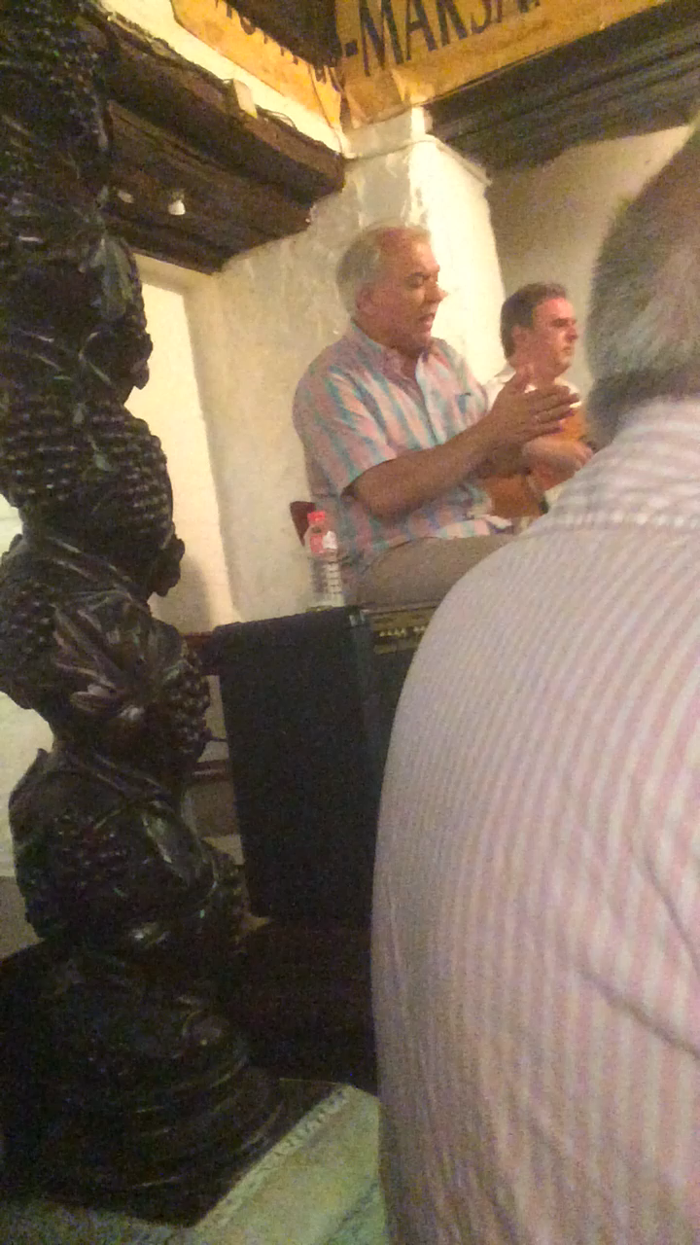
La Carboneria Sevilla 2016 (phones are banned so I shouldn’t really have taken this video)

Slide 16
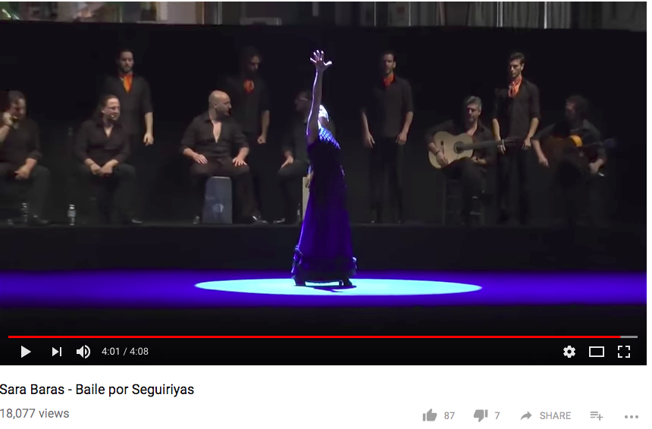
Sara Baras: Andalucian flamenco dancer
There is a Flamenco Festival at Sadlers Wells every year in February time, I recommend you go.

