Slide 1
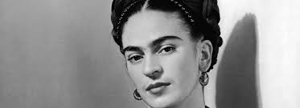
Frida Kahlo
LO: Who was Frida?
Why? She is important to the history of women and art

Slide 2
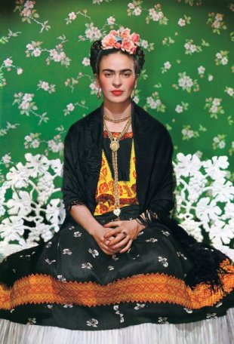
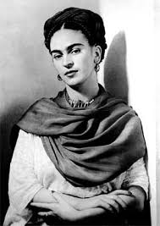

Slide 3
Frida Kahlo de Rivera
Born: Magdalena Carmen Frida Kahlo y Calderon
Born: 6th July 1907 in Coyoacan, Mexico City, Mexico
Her father was German and her mother was mestiza
Lived in La Casa Azul – the blue house most of her life
Artist, Surrealist, Magical Realist, Post-colonialist, Feminist, celebrated folk art style lot of autobiographical art
Disabled from polio as a child and then at 18 was seriously injured in a traffic accident and as a result couldn’t have children, and suffered with miscarriages which her art depicts
She was going to become a doctor but after the accident couldn’t continue higher education so continued her childhood hobby as an artist

Slide 4
Frida Kahlo de Rivera
Gender fluid, wore suits and dressed as a man sometimes, had romantic relationships with men and women
Joined the Mexican Communist Party in 1927 where she met her husband Diego Rivera, they married in 1928 and were together until death.
Both Frida and Diego had affairs and divorced in 1939 but remarried the following year.
Frida and Diego offered their house as refuge to a former Soviet leader Leon Trotsky and his wife, he was one of the men Frida had an affair with
Frida and Diego travelled to USA in the late 1920s and early 1930s
Frida spoke French, Spanish and English

Slide 5
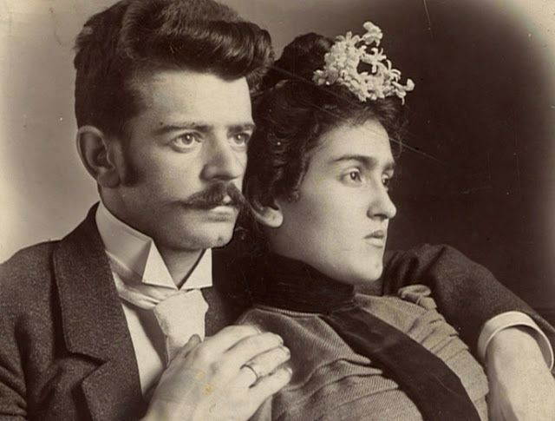
Frida’s parents

Slide 6
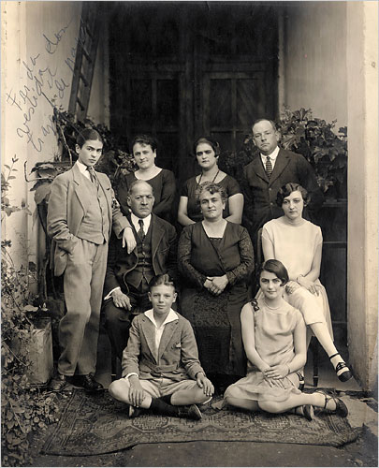
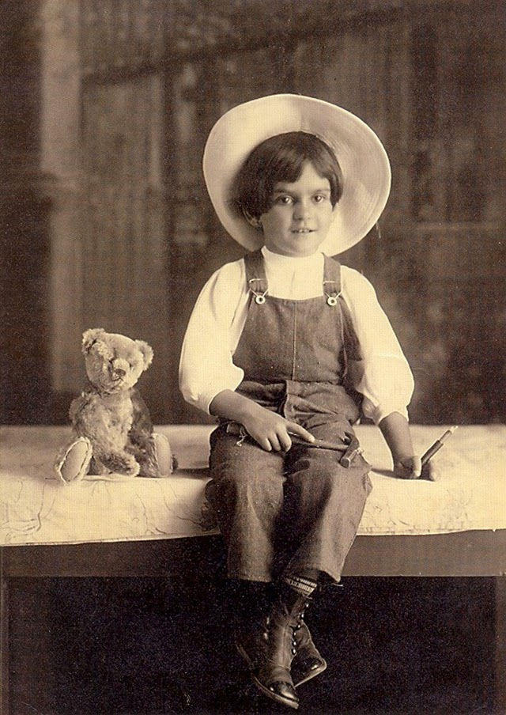
Frida aged 6
Frida in family photo dressed as a man

Slide 7
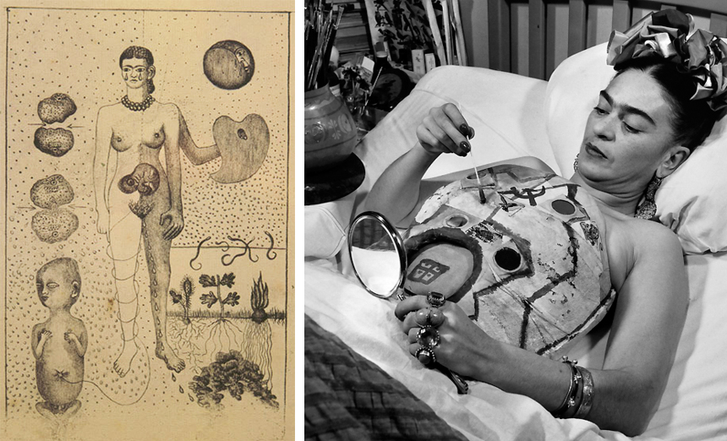
Frida painting her body cast

Slide 8
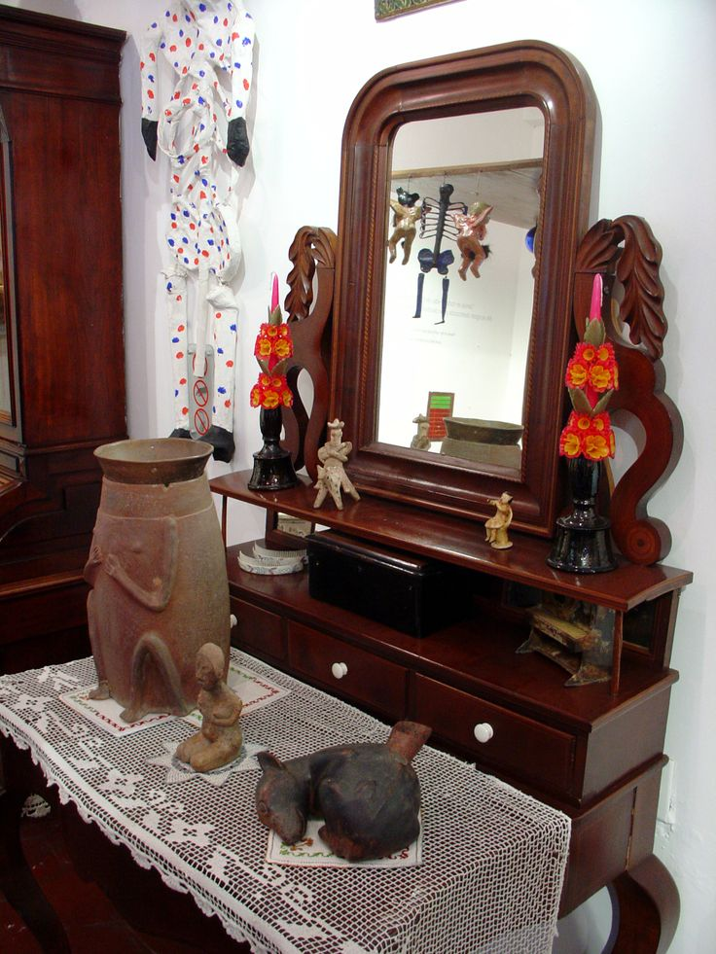
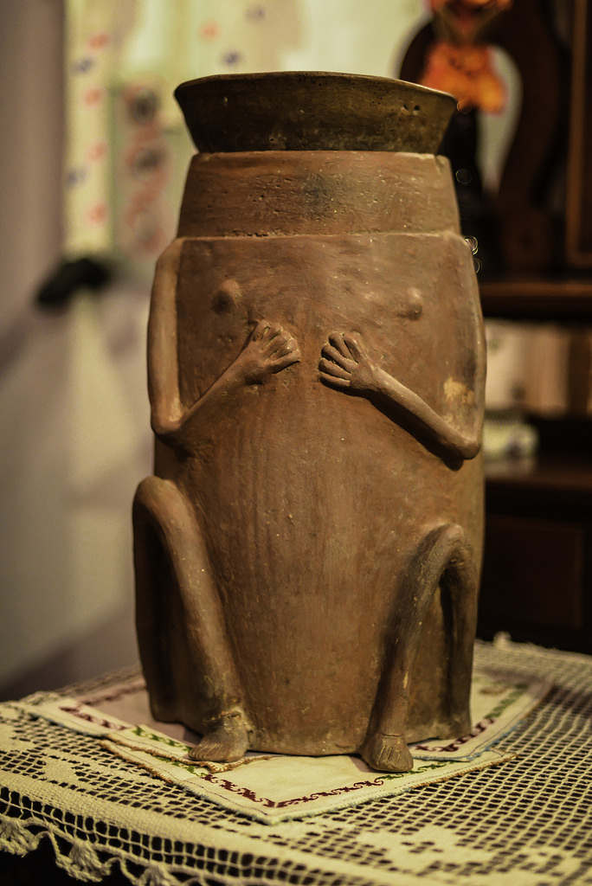
Frida’s ashes are inside this urn in her blue house in Mexico City

Slide 9
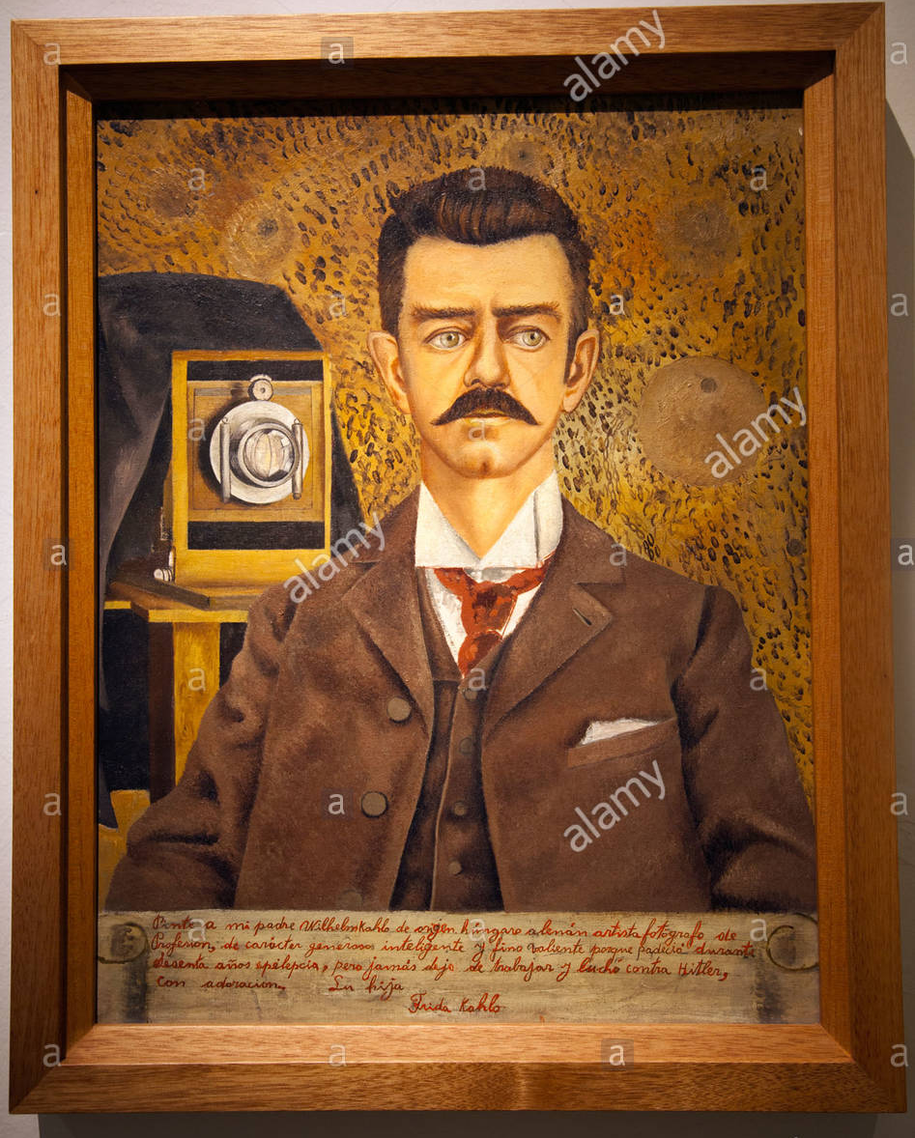
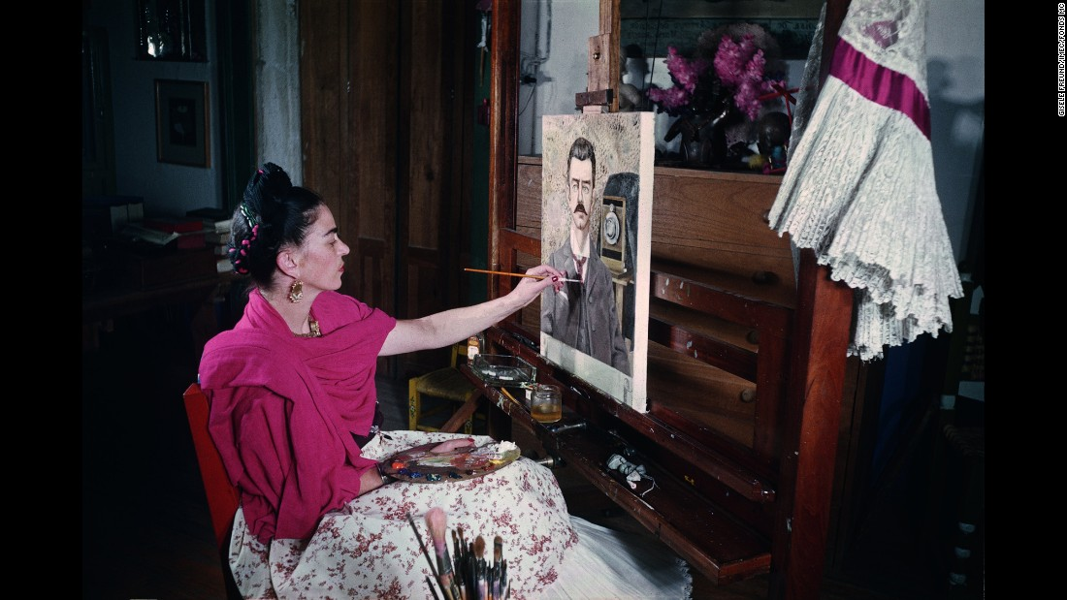
Frida had a strong relationship with her father and this is her painting him

Slide 10
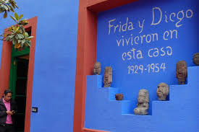
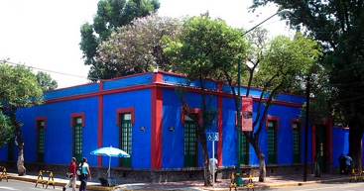
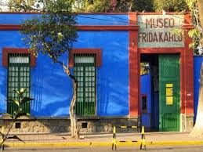
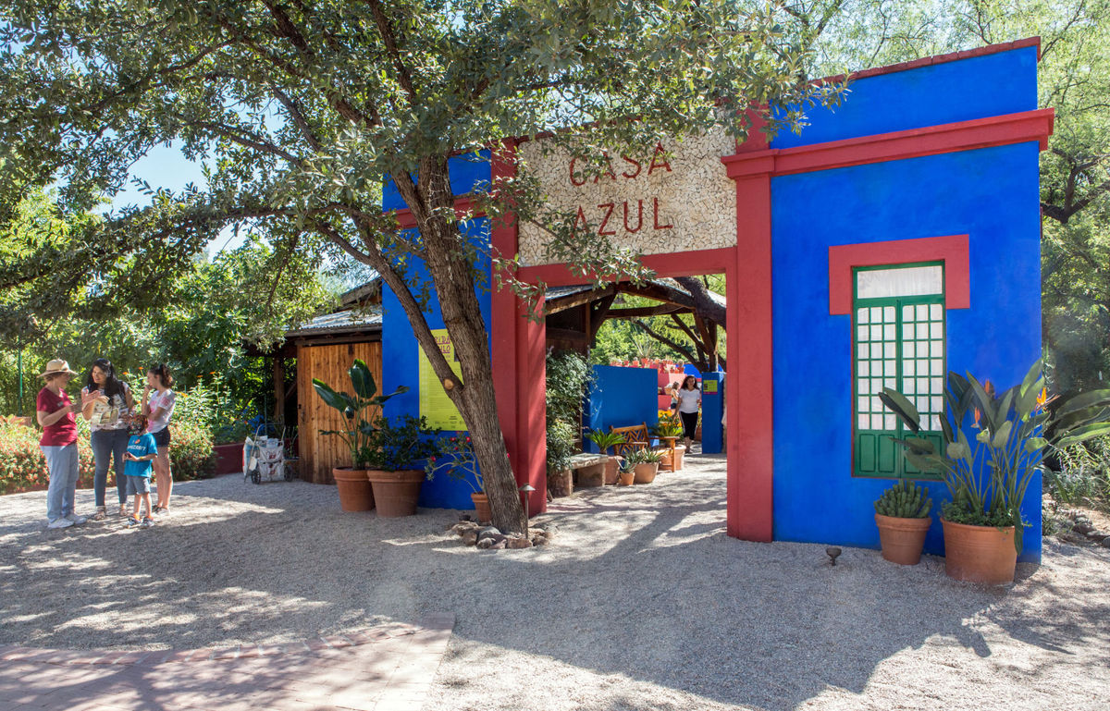
La Casa Azul
The blue house

Slide 11
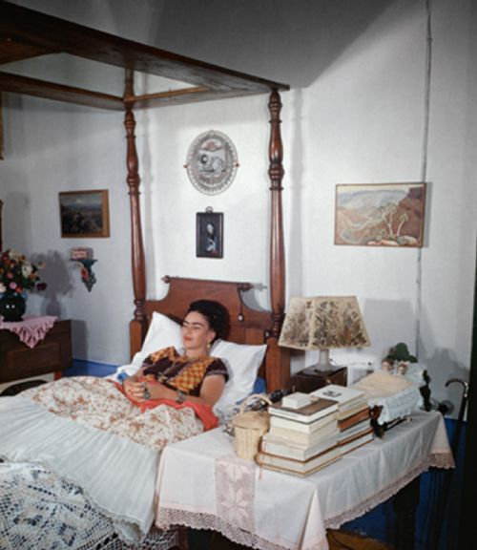
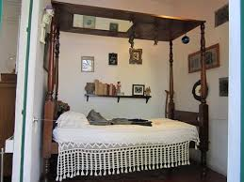
She lay in a bed with a mirror over the top, and also had one with butterflies over it because she spent so much time in bed.

Slide 12
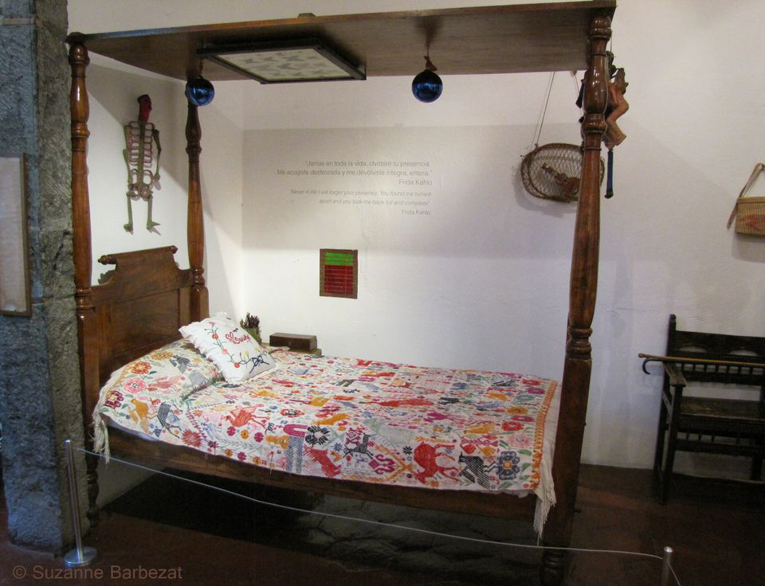
This bed has butterflies above where she lay.

Slide 13
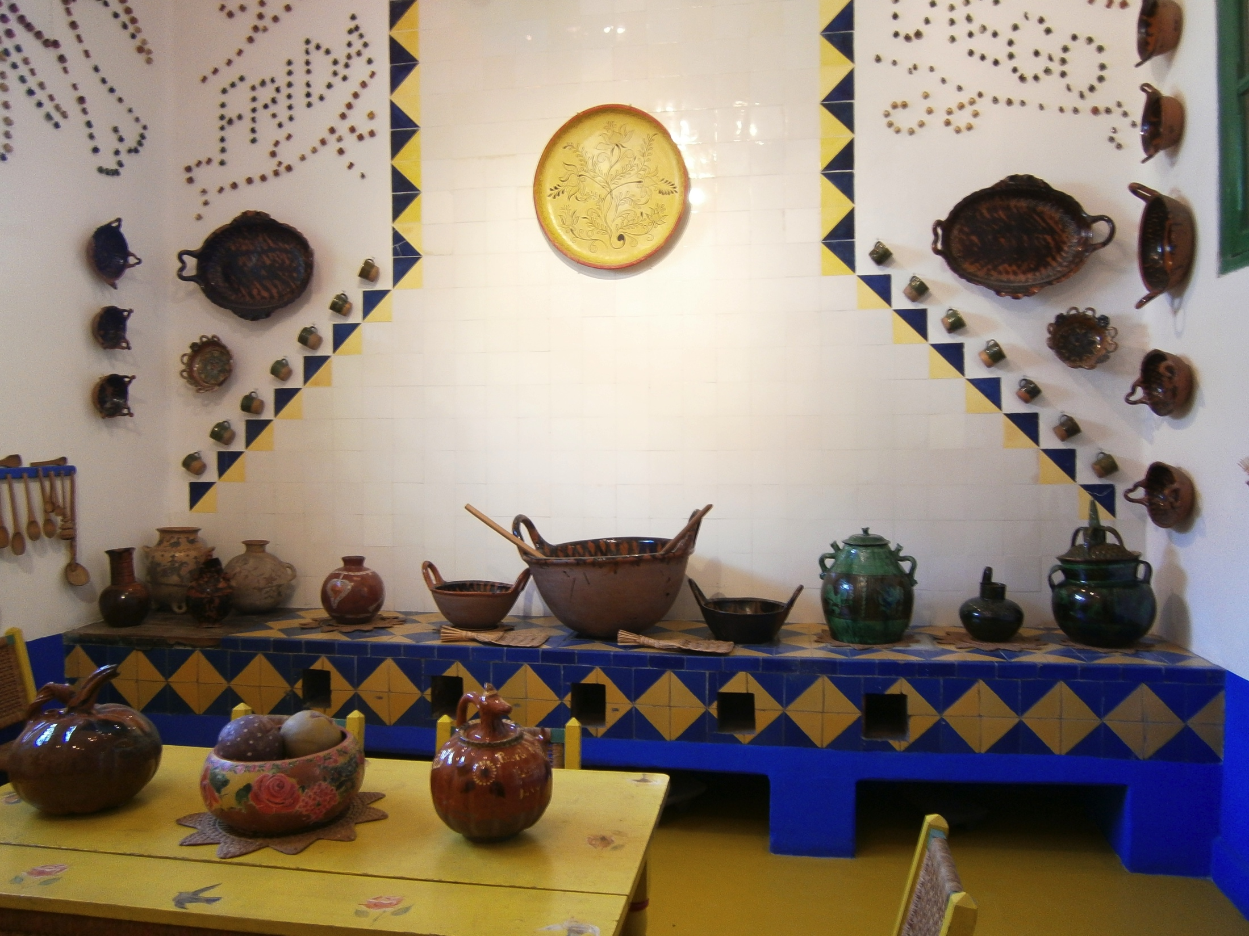
The kitchen where Frida would cook for Diego had their names on the wall

Slide 14
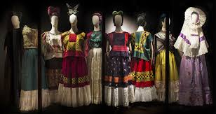
Frida’s dress collection in the blue house Mexico

Slide 15
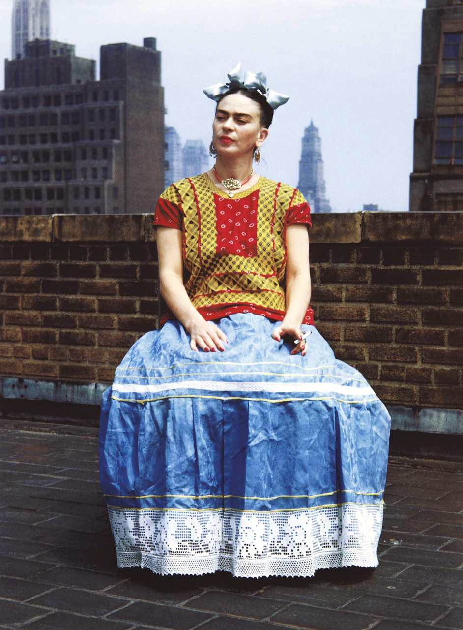
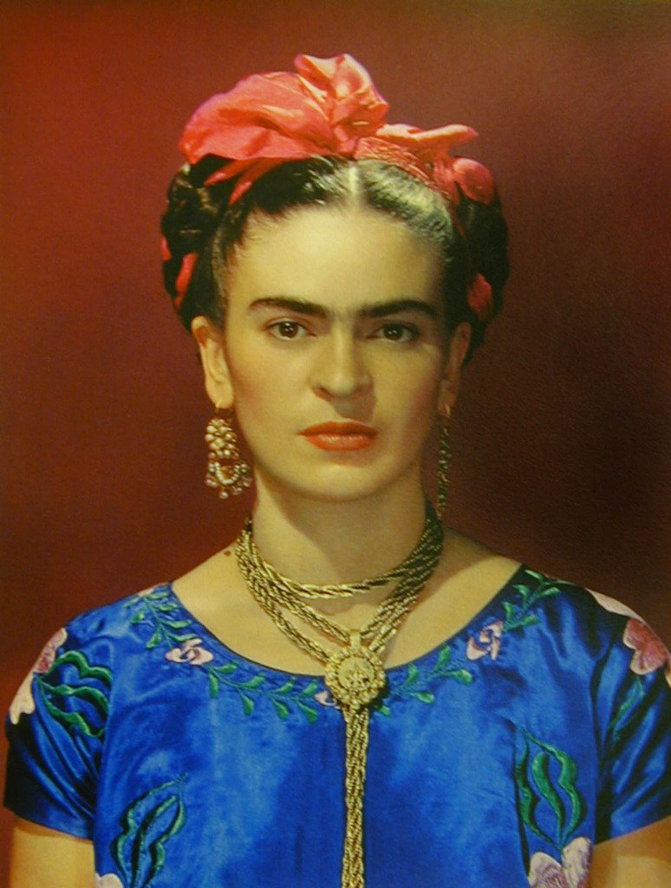
An example of her great fashion style

Slide 16
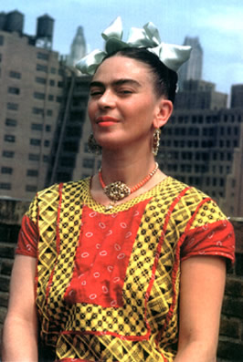
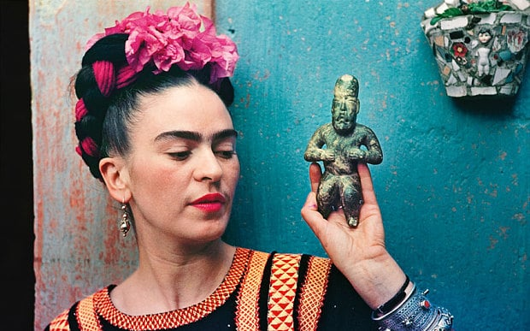

Slide 17
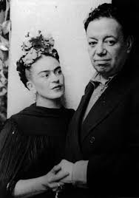
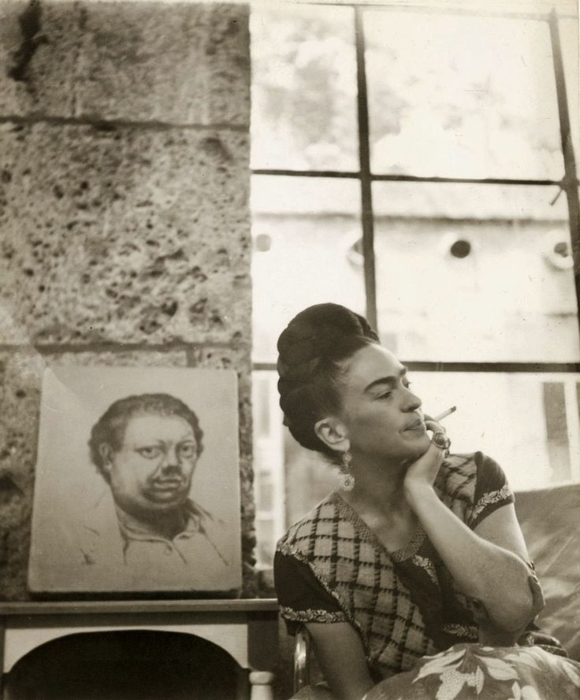
Frida and Diego

Slide 18
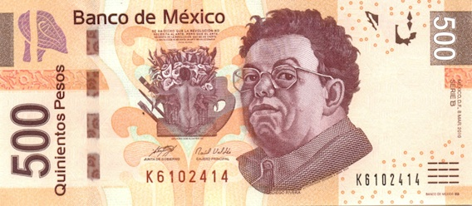
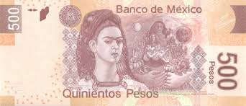
Frida and Diego are considered such important figures in Mexican history they are on the modern day money.

Slide 19
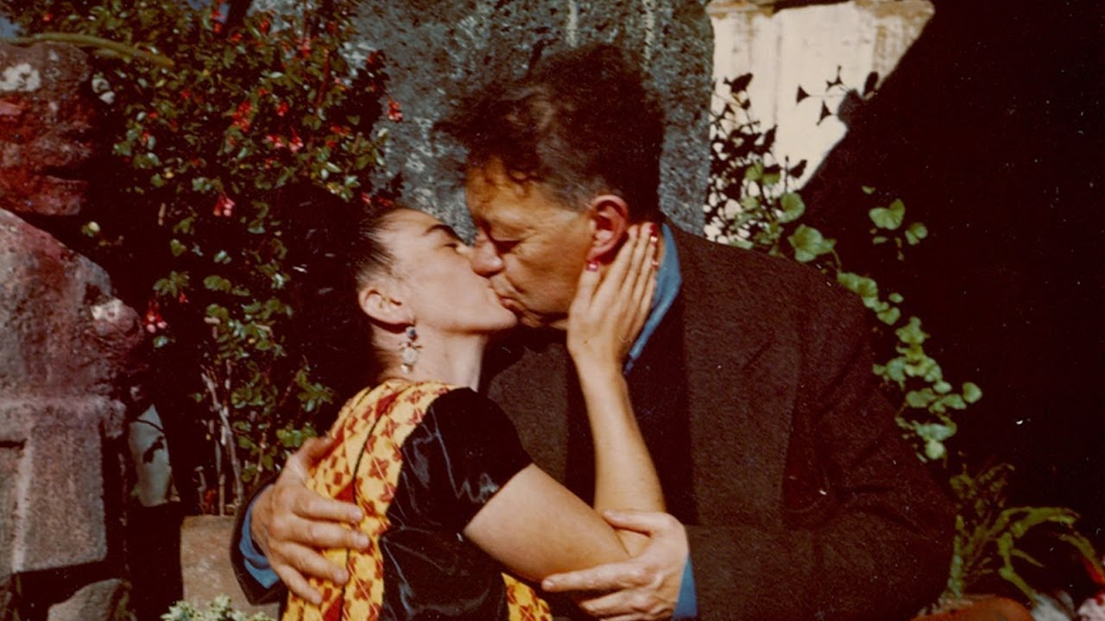

Slide 20
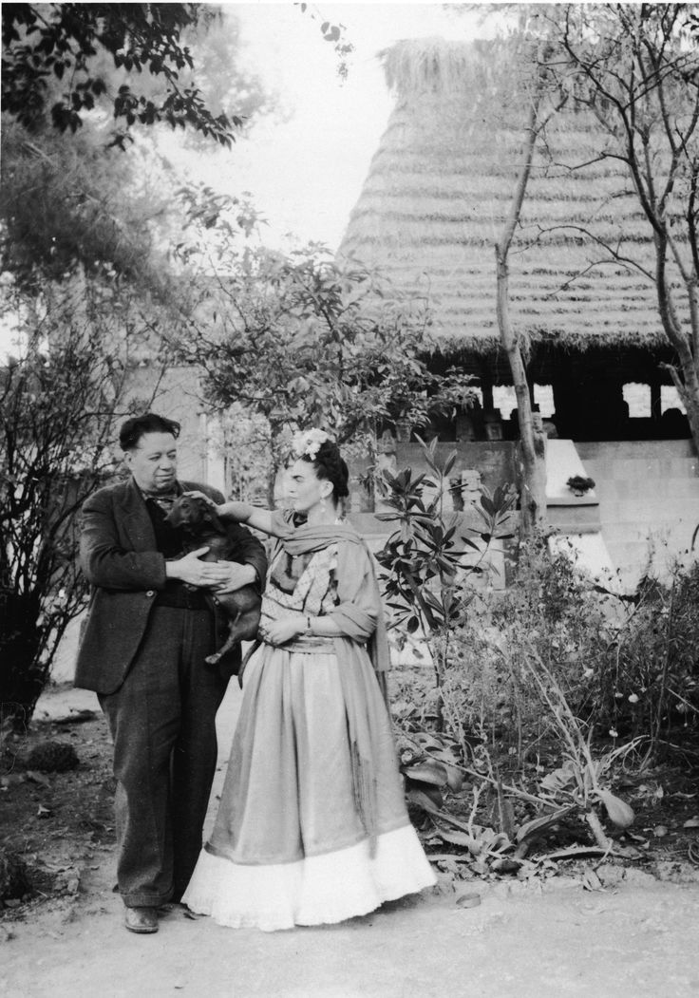
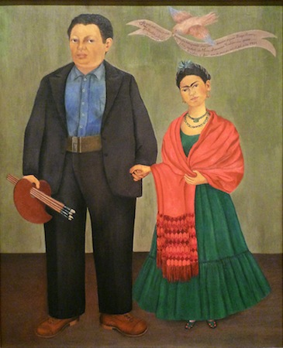

Slide 21
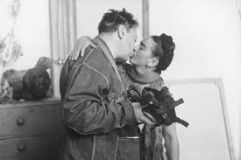
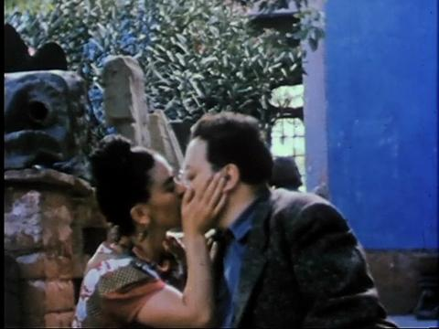
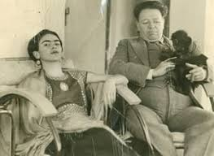

Slide 22
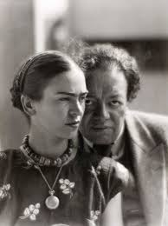
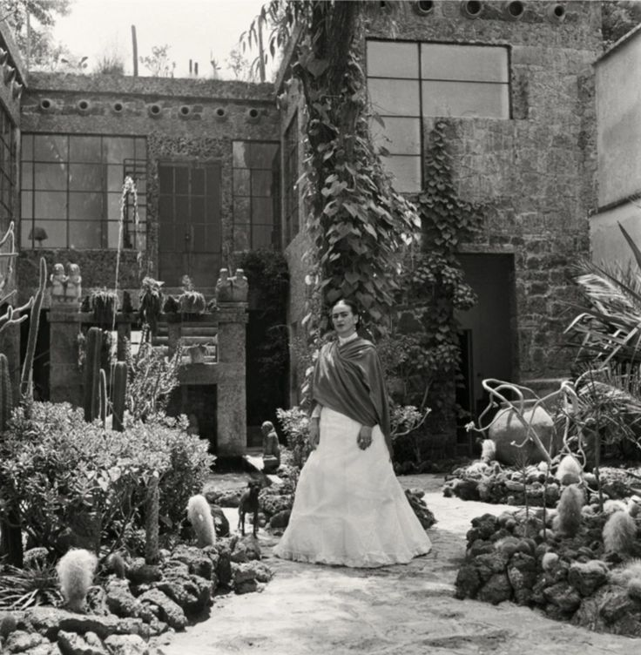

Slide 23
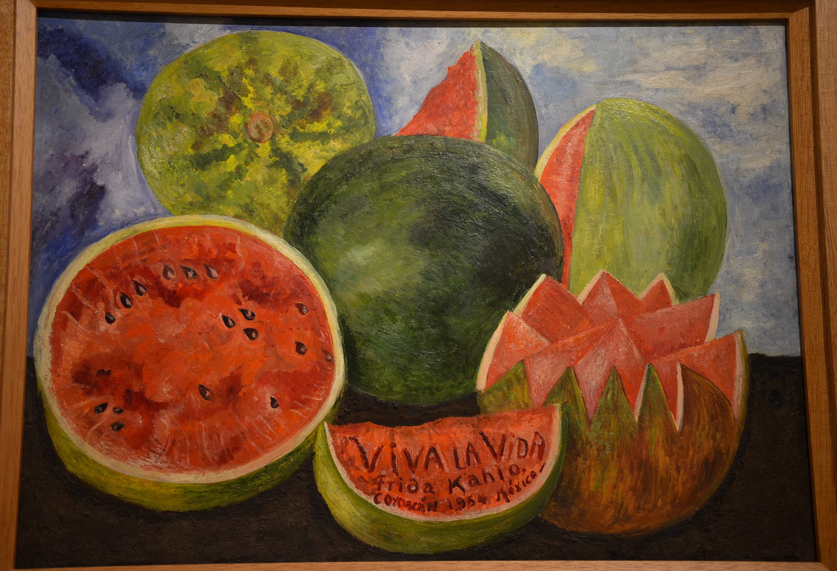
This was the last painting she did before she died.

Slide 24
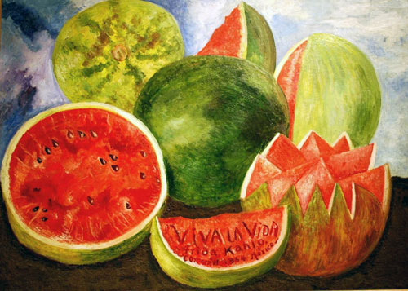

Slide 25
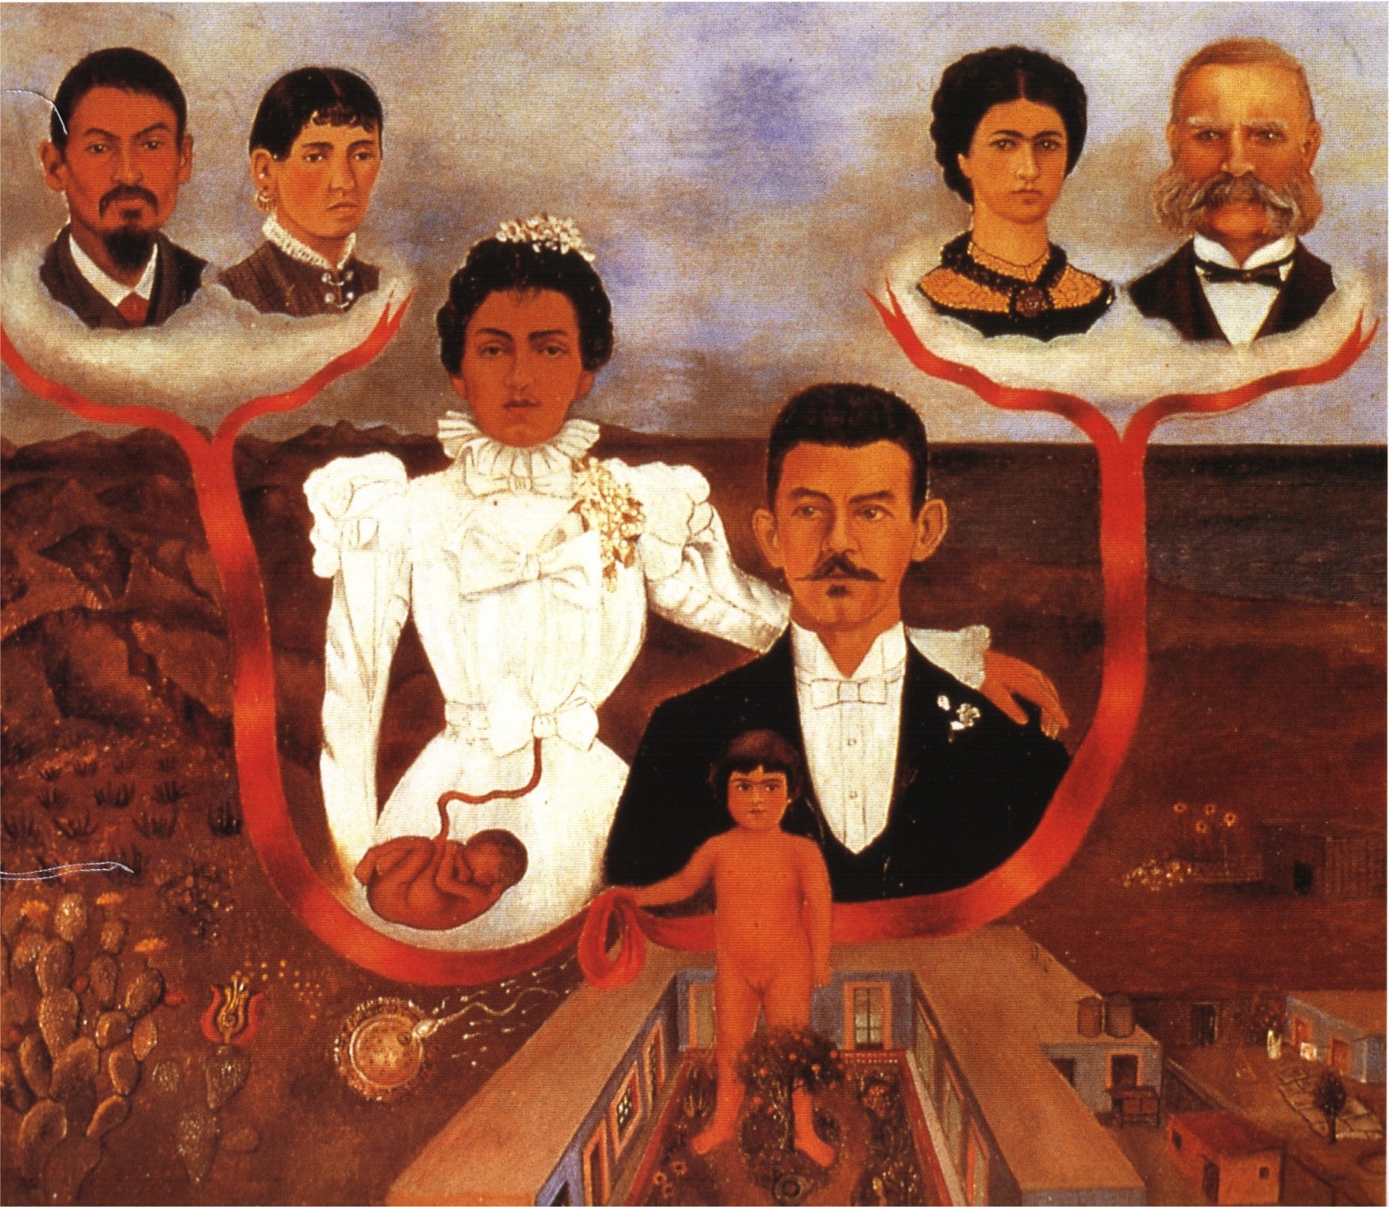

Slide 26
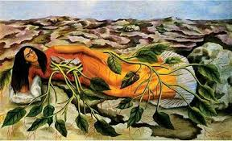

Slide 27
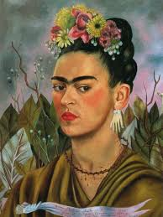
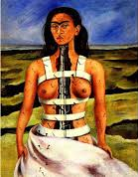

Slide 28
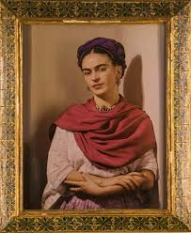
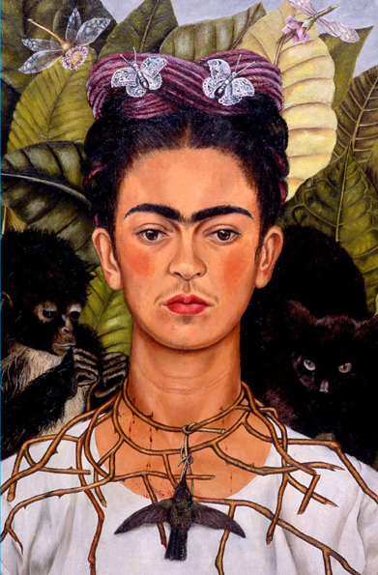

Slide 29
Miss Wood’s pictures of Frida’s house in Mexico

Slide 30
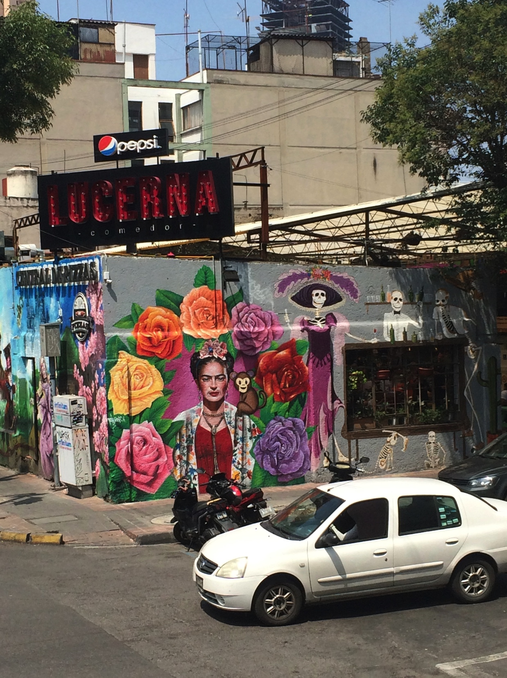

Slide 31
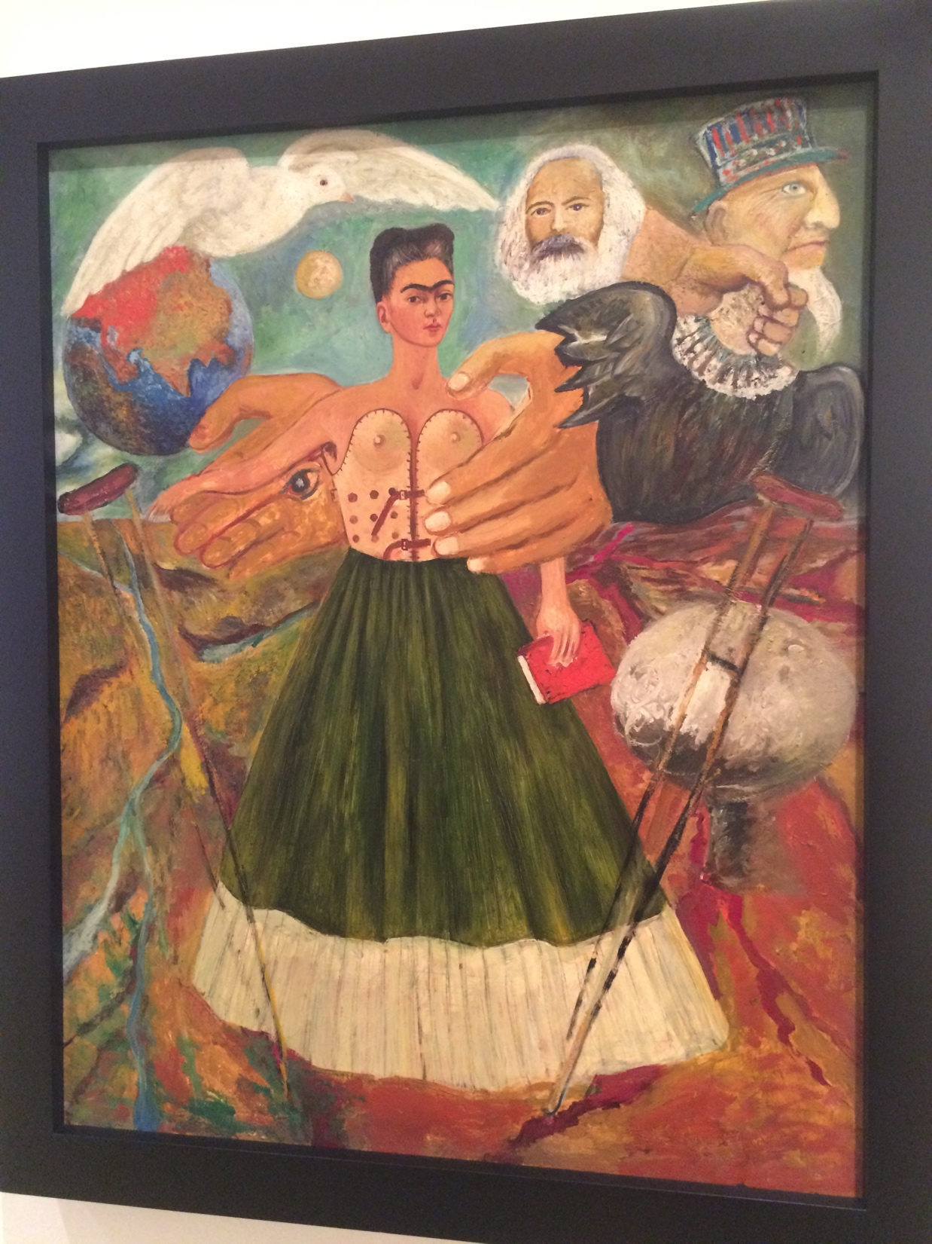
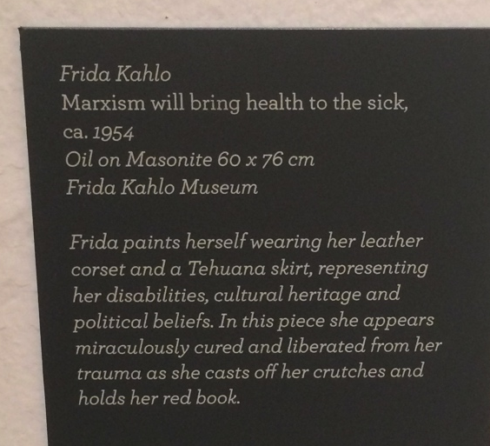

Slide 32
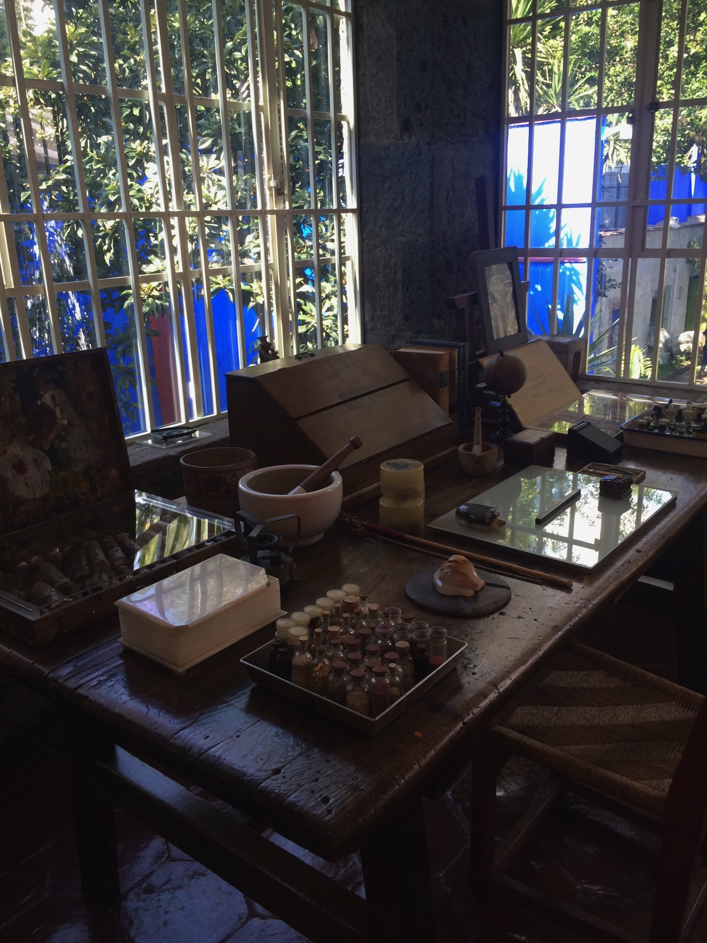
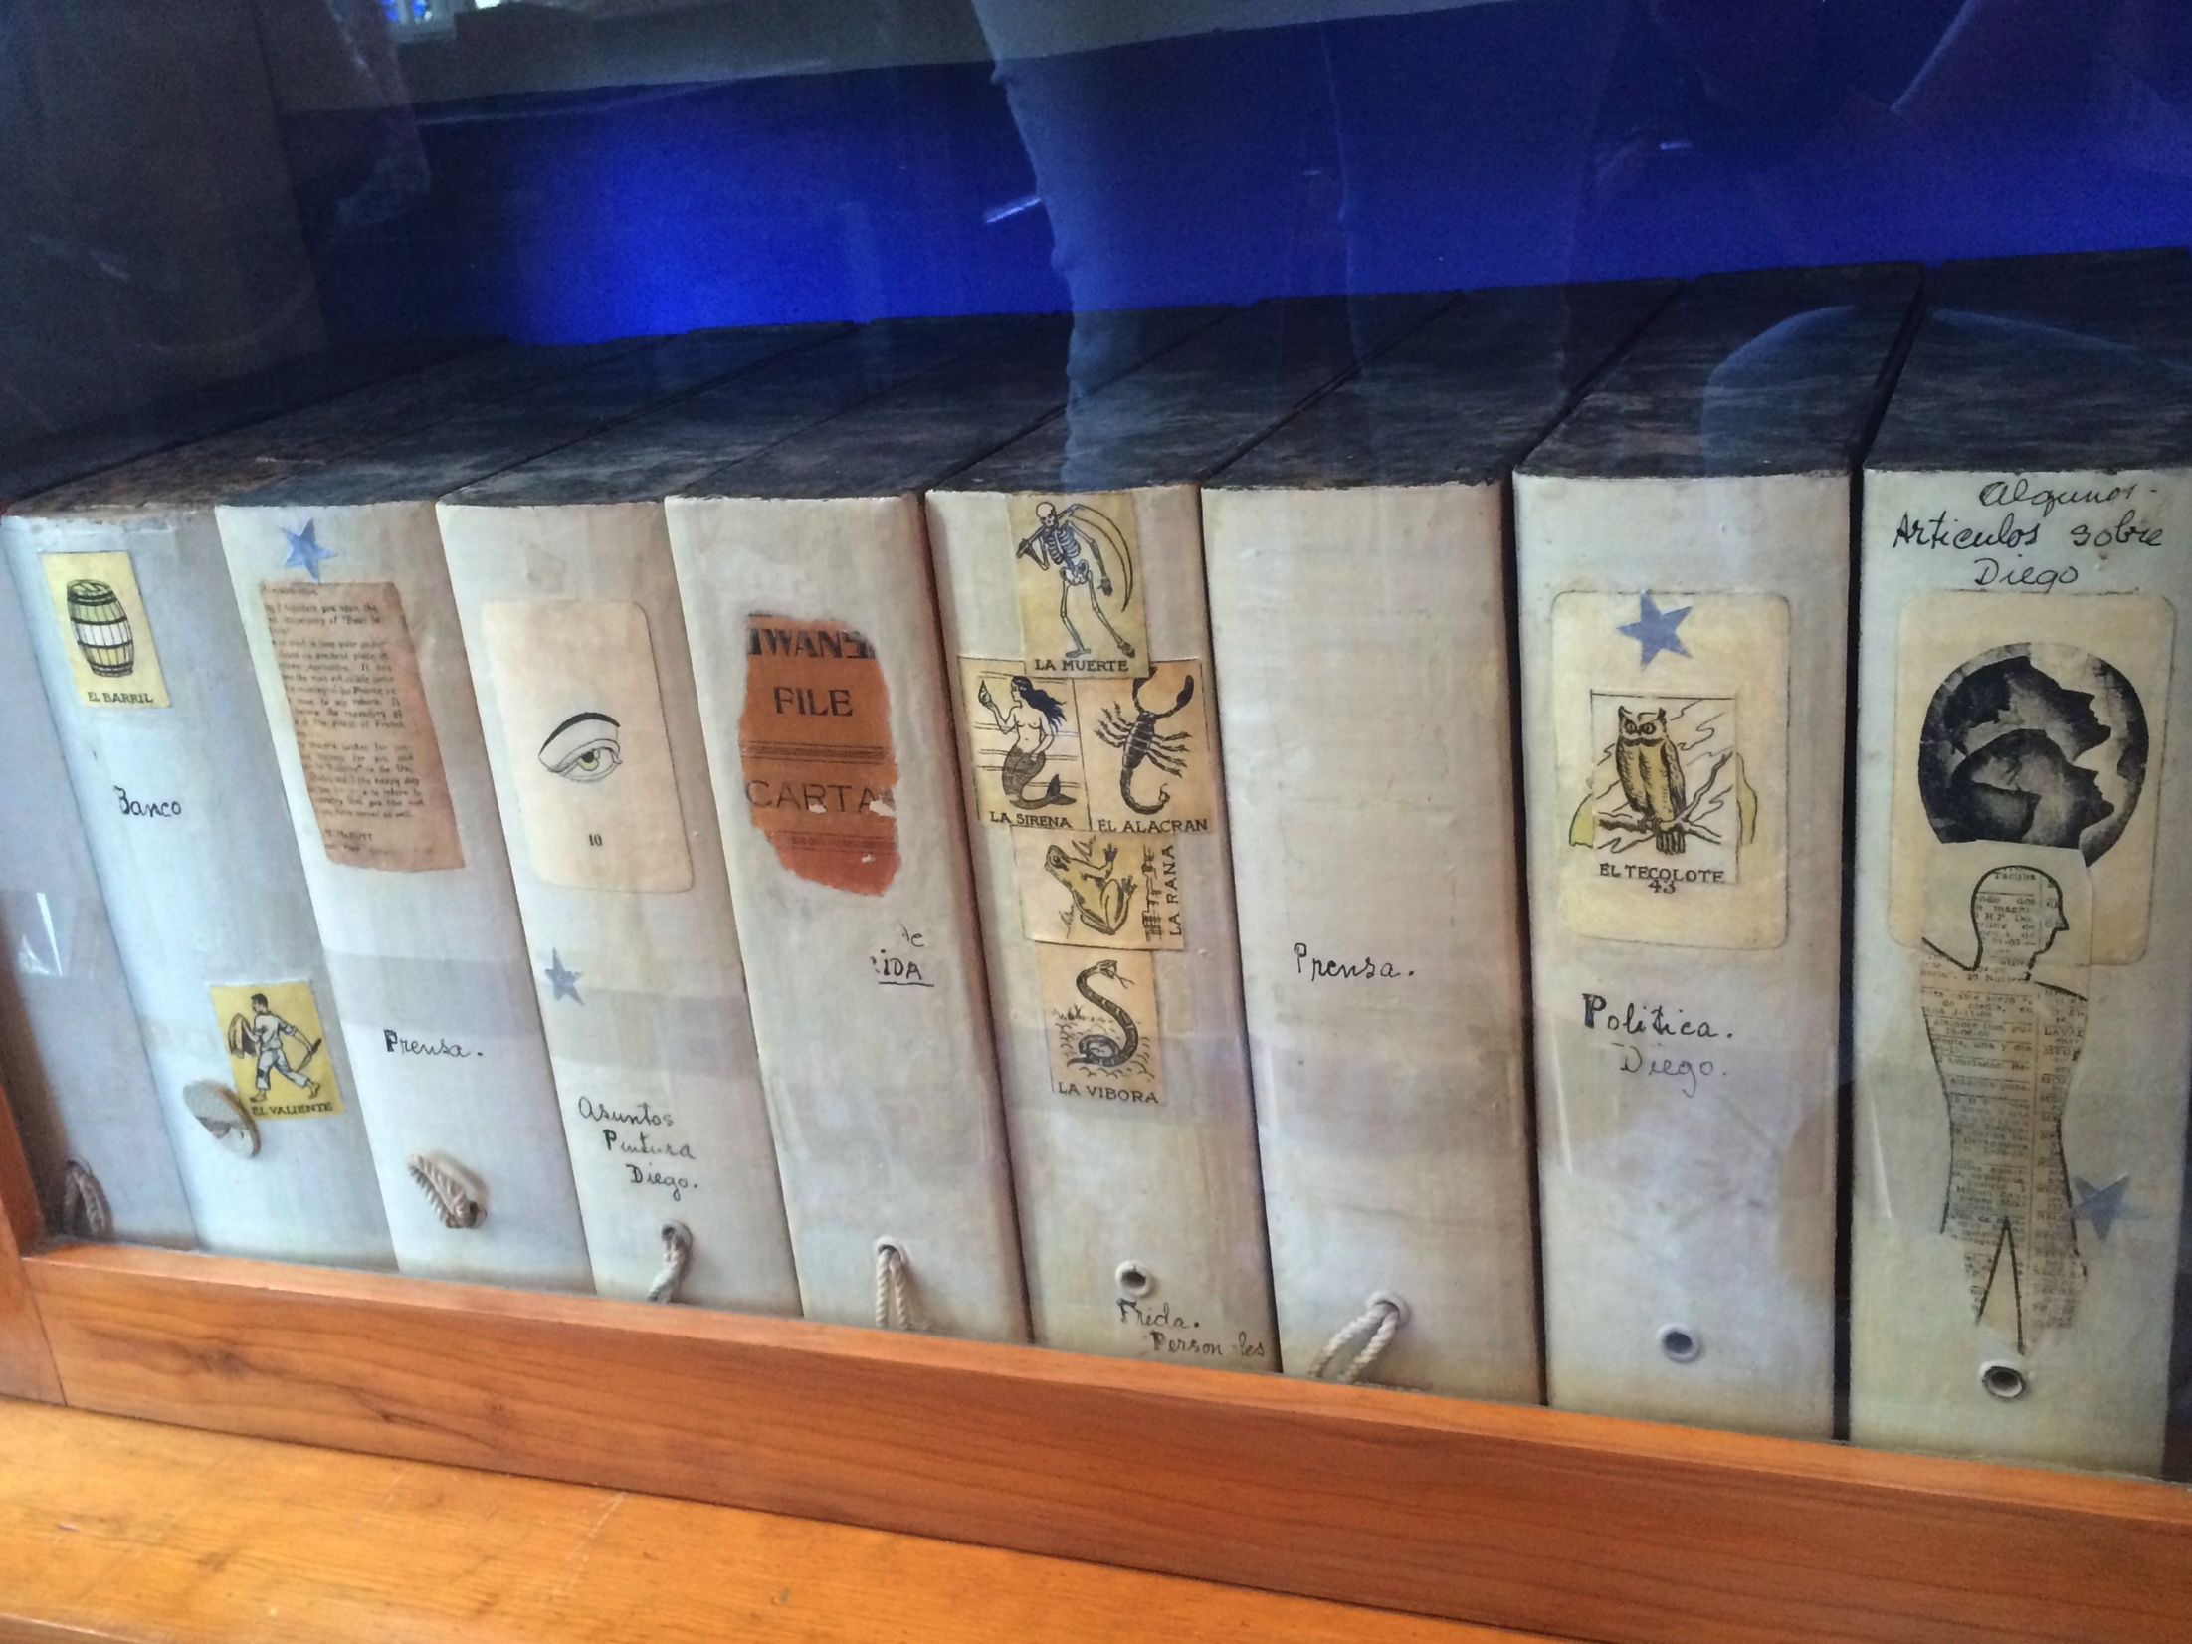

Slide 33
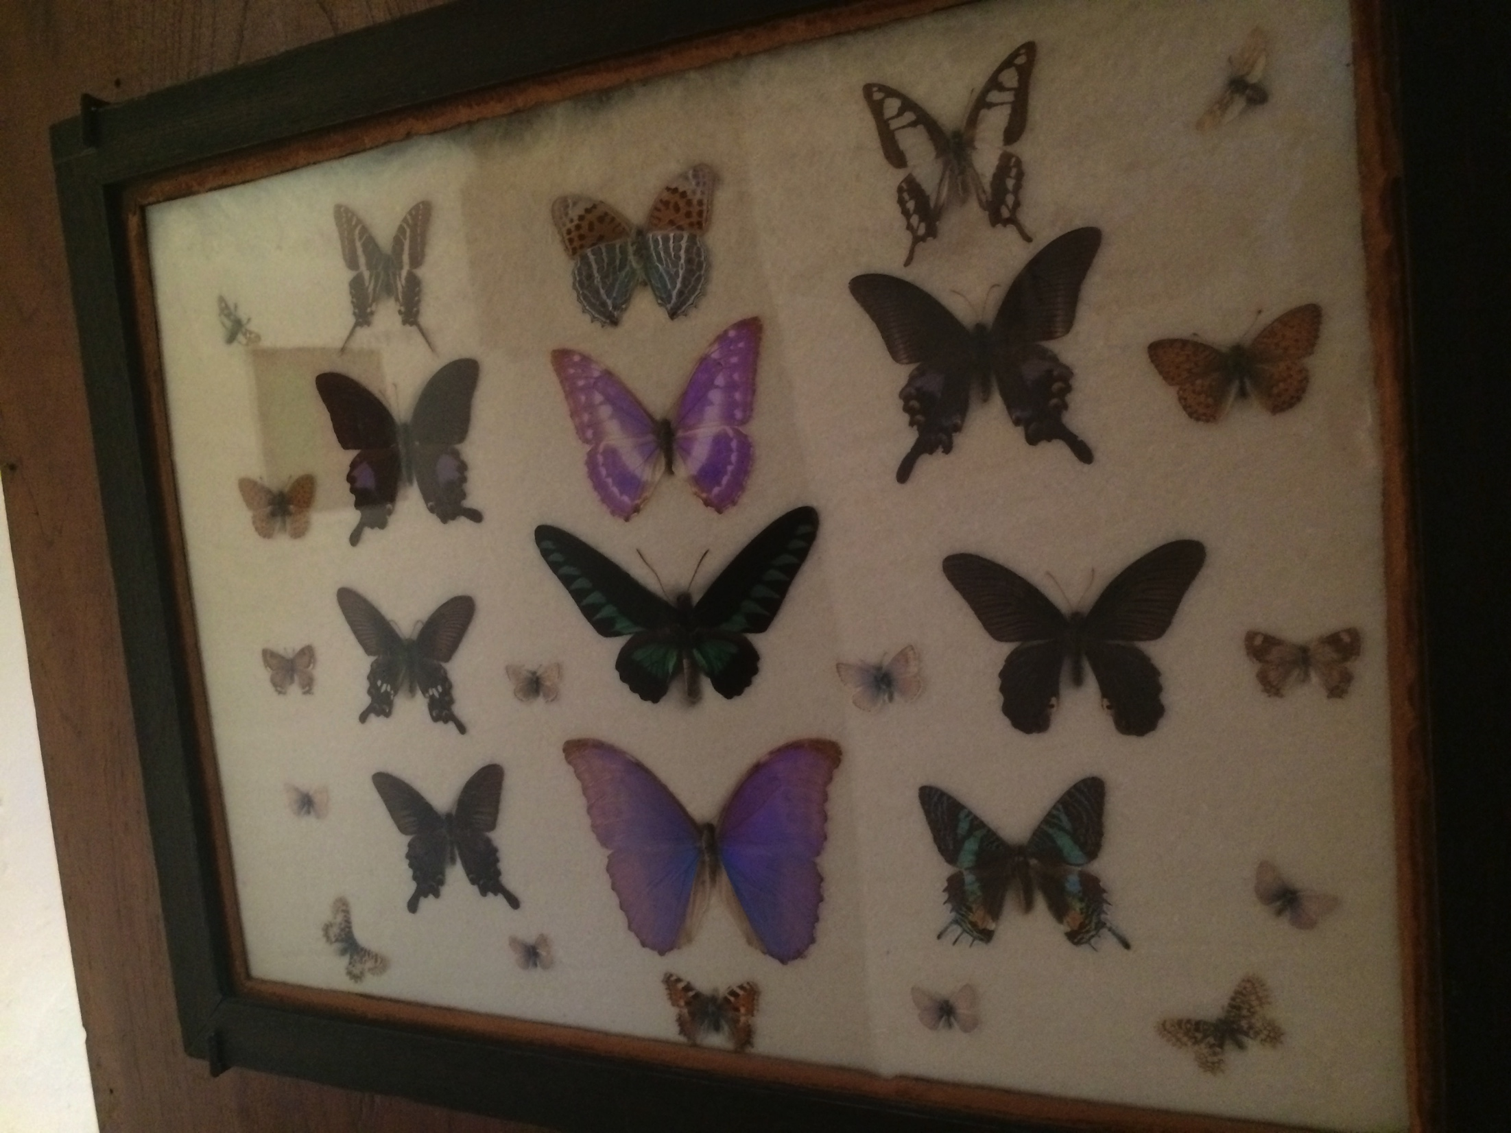

Slide 34




