Slide 1
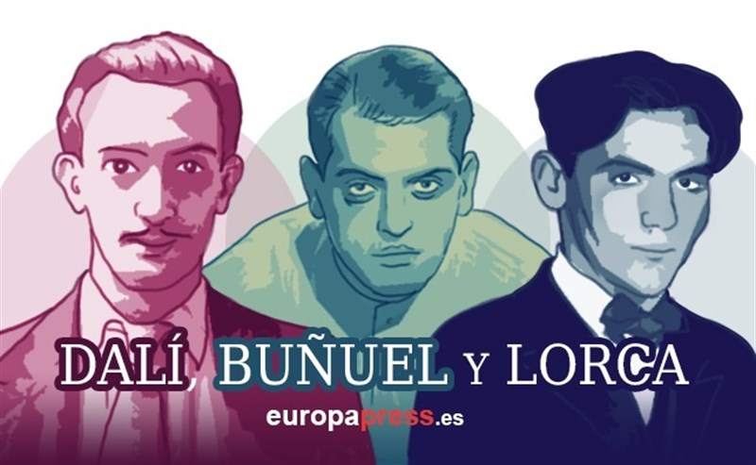
Lorca, Dalí, Buñuel
LO: Who were Lorca, Dalí and Buñuel?
Why? They were ‘muy amigitos’

Slide 2
Lorca, Buñuel and Dalí
Federico García Lorca: 5th June 1898 – 19th August 1936 assassinated by the Spanish Nationalist fascist regimen at the beginning of the Spanish Civil War (1936 - 1939) aged: 38 for being homosexual and a socialist, his body was never found. From Fuente Vaqueros, Granada, Andalucia, Poet, playwright and theatre director.
Luis Buñuel: 22nd February 1900 – 29th July 1983 died aged 83. Film director.
Salvador Dalí: 11th May 1904 - 23rd January 1989 died aged 84. From, Figueres, Catalonia, Spain. Surrealist artist.
Notes:
Spanish Civil War
1936 – 1939
Republicans were loyal to the democratic left leaning urban Second Spanish Republic , who were in an alliance of convenience with the Anarchists.
The above fought against the Nationalists, an aristocratic conservative group led by Franco. (supported by the Catholics and Monarchists)
The Spanish Civil War was often portrayed as a war between democracy and fascism, but it was more about a leftist revolution and a rightist counter-revolution.
Essentially the Nationalists won
Franco ruled Spain fro 36 years from April 1939 – November 1975 when he died
The Nationalists received ammunitions and soldiers from Nazi Germany and Fascist Italy under Mussolini in 1915 – 1943.
The Republican side received support from the Communist Soviet Union, and leftist Mexico
1937 aerial bombing of Guernica was ordered by Franco to Nazi Germany and Fascist Italy
Half a million people died in the Spanish Civil War
Franco ran the country under a military dictatorship and he claimed Spain was a totalitarian state
Forced labour, executions and concentration camps killed over 400,000 people
Franco did not help much during the WW2 they stayed neutral, but allowed Italy and Germany to use the ports and harbours
Spain was left isolated by the international community for 10 years after WW2
During the cold war Franco was anti-Communist so he was asked to join NATO and he was assisted by the west

Slide 3
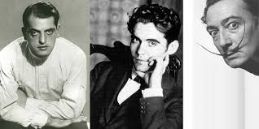
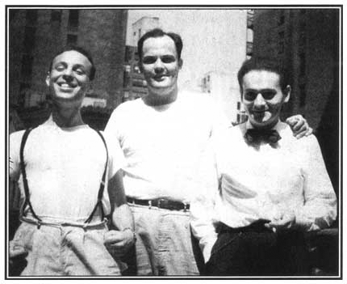
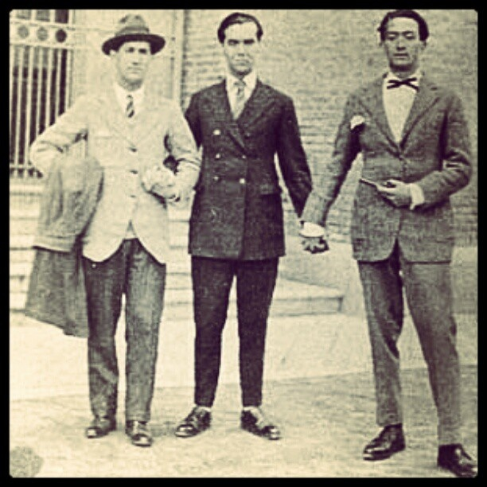
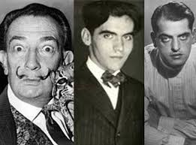
Residencia de Estudantes, Madrid
“La Generacion del 27”
Dali joined in 1922
Lorca joined in 1919
Buñuel joined in 1917
Notes:
Like oxbridge in spain

Slide 4
Salvador Dalí
Self proclaimed genius
Public displays of eccentricity drew attention to him
He loved oriental clothes and claimed his ancestors descended from Moors (Arab lineage)
Dalí and Lorca had a strong friendship and shared a passion for the arts. Lorca was deeply in love with Dali and they did have some kind of complex love affair between 1925-1928.
Dalí married Gala whom he was obsessed with and loved and who was his artistic muse.
Dali continued to praise the work of Lorca, even during the times his work was banned.
Politically Dalí liked to make political statements to shock people more than from conviction (believing them) which annoyed other artists who were more political.
Dalí met Franco and painted his granddaughter, he seemed to praise his fascist regimen, much to the criticism of other Spanish artists including his dead friend Lorca.
Dalí became increasingly more Catholic as he got older, even though he had abandoned it and it during his time at art school.
Dalí sought to make a lot of money from his art which went against the main surrealist movement, many groups expelled him and spoke of him in the past tense as if he were dead as well as were rude about him.
Notes:
Dali’s father showed him pictures of unreated sexually transmitted diseases so he was traumatised and much of this came out in his art.
He is said to have never had sex because of his fear of touching other people, but would watch Gala have sex with other people and they would throw large orgies at their house.
Dali was banned from visiting Gala in their last years and she rejected him, which broke his heart.

Slide 5
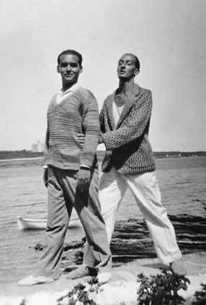
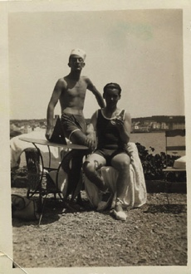
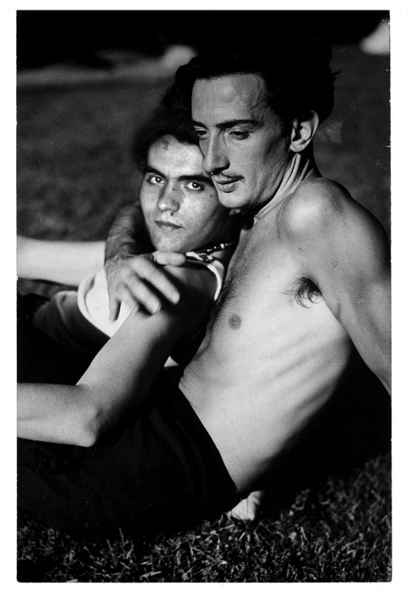
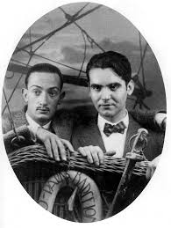
Salvador Dalí and Federico Garcia Lorca

Slide 6
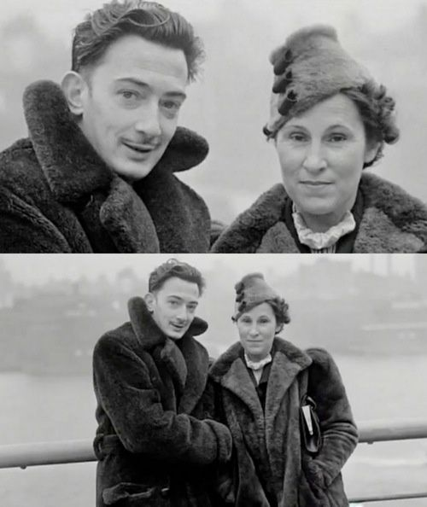
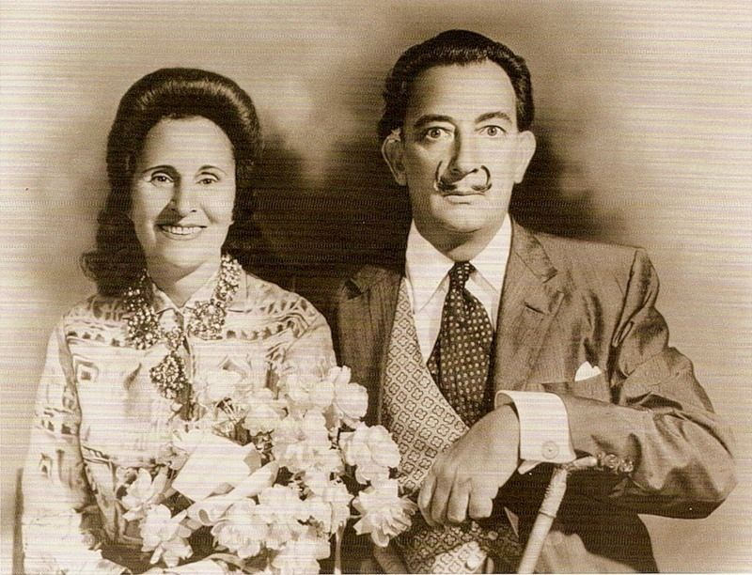
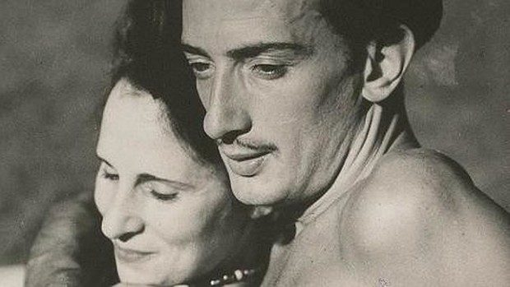
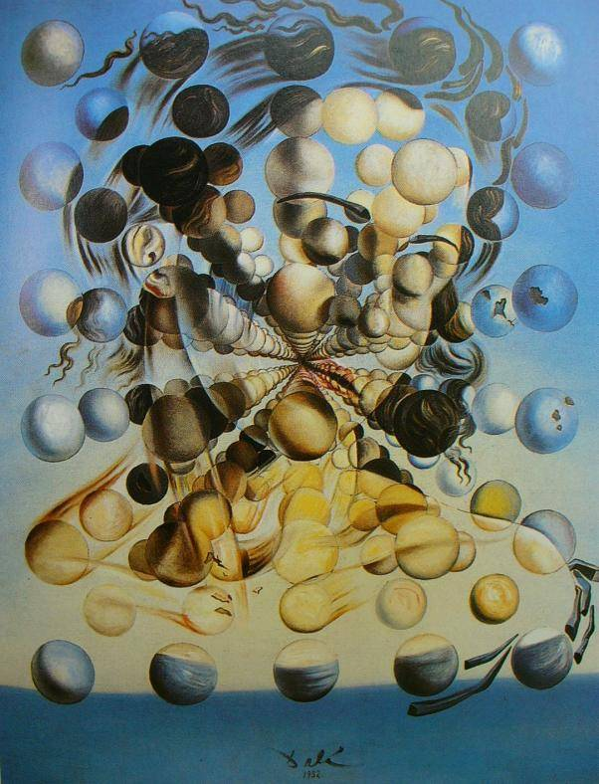
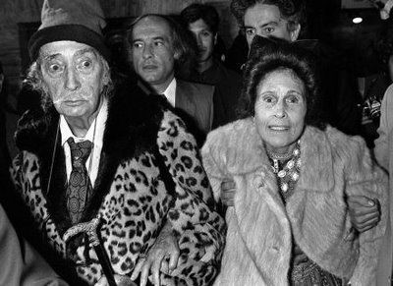
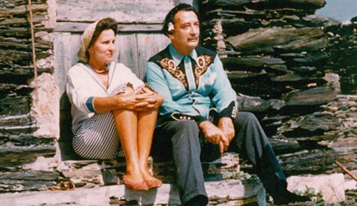
Salvador Dalí and Gala

Slide 7
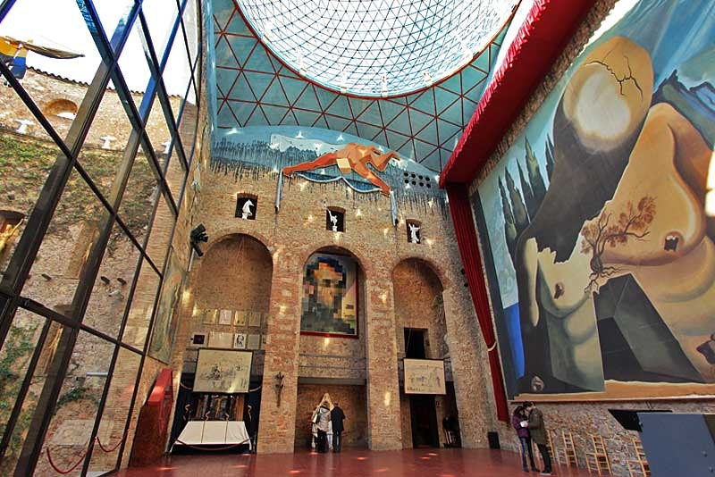
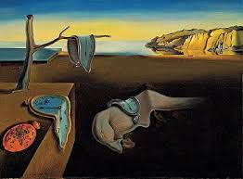
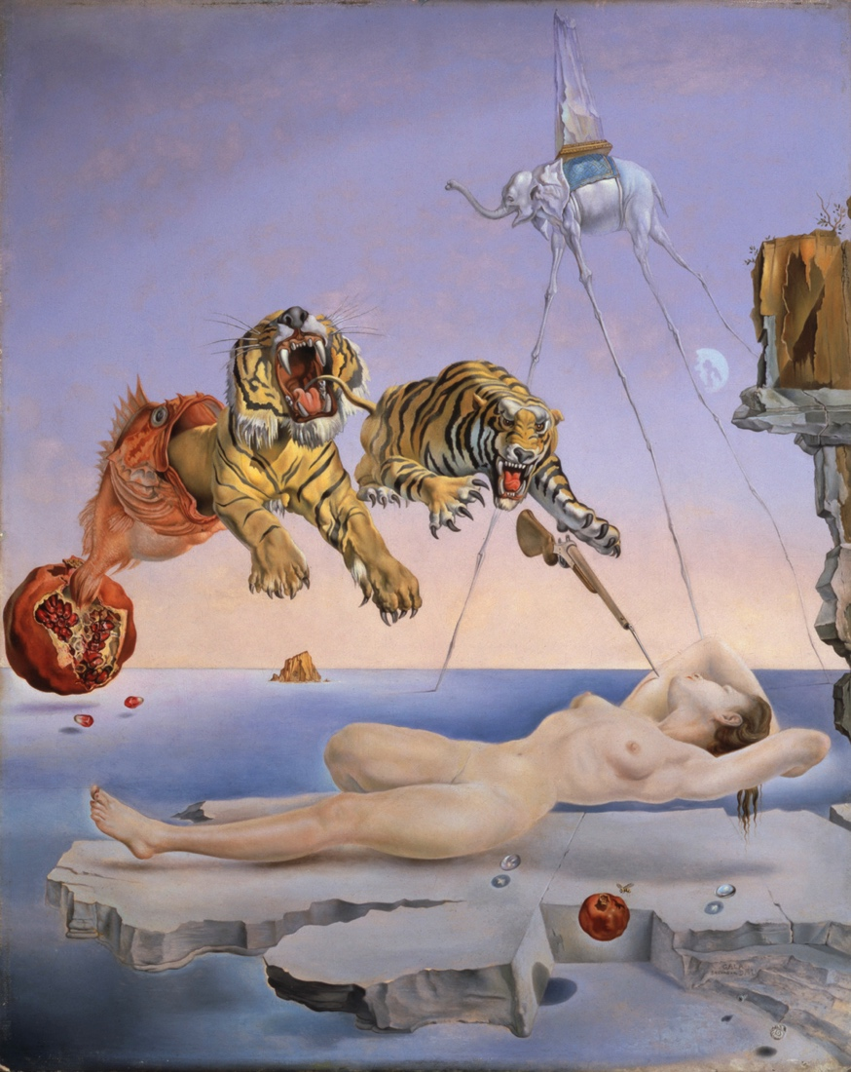
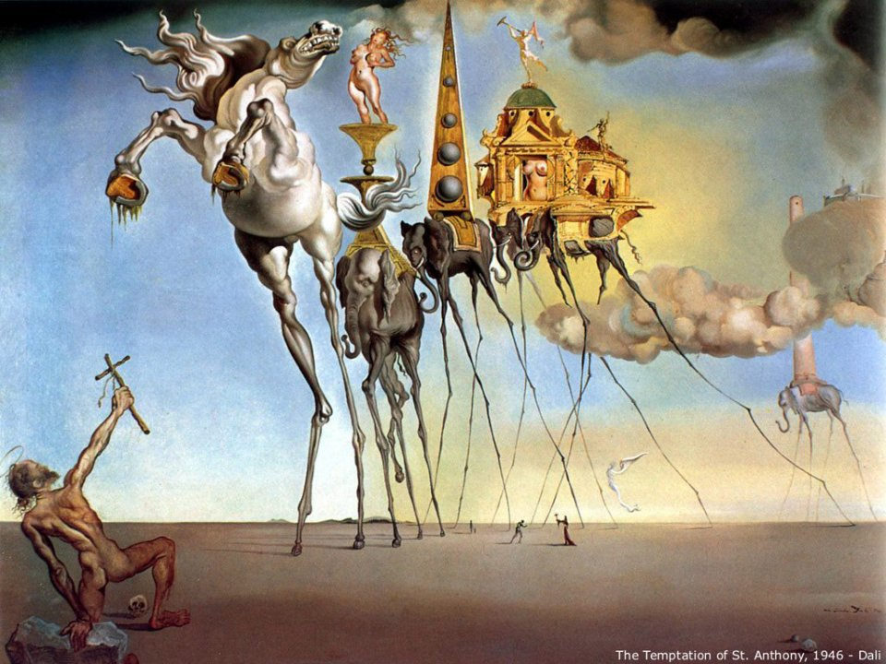
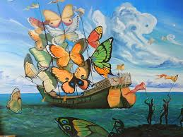

Slide 8
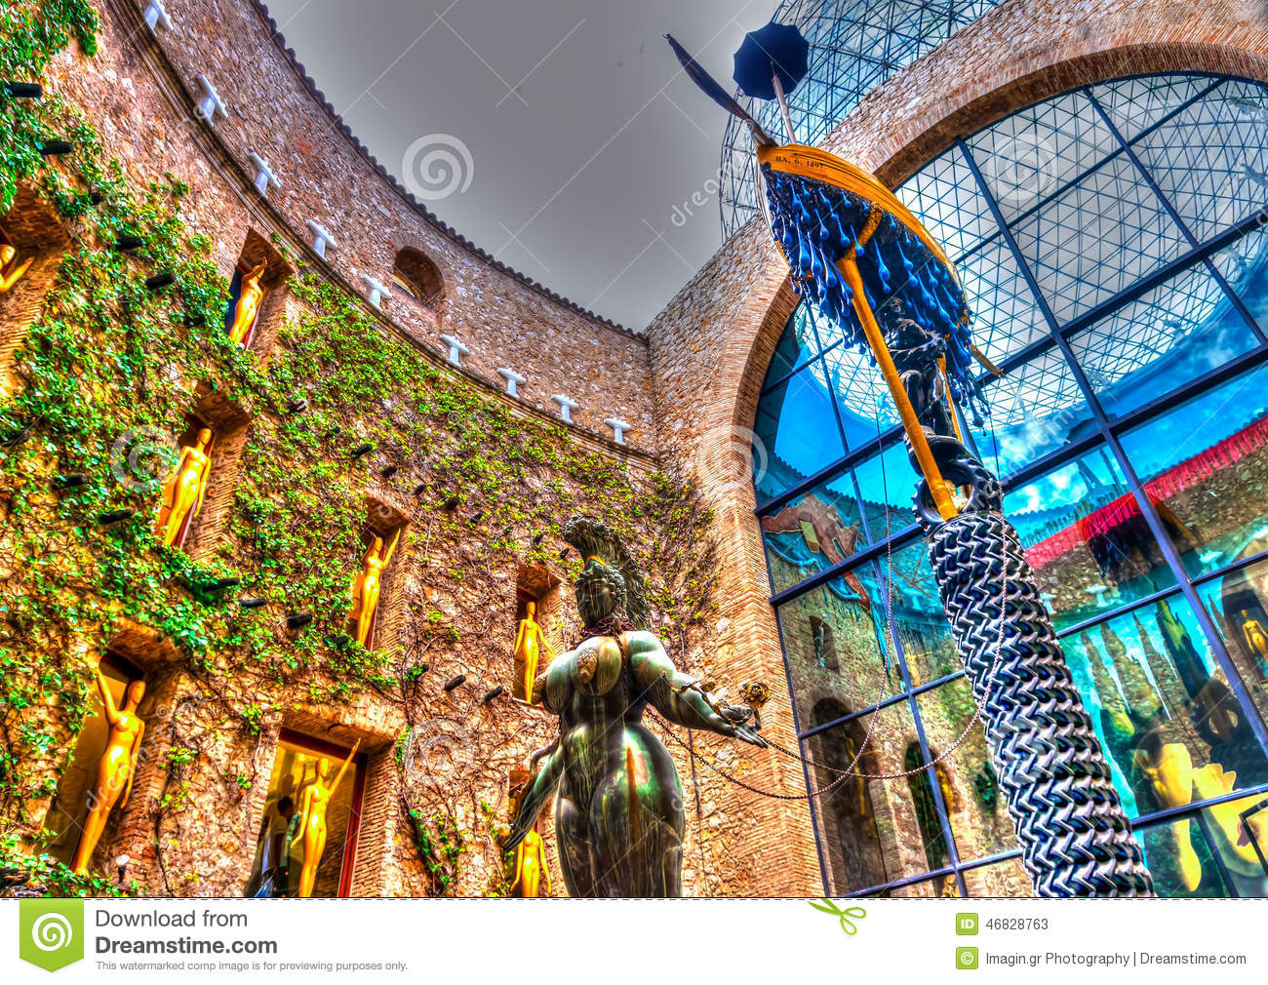
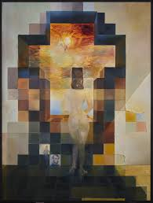
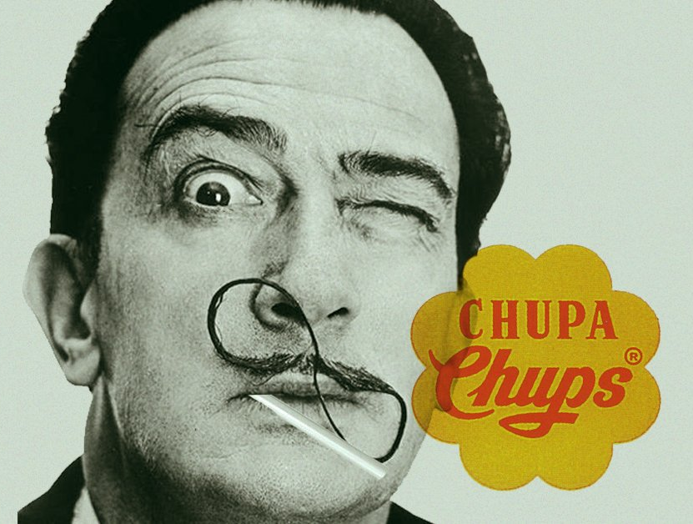
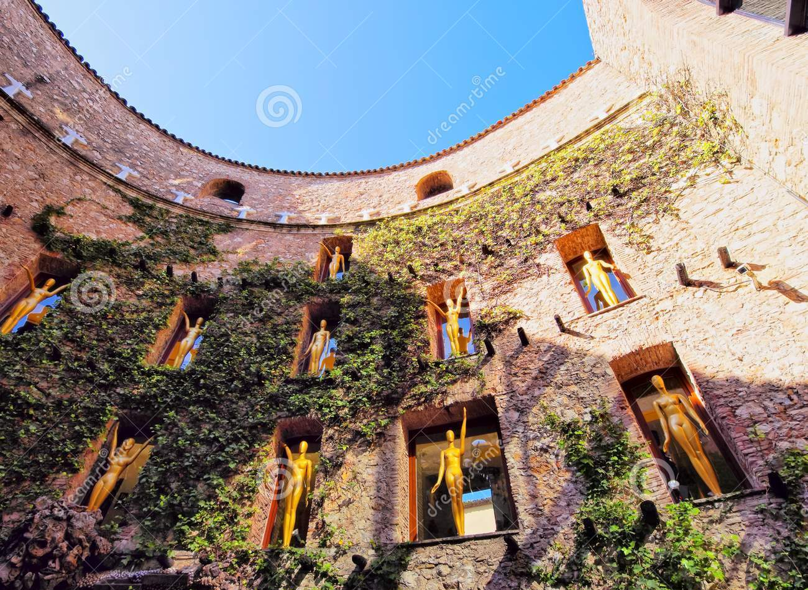
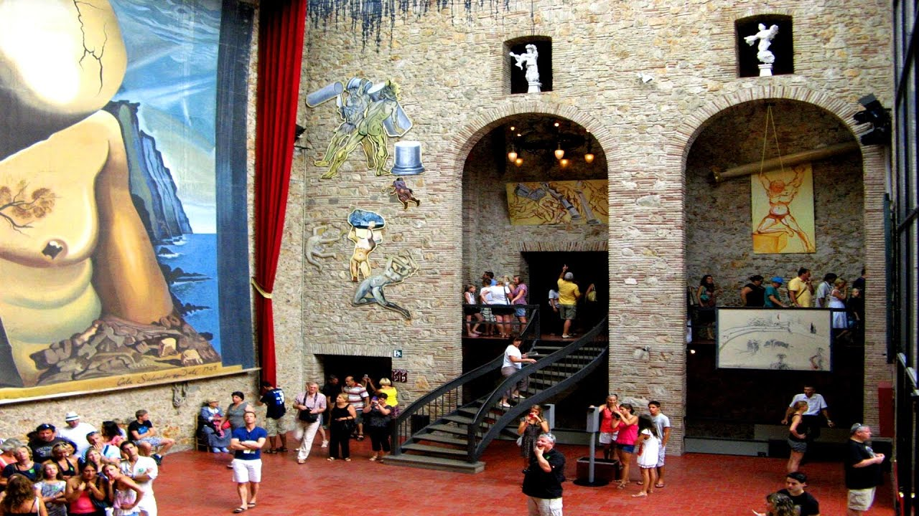
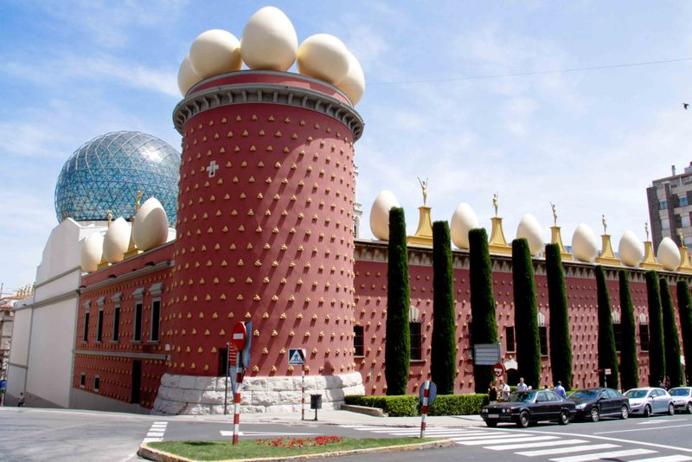

Slide 9
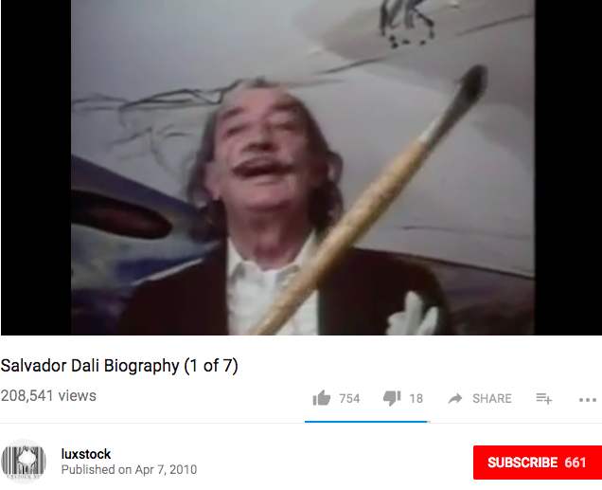

Slide 10
Federico Garcia Lorca
His father was a rich landowner with a farm in the valley surrounding Granada and a villa in the city centre. He made his money in the sugar industry. His mother was a teacher. All their old homes are museums today.
Lorca loved living in the countryside and Andalucia was his muse/inspiration.
Lorca started his artistic career in music then moved to Spanish folklore which was his muse for a long time after.
His first book of poems were published in 1921 including collections from 1918
In 1922 Lorca joined Manuel de Falla to promote a flamenco competition specialising in the traditional Cante Jondo which would raise flamenco into the public eye forever.
Lorca wrote Poems of Cante Jondo which means deep song.
Lorca was inspired by the lived experiences of gypsies and close to their communities, however people stereotyped him as a gypsy poet, which he wasn’t he was a well educated intellectual and wanted to be recognised as such.

Slide 11
Federico Garcia Lorca
Lorca struggled with depression due to the rejection by Dali and his being gay in a time that was illegal he had to put on a front all the time.
He travelled to New York and wrote about isolation, capitalism and materialistic modernity.
Experiencing impoverishment in rural Spain and New York, particularly the disenfranchised African American population, Lorca was an advocate of theatre of social action.
Lorca created a travelling theatre to take theatre to rural areas and lower classes who had never seen theatre before.
Lorca wrote a theatre trilogy which rebelled against the norms of bourgeois/ middle class Spain: 1. Blood Wedding, 2. Yerma and 3. The House of Bernarda Alba.
His work challenged the role of women in society and explored issues of class and homosexuality.
Lorca had strong socialist views which were not liked by the fascist government.
The Spanish government have spent over 70,000 Euros trying to find his body by digging up sites around where he was reportedly killed, but still have no evidence of his body.

Slide 12
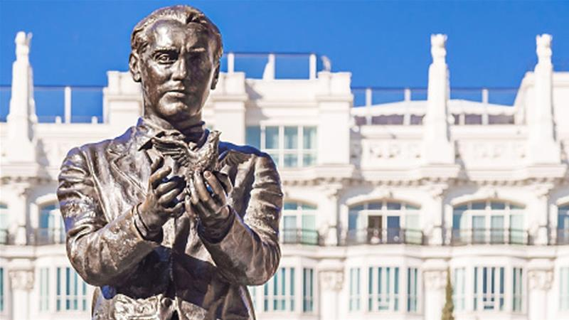
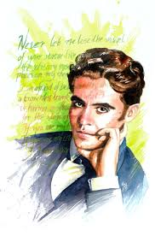
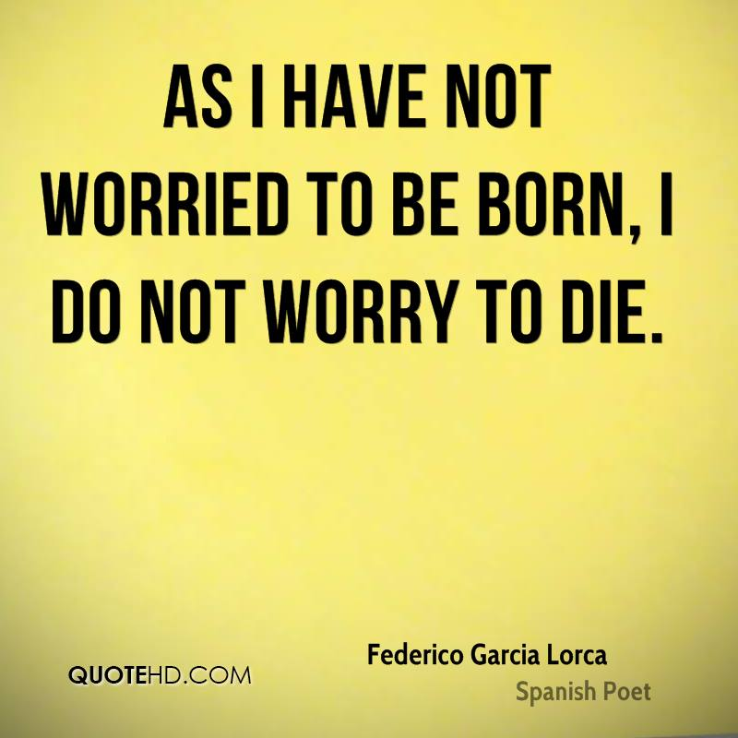
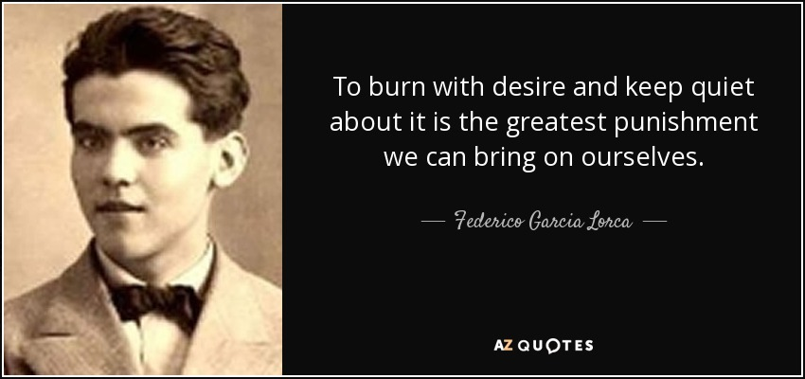

Slide 13
Luis Buñuel
Born in: Calanda, Teruel, Aragon, Spain to wealthy well connected parents, he had 6 brothers and sisters. Later moved to Zaragoza.
Worked in Mexico, Spain and France.
Like most Spanish children, grew up with the Catholic church, but became annoyed with the institution's power and wealth.
He was important in the Spanish surrealist movement.
He was very dedicated to politics in the period of the Spanish civil war and joined the Communist Party of Spain, but later in life denied being a communist.
Buñuel was very close friends with Lorca, although they were completely different types of people.
Buñuel had a harder relationship with Dalí because he was jealous of the intimate relationship Dalí and Lorca had as well as his rapid success as an artist.
Dali and Buñuel made their first film together called “Un Chien Andalou” meaning, an Andalucian Dog, it was as silent film and went down very well and is still shown today.
Buñuel married Jeanne Rucar and had 2 children, one of his grandson’s is today a film maker too on National Geographic series “Don’’t tell my mother…”
Bunuel worked for the Republican government making propaganda films and spying.

Slide 14
Luis Buñuel
Bunuel mourned the death of his friend Lorca but never mentioned him again, unlike Dali who reportedly spoke about him more than Gala.
After the Spanish Civil War because the Nationalists won, Bunuel stayed living in the USA working in Hollywood, but struggling to do so.
Bunuel worked for Warner Brothers.
His career in USA became difficult once Dali released a biography which said he was not friends with Bunuel anymore because Bunuel was a Communist, which made problems for him and he confronted Dali about it, who said he didn’t do it to draw attention to Bunuel but to himself.
Bunuel moved to Mexico after these issues, he had a lot of success in Mexico.
After Mexico he returned to international films and won many awards and has been remembered by many film festivals and had cinemas and schools named after him.

Slide 15
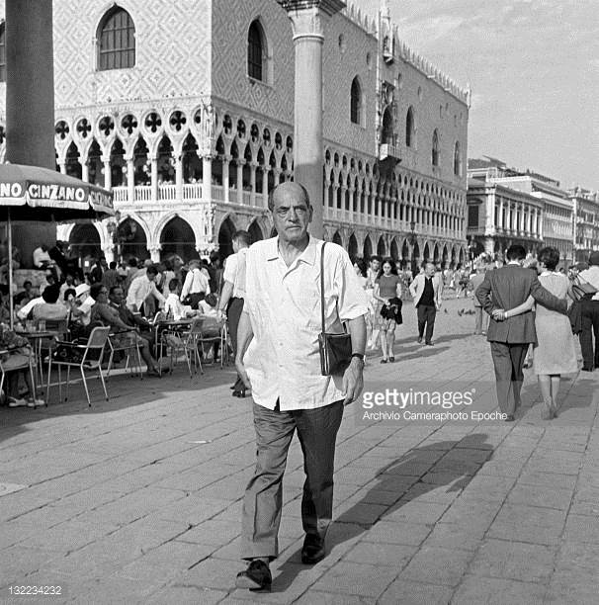
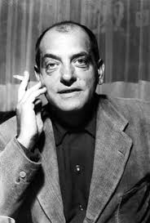
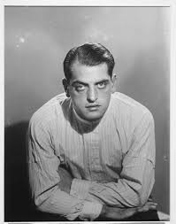
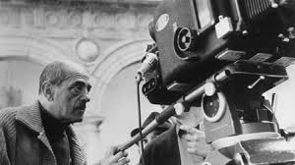
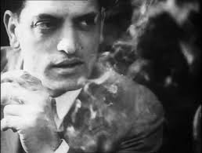

Slide 16
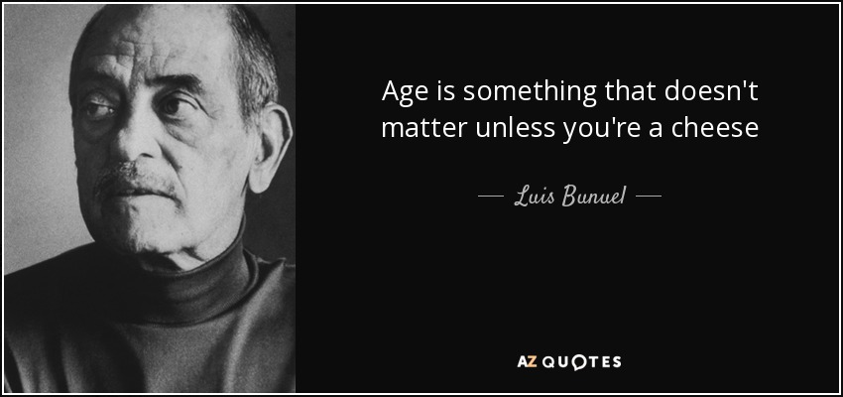

Slide 17
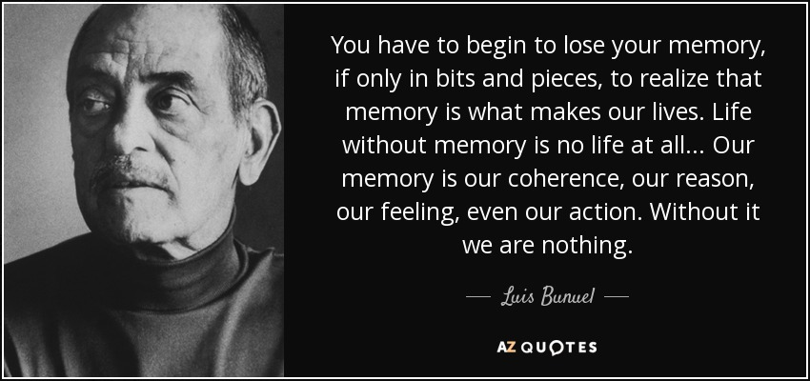

Slide 18
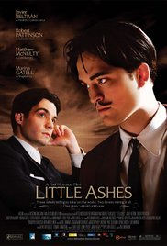
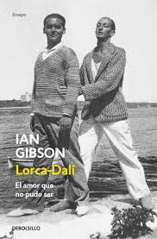
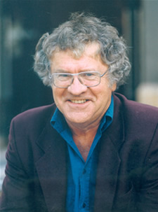
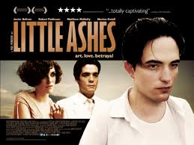
Little Ashes (2008) rated 15
Little Ashes is a film about Lorca, Dali and Bunuel.
It is ok, but has English people playing Spanish people, which is not ideal.
It is a good summary to begin with but books by Ian Gibson are more detailed.
The best research being done about the three Spaniards is by Gibson.

