Slide 1
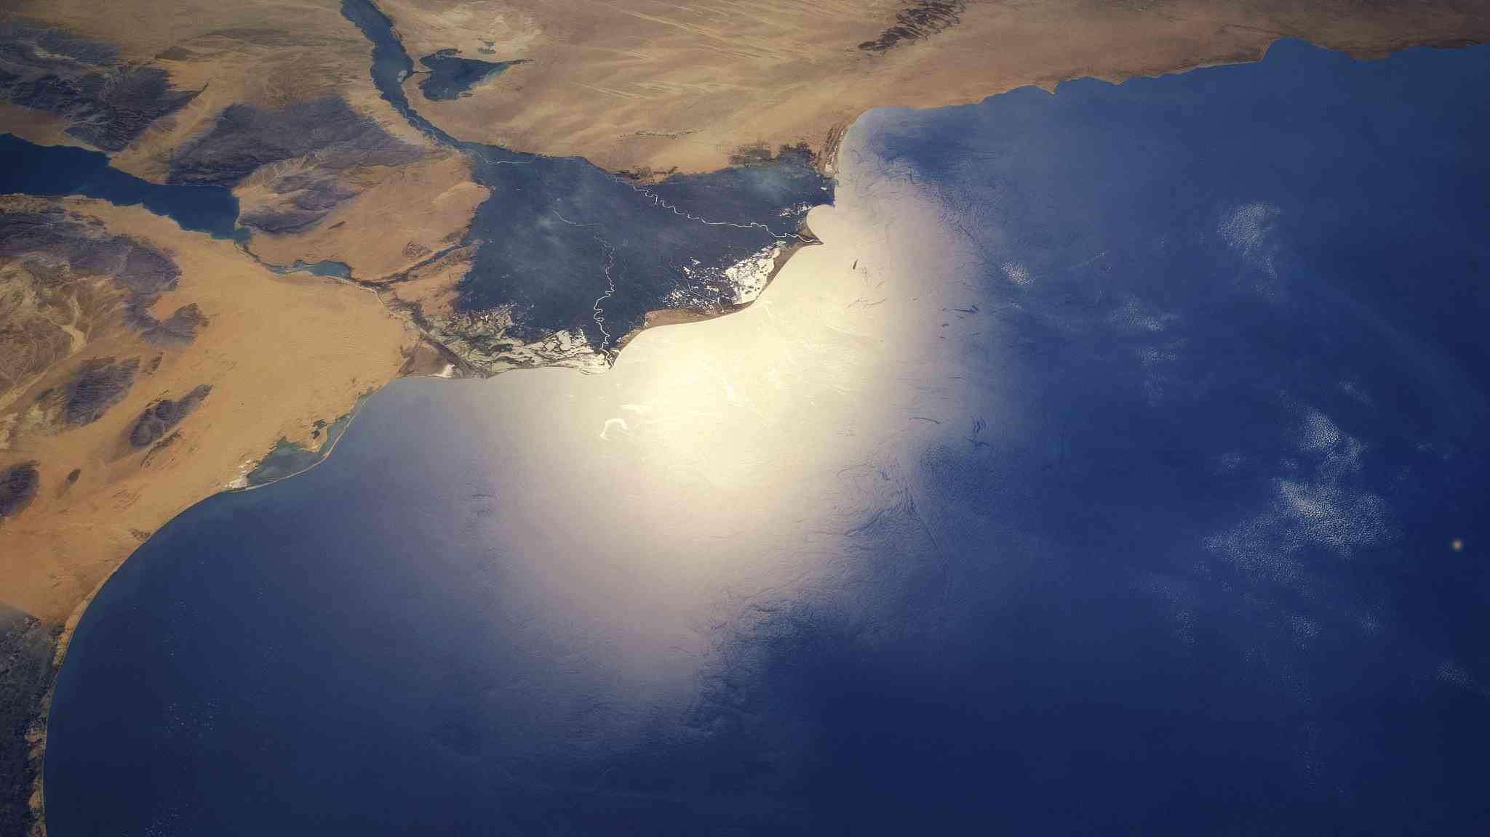
Nile Delta Low Energy
E.Q: What is happening at the Nile Delta?
L.O: Explain how the low energy coastline shapes the landscape at Nile.

Slide 2
A Level OCR Coastal Landscapes
1. Coasts as a Natural System
2. Coastal Influencers
3. Coastal Sediment
4. Landforms
5. Yorkshire High Energy
6. Nile Delta, Low Energy
7. Emergent Landscapes
8. Submergent Landscapes
9. Management in Dorset
10. Humans and the coast in NZ
11. Skills Focus

Slide 3
Nile Delta Low Energy
Connect The Learning
Map it
Demo
Traffic Lights
Input
A3 sheet
Activity
Video

Slide 4
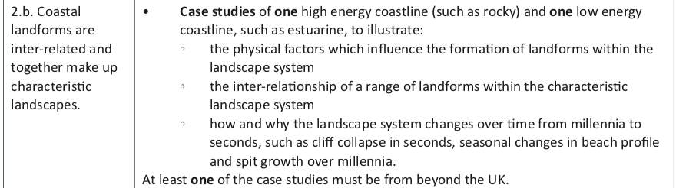
To get top marks the aspect of time and space have to be considered and mentioned – so from seconds to millennia and located so it might be different in Alexandria or Port Said etc.
Can you draw a diagram of the Nile Delta to annotate and add to an exam answer?

Slide 5
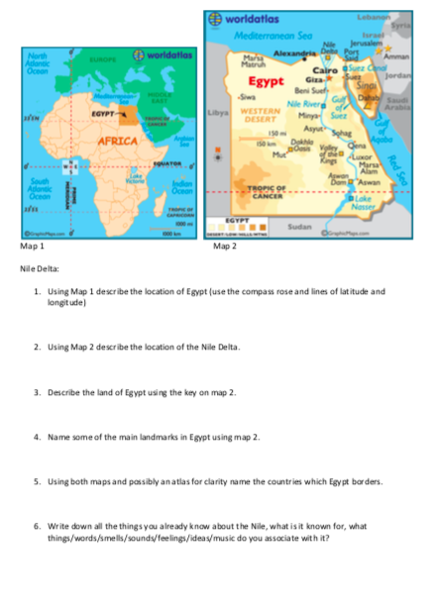
`
Task Instructions:
Complete map worksheet.
Map it
Videos
Video
Traffic Lights
Map it

Slide 6
Deltas are: large areas of sediment found at the mouth of many rivers. The sediment is deposited by rivers and tidal currents. Deltas form where this happens faster than waves and tides can remove it. Tidal range is low at the Mediterranean, contributing to this.
Deltas are divided into 3 zones:
  Upper delta plain (inland beyond reach of tides, made from river deposits)
  Lower delta plain (inter-tidal zone submerged regularly by tide, made of marine and river deposits)
  Submerged delta plain (below mean low water mark, mostly made of marine sediments and grows outward into the sea)
The Nile Delta is an arcuate delta, this means: there is (or was) sufficient sediment supply available for the delta to grow seawards, but wave action is strong enough to smooth and trim its leading edge.
Deltas have criss-crossing distributaries where further deposition occurs.
Levées (mounds of sediment) line their banks, but in times of flood the natural embankments are breached and the water and deposition occurs on crevasse splays.

Slide 7
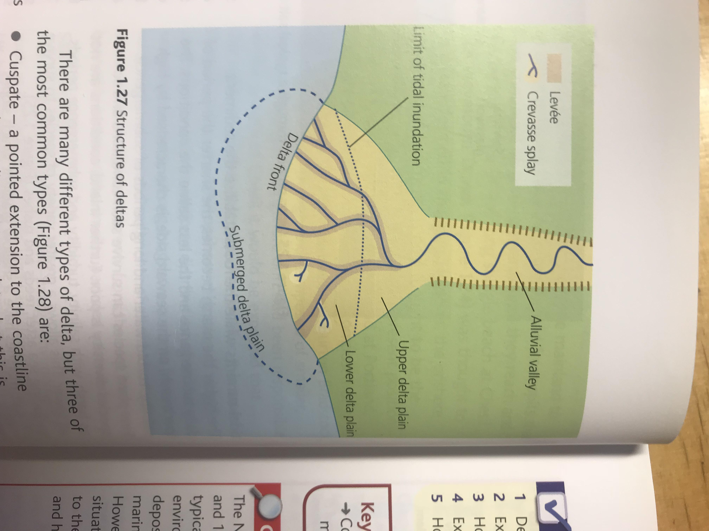

Slide 8
The Sweet Nile Delta:
Using sweets create the river delta features on A3 paper and annotate then take picture:
Shoe laces: river channel and delta distributaries
Yellow/brown sweets/chocolate: Levées, barrier bars, spits
Green sweets: surrounding fertile soils
Shoe laces make arrows for Prevailing winds and swell (page 24)
Dairy milk blocks: Aswan Dam (built in 1964) & Cairo.
Blue sweets: lagoons
White chocolate: Dune accumulation
Make sediment behind the Aswan dam (120 million tonnes/year did flow past it, now only trace amounts of sediment are flowing from there)
If the above is true, how many metres do you think the coast is retreating/year?
Notes:
Coastal retreat is now 148m/year.

Slide 9
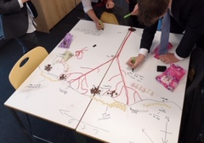
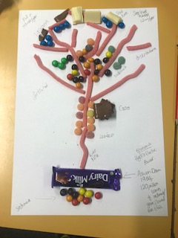
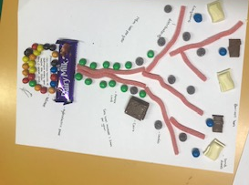
Does your delta look like this?

Slide 10
The Nile Delta displays many features typical of low energy coastal environment, with rates of fluvial deposition having exceeded rates of marine erosion for over 3000 years.
However, more recently the situation has started to change due to the influence of both physical and human factors.
One of the largest river deltas covering 240km of the Mediterranean coast.
The Delta is 160km in length.
It is a marine arcuate delta (shape)
Rich agricultural region, fertile flood plain compared to dry desert in the rest of Egypt.
Many people in Egypt live along the river Nile, and most live in the Nile delta region.

Slide 11
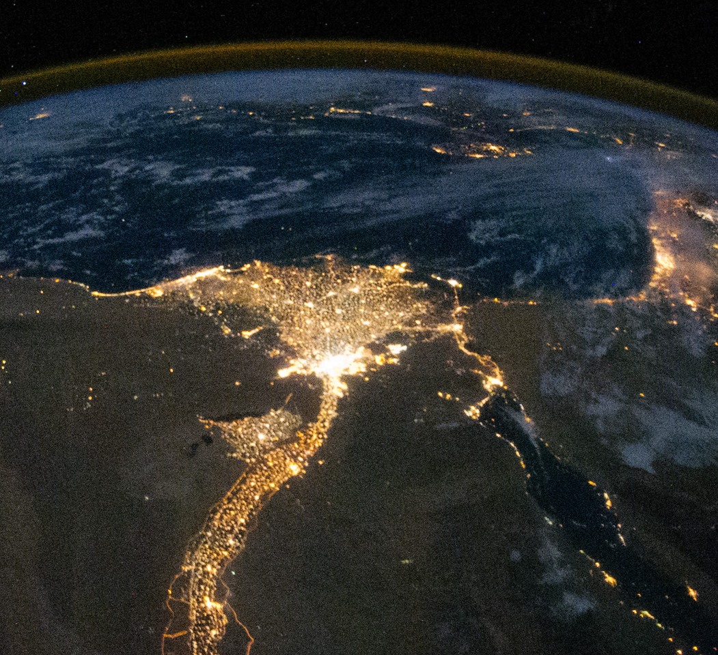
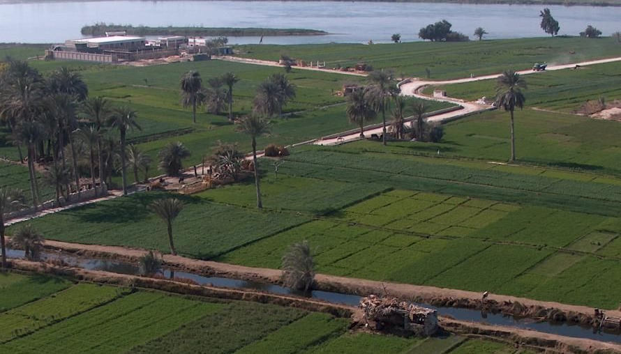
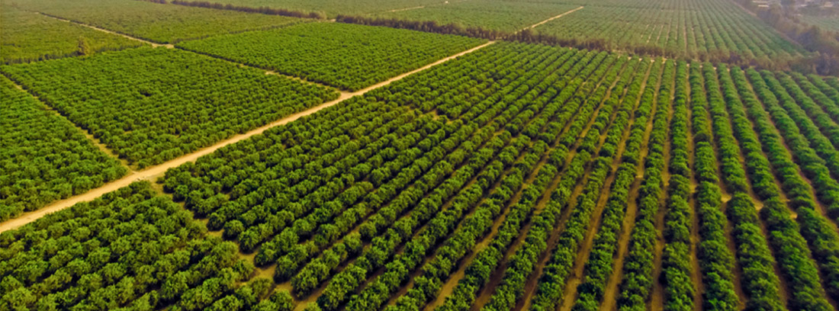

Slide 12
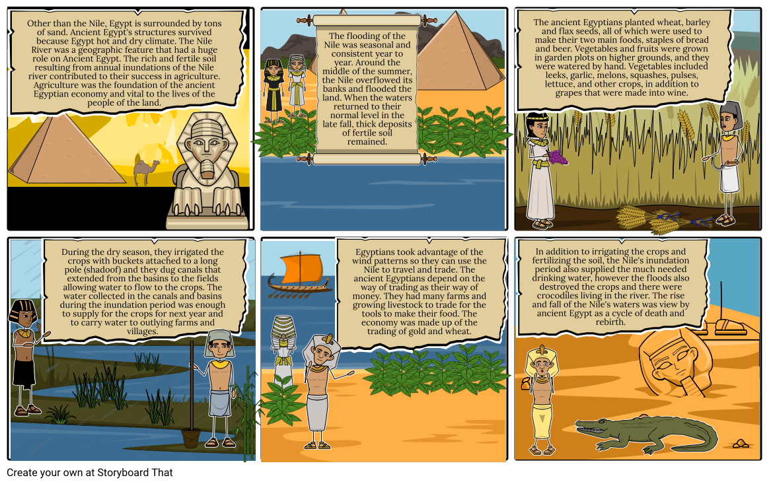

Slide 13
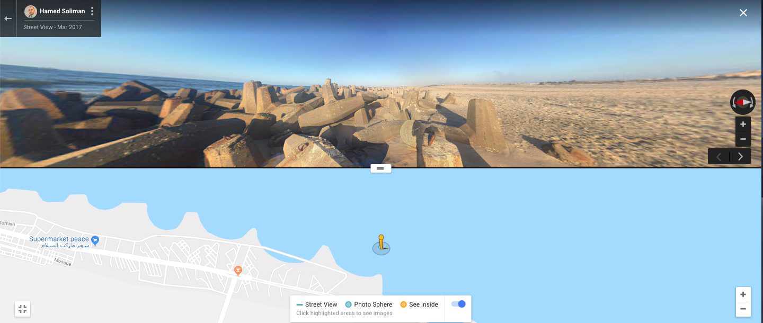
Lets browse the areas available on google maps or even ArcGIS layers… what layers would you add?

Slide 14
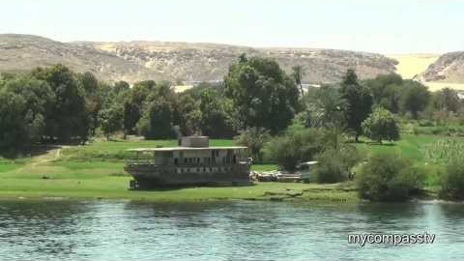

Slide 15
`
Task Instructions:
Explore the Nile Delta and complete the A3 sheet using the text book and any additional online sources.
Word Association
Videos
Video
Traffic Lights
A3 sheet

Slide 16
The River Nile

Slide 17
The Nile is, with a length of 6650 km, one of the longest rivers in the world.
Its catchment area is huge, at more than 3000 m³/s, among the lowest of the world’s great rivers.
A large proportion of the Nile flow originates in Ethiopia and is summer monsoon rains. The rest comes from central Africa, as far away as Rwanda.
Despite the relatively low discharge [volume of water flowing through the banks], the river carries a huge sediment load.
The sediment load distribution is
  30% clay (0.002mm)
  40% silt (0.002mm– 0.02mm)
  30% fine sand (0.02 – 0.2mm)
The annual average sediment yield is 4.26 t/ha/year and the total is 91.3 million tonnes for the whole Blue Nile Basin in Ethiopia.

Slide 18
The Nile Delta

Slide 19
The coastal plain occupies the northern part of the Nile Delta and runs parallel to the Mediterranean coastline.
In places, three distinct subunits of the coastal plain may be recognised:
  the foreshore plain
  the frontal plain
  the sandy zone.
The foreshore plain is characterised by elongated rides, running almost parallel to the present shoreline, alternating with lagoons, salt marshes and alluvial deposits in the depressions between them.
The frontal plain is located south of the foreshore plain, and has scattered eroded limestone outcrops and clay deposits.
The sandy zone is composed of a variety of different sand formations, such as sheets, dunes and hummocks.
The delta begins to split into distributaries at Cairo more than 160km inland, which fan out over the entire area of the delta.

Slide 20
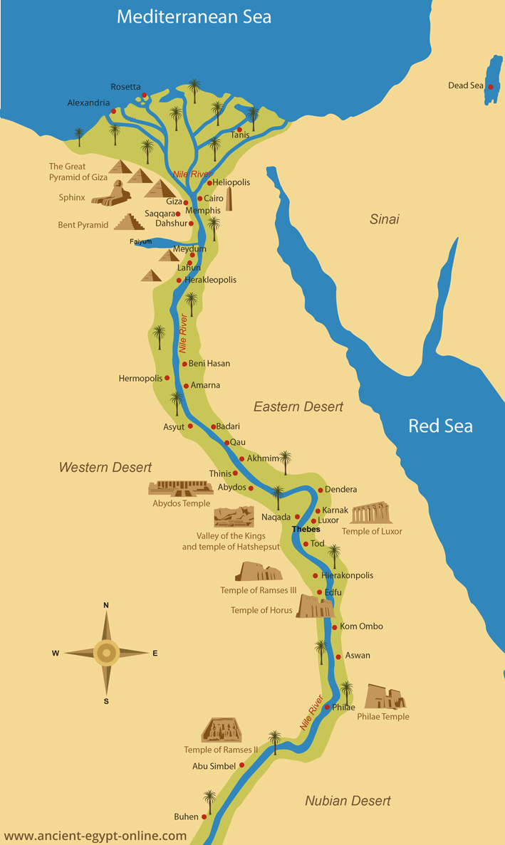
Before the construction of the Aswan High Dam in 1964, the Nile’s annual flood briefly covered much of the delta each year and deposited a thick layer of silty mud.
The depth of these alluvial deposits is 4m at Aswan, 9.6m in the Cairo region and even greater in the Delta itself.
Two of the large distributaries have built major lobes extending beyond the general front of the delta.
Wave action in the Mediterranean redistributes the sediment forms a series of curved barrier bars, which close off segments of the Mediterranean Sea to form lagoons.
The lagoons in turn form a sub-environment, and soon become filled with fine sediment.

Slide 21
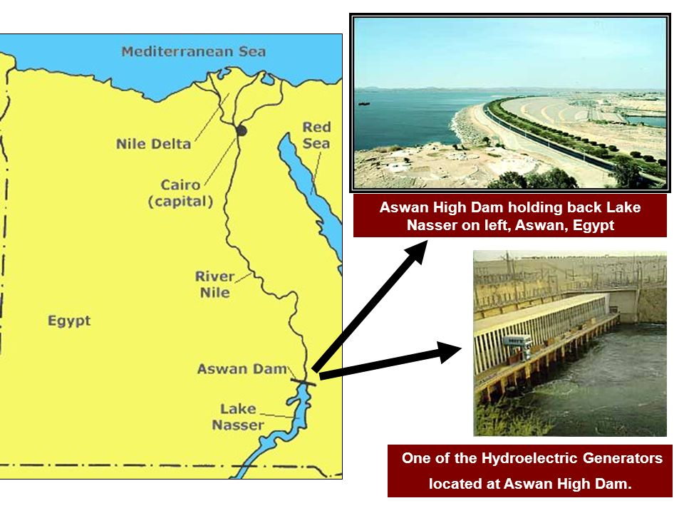

Slide 22
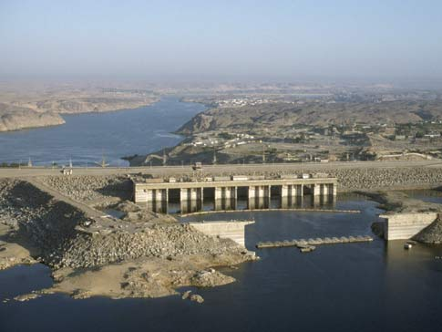
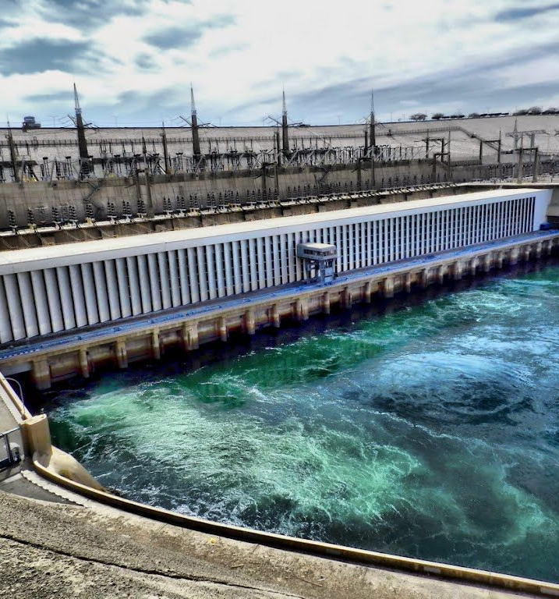

Slide 23
Coastal Landforms

Slide 24
The prevalence of northwesterly winds over the Mediterranean Sea for most of the year enhances the constant eastward movement of water and sediment. The estimated surface current velocity ranges from 9.26 to 13.5 cm/s during the summer, declines to 4.46cm/s during the autumn, increasing sharply to 23.14cm/s in winter due to strong winds, and declining again during calm spring weather to 8.4cm/s.
The prevailing northwesterly winds lead to waves coming from the west, northwest and north for 55-60% of the time and from the northeast for only 8% of the time.
The resultant nearshore features along the Nile Delta coast include underwater sand bars, typical of tideless seas.
Aerial photographic analysis and field observations show that many beaches west of Abu Qir headland contain long crescentic bar systems.
In contrast, parallel longshore bars exist along the delta extending from east of Abu Qir to Port Said.
The parallel bar systems along the Nile Delta are generated by the dominant eastward longshore drift of sediment. The crescentic bars west of Abu Qir headland at Alexandria are associated with rip currents and negligible longshore drift.

Slide 25
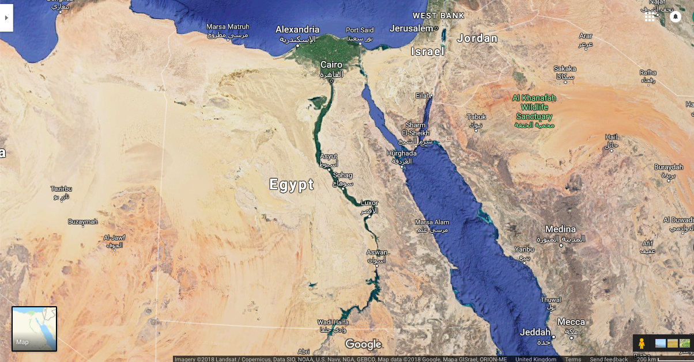
Nile Delta and Cairo city.
Aswan Dam

Slide 26
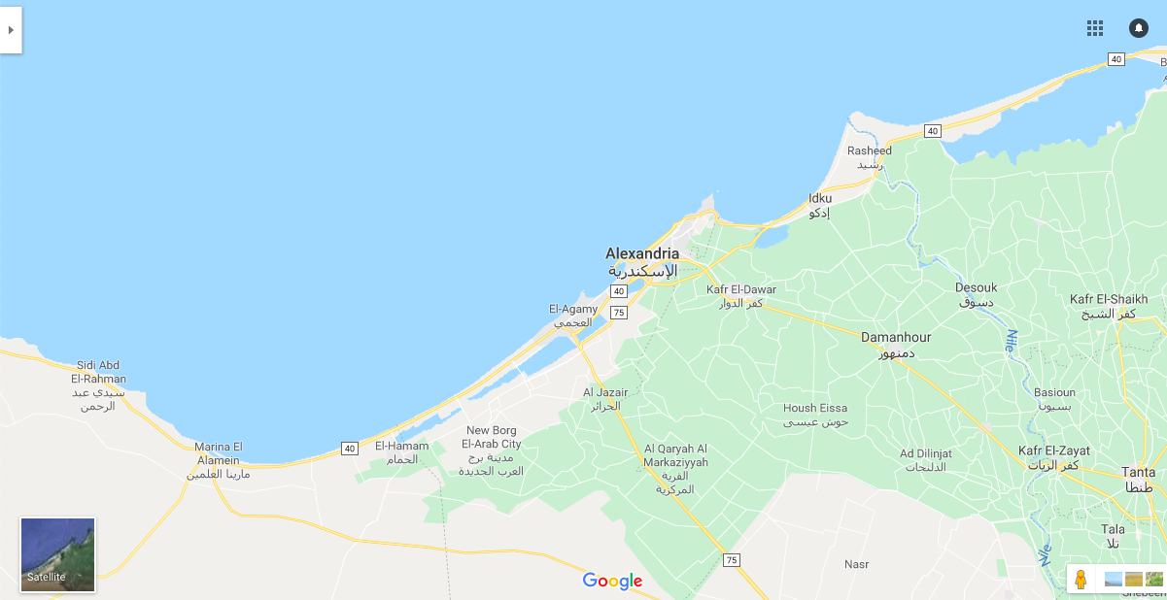
What landforms can you see?

Slide 27
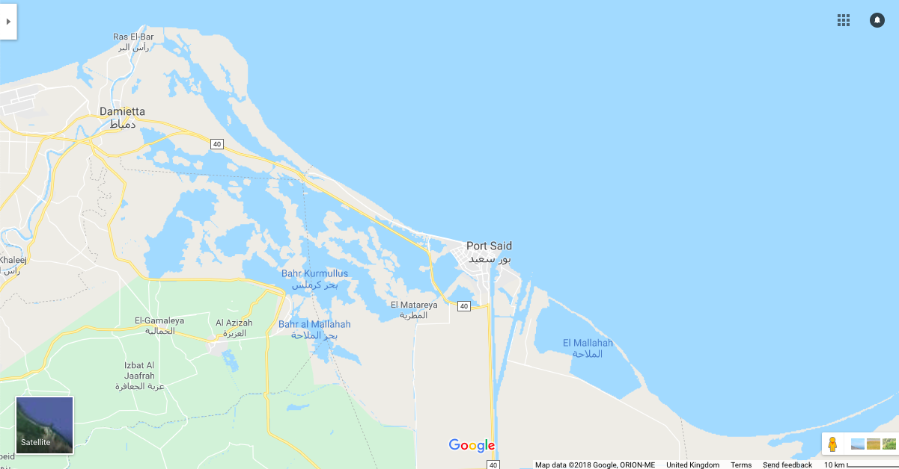
What landforms can you see?

Slide 28
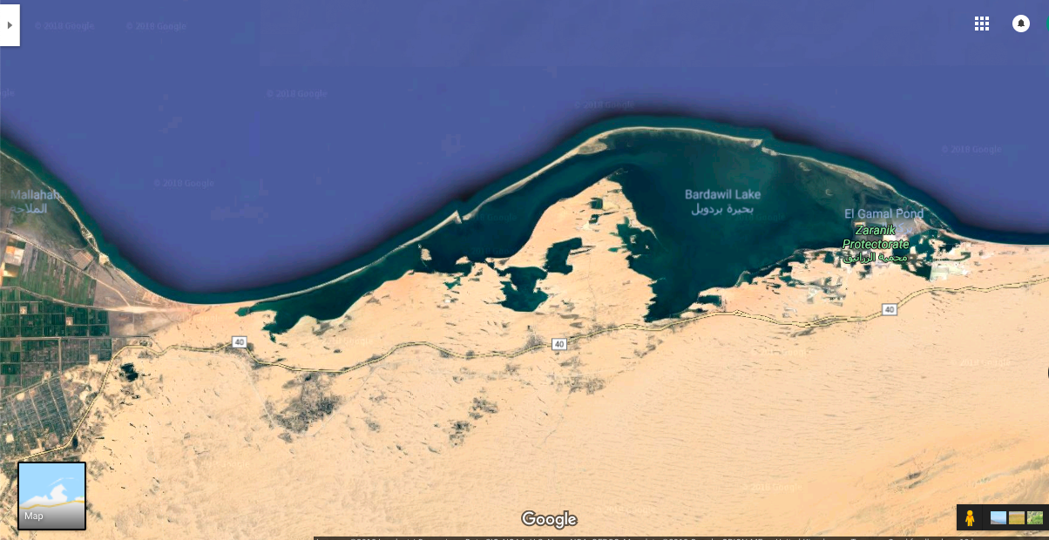
What landforms can you see?

Slide 29
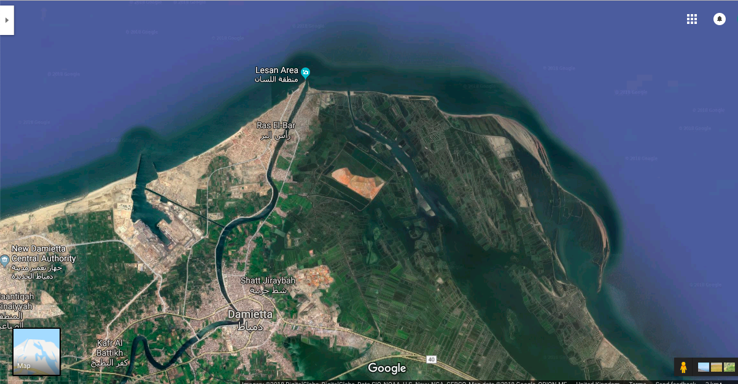
What landforms can you see?

Slide 30
Changes to the sediment budget

Slide 31
Although this delta coastline is, in general, a low-energy environment, since the building of the Aswan High Dam and imbalance has been created between two of the major forces affecting the delta: erosion and accretion.
There has been a rapid reduction in the amount of sediment accreted from 120 million tonnes/year to only trace amounts today!!!
This has caused significant changes along the shoreline of the northwest Nile Delta with accelerated erosion and rates of coastal retreat as high as 148m/year.
Rising sea levels in the Mediterranean of 1.2mm/year have also contributed to higher erosion rates as deeper water produces larger waves with higher amounts of energy and these reach further inland.

Slide 32
`
Task instructions:
Complete questions page 24 in Activities box.
Word Association
Videos
Video
Traffic Lights
Questions

Slide 33
`
Task Instructions:
Write a news paper headline about the Nile Delta to sum up todays lesson.
Word Association
Videos
Video
Traffic Lights
Headlines

Slide 34
